Slide 1
H10 Hot Dessert
H9 √ Stir Fried Shrimp with Seasonal Vegetables, (v) Coriander Roast Potato
H8 Pilaf Rice with Confetti Peppers, Fennel Gratin with Parmesan Cheese Melted Butter
H7 Rice & Beans with Mushrooms, Crab Quiche and Sauce
H6 Pork Tenderloin with Mushroom Sauce . (v) Mashed Potato with gravy
H5 Hunter-Style Rock Cornish Game Hen , (v) Cauliflower Florets Polonaise
H4 Beef Tournedos Madeira, (v) Croquette Potatoes
H3 Seafood Newburg and Garlic Croutons, (v) Sautéed Mixed Vegetables
H2 Pan-Fried Barramundi with Grain Mustard Sauce (v) Baby Carrots with Chopped Tarragon
H1 √ Bow Tie Pasta Veal Strips, Morel Mushroom, Green Peas Cream Sauce , Penne Scarpara ( Action Station ) Sliced Garlic, Tomato, Basil
Coated Roast Beef with Mushroom Gravy and Béarnaise Sauce
C6
Pate Armagnac with Apricot Preserves
C3
DRESSINGS
C5
DESSERT 5 ASSORTED PASTRY
C4
SALAD BAR
H11
Coconut Curry Pumpkin SoupFortified French Onion Soup and Croutons
C0
Assorted Cheese Plates
C8
ASSORTED BREAD ,
C1
Sea Food Salad, Hawaiian Chicken Salad, Capers Salad, Eggplant Caponata
C7
SLICE FRUIT and Fresh Fruits
C2
Three types of Cold cuts depends on Available
exit
entrance
C0:_ 2nd Commis
C1 – C4:___2nd Commis
C5 – C8:__ 1st Commis
H1 – H5:___2nd Commis
H11:____2nd Commis
CARVING:_ 2nd Commis
H6 – H10:__2nd Commis
HOT FILLER:__DCDP
COLD FILLER:___1st Commis
GAZEBO:__DCDP
INSIDE RUNNER:_2nd Commis
STARBOARD SIDE DINNER Welcome Day 01

Slide 2
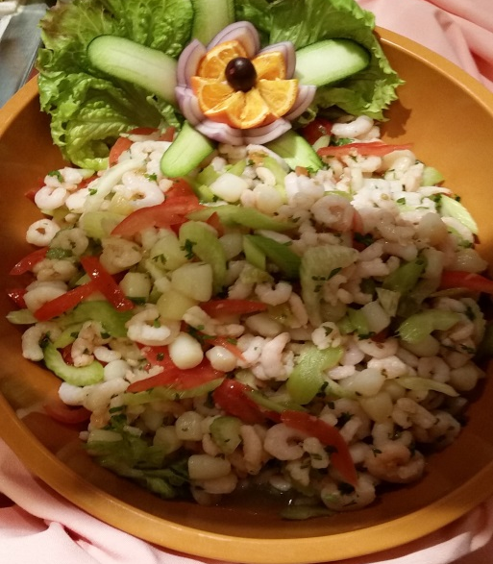
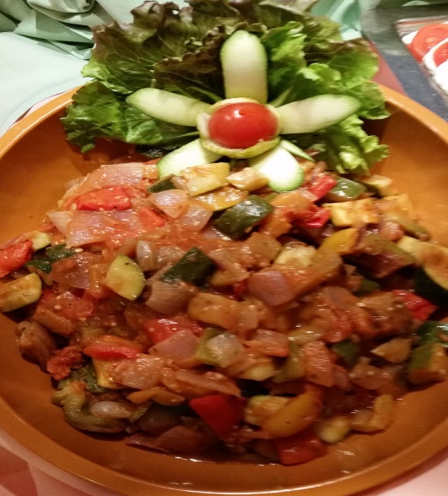
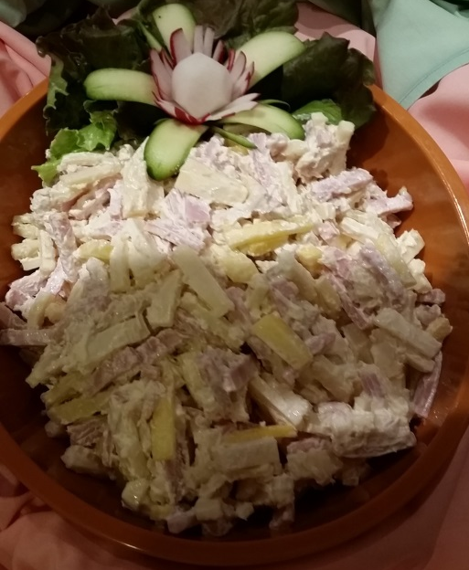
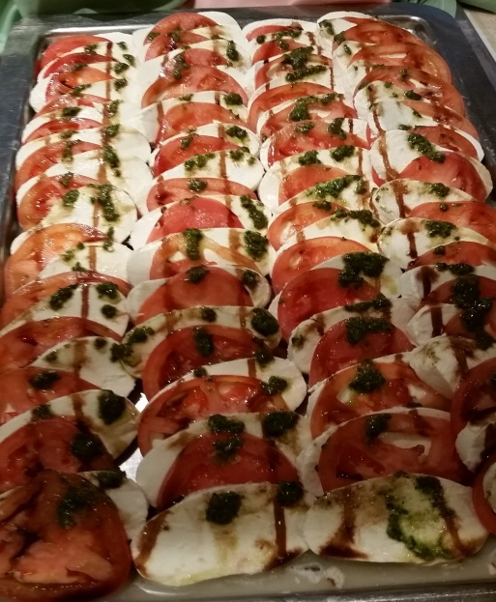
C 1 Compote Salad

Slide 3
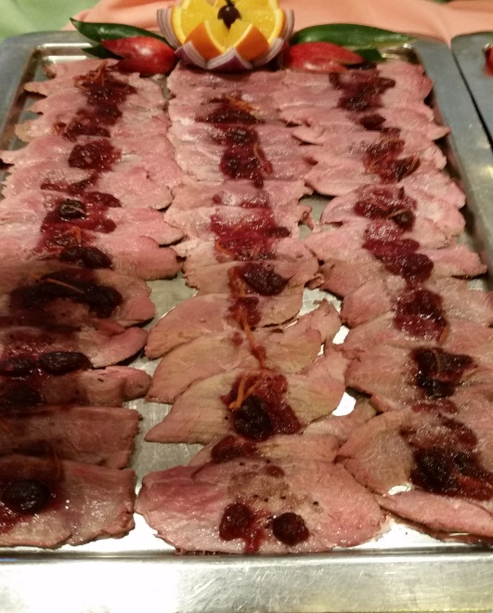
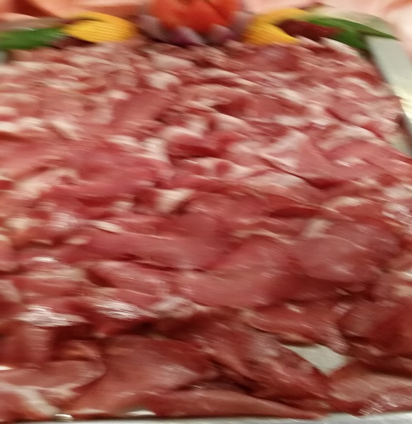
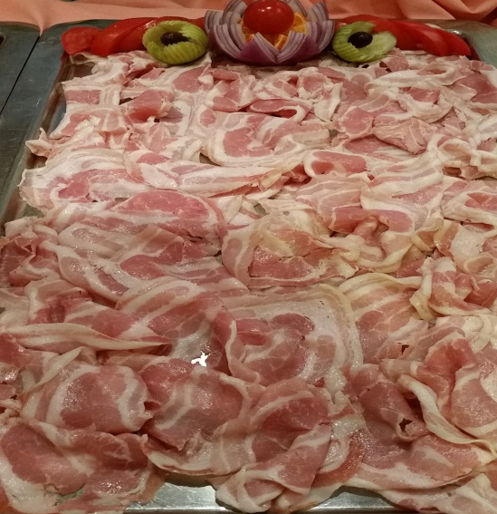
C 2 Assorted Cold Cuts

Slide 4
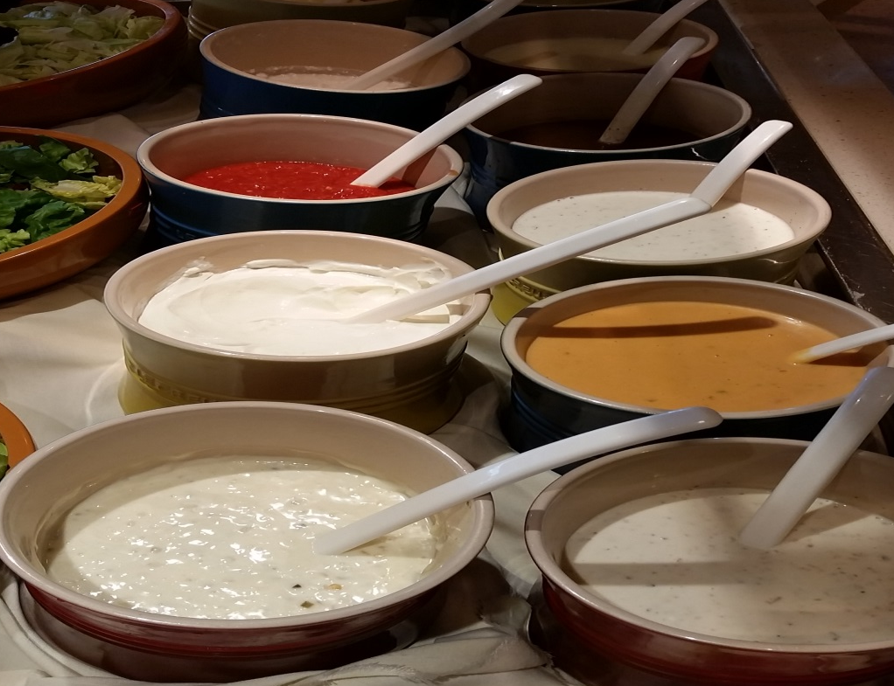
C3 DRESSING

Slide 5
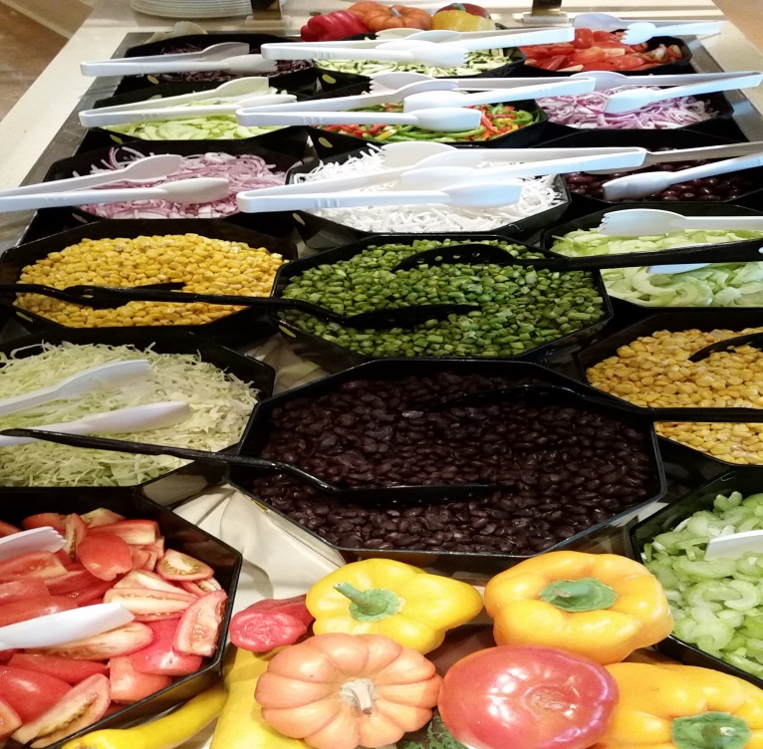
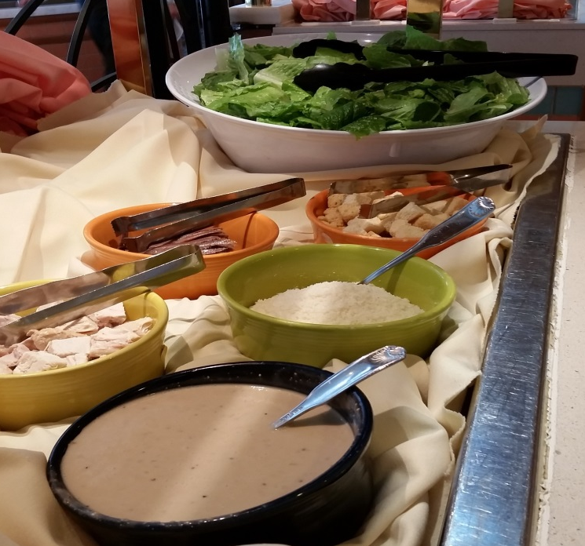
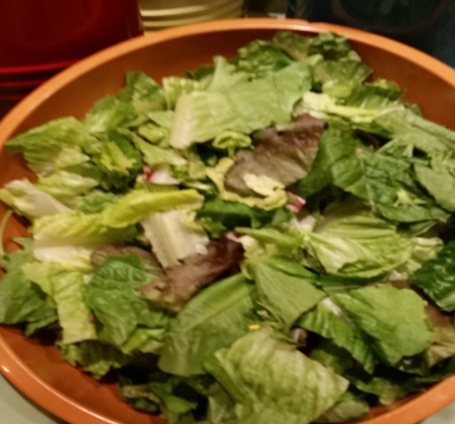
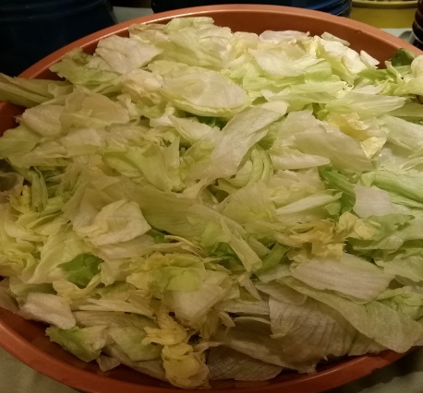
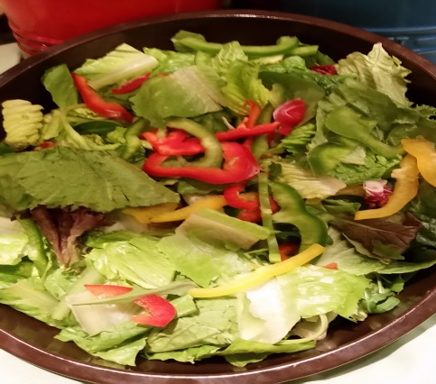
C4 SALAD BAR

Slide 6
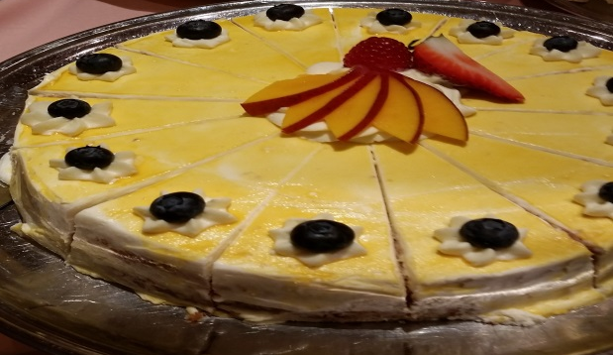
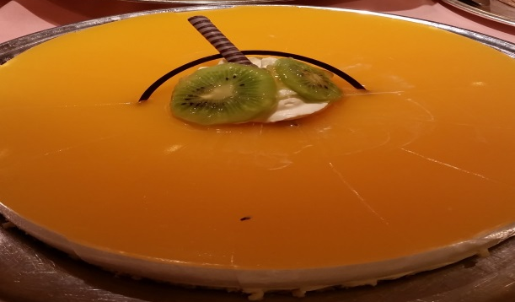
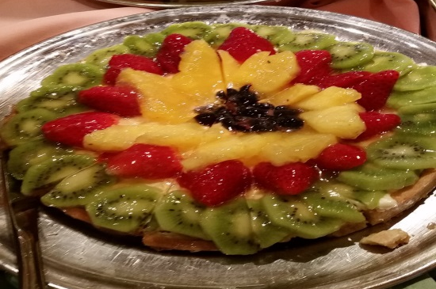
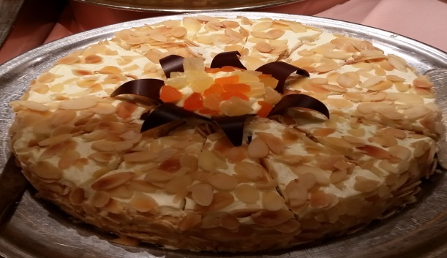
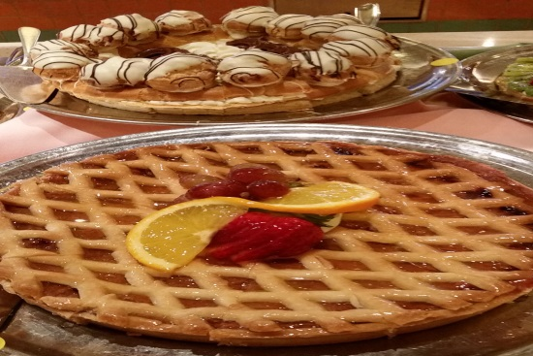
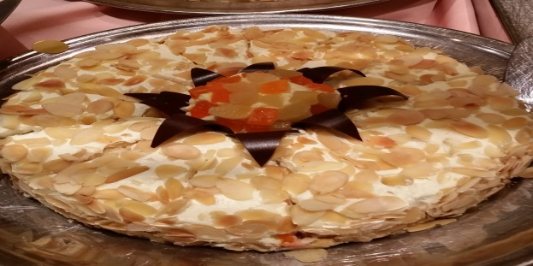
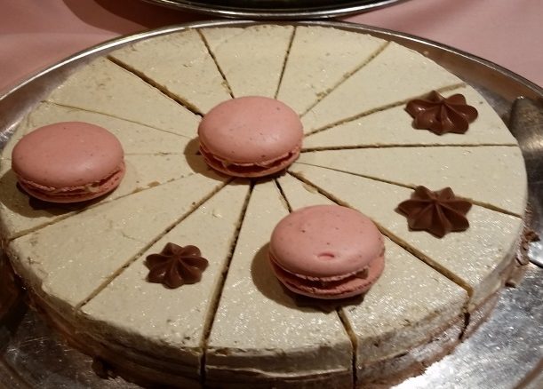
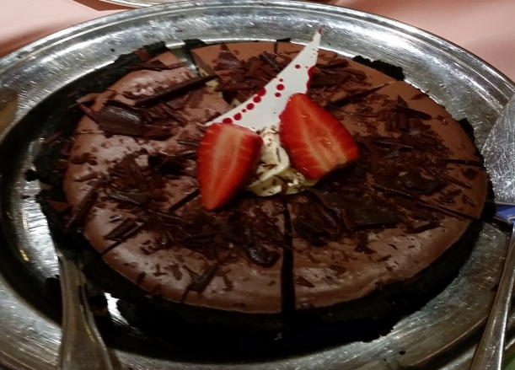
C5 DESSERT ASSORTED PASTRY

Slide 7
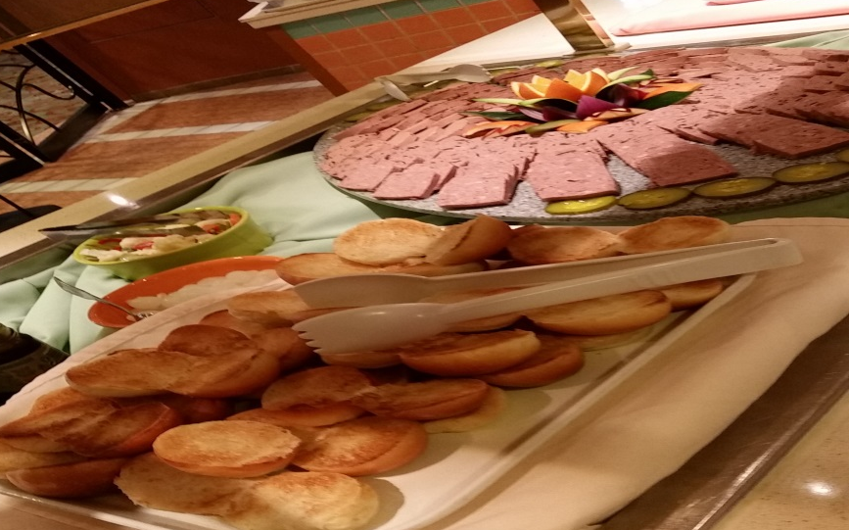
C6 PATE AND PICKLED

Slide 8
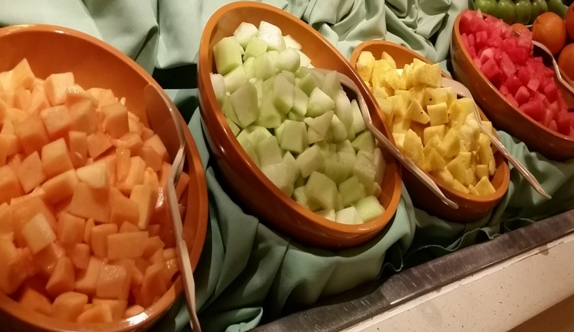
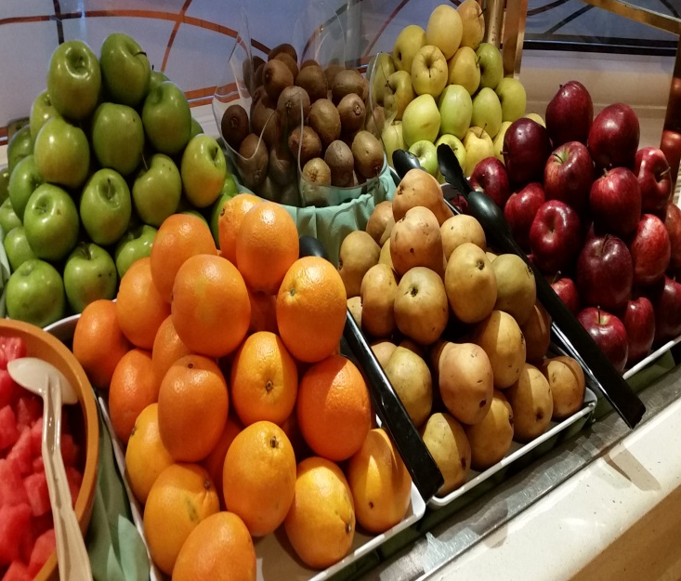
C7 Sliced Assorted Fruit and Fresh Fruit

Slide 9
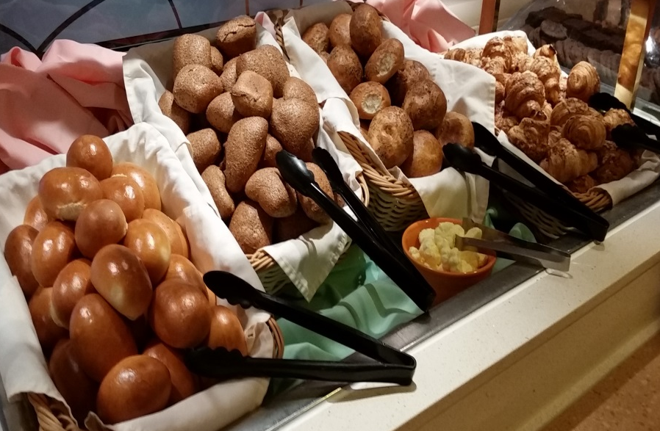
C8 ASSORTED BREAD

Slide 10
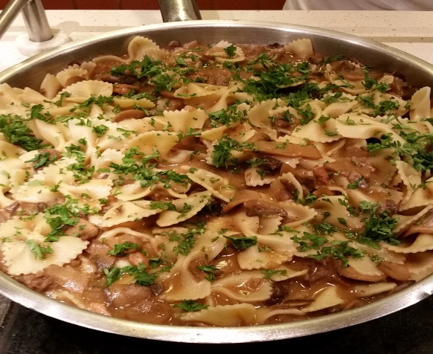
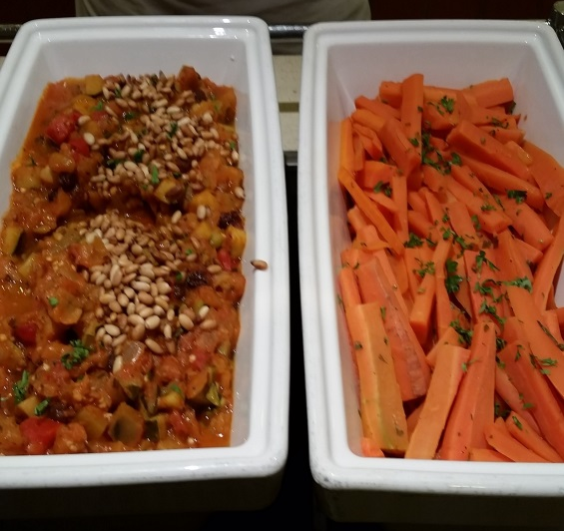
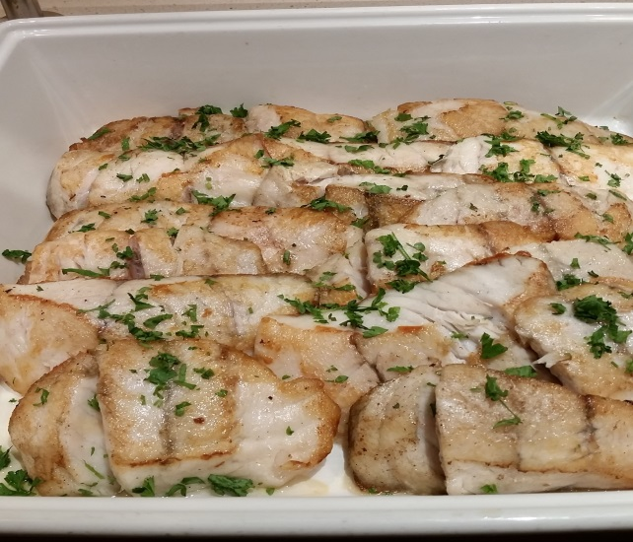
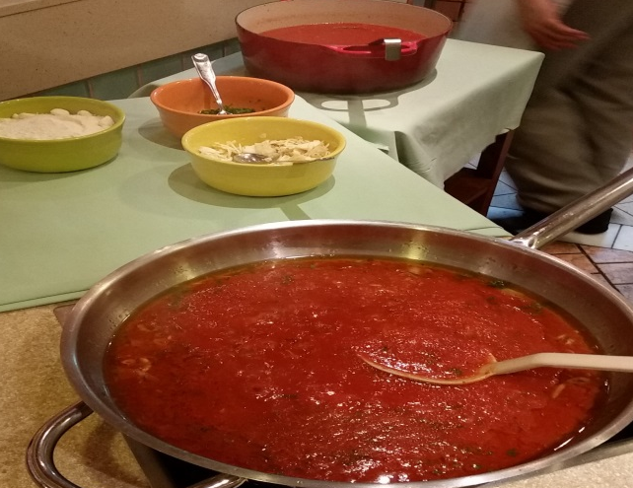
H1 & H 2 Bow Tie Pasta, Pan-Fried Barramundi with Grain Mustard Sauce, (v) Baby Carrots with Chopped Tarragon

Slide 11
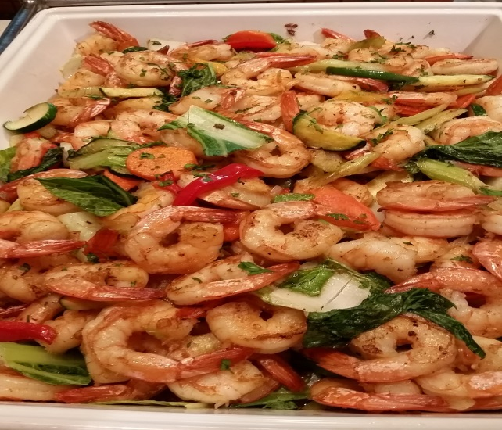
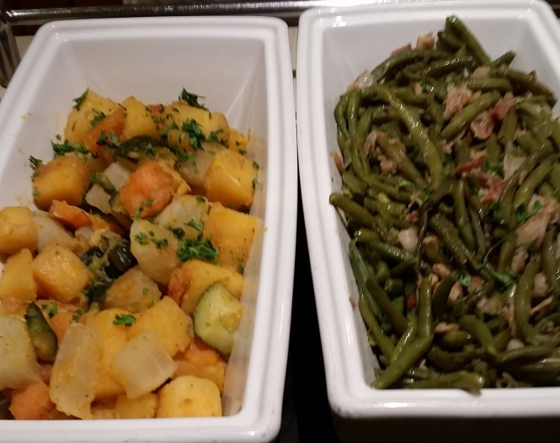
H 3 Seafood Newburg and Garlic Croutons, (v) Sautéed Mixed Vegetables

Slide 12
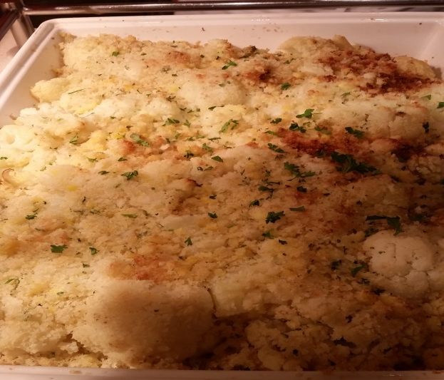
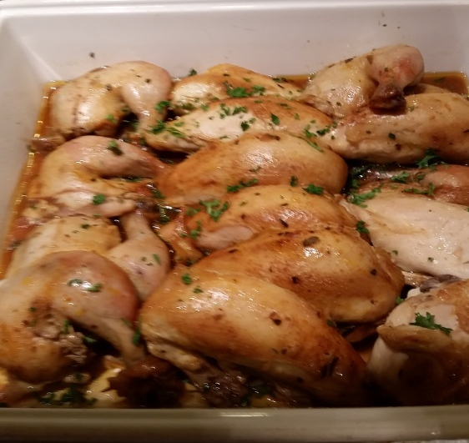
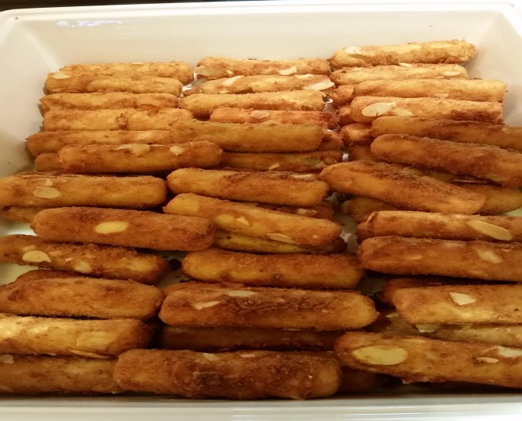
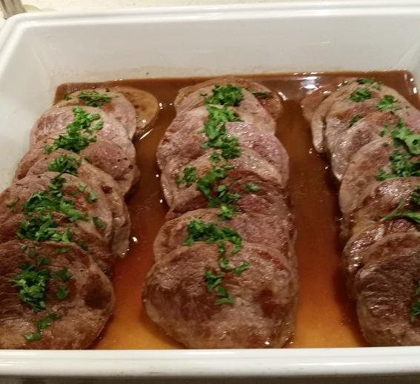
H4 & H5 Beef Tournedos Madeira, (v) Croquette Potatoes

Slide 13
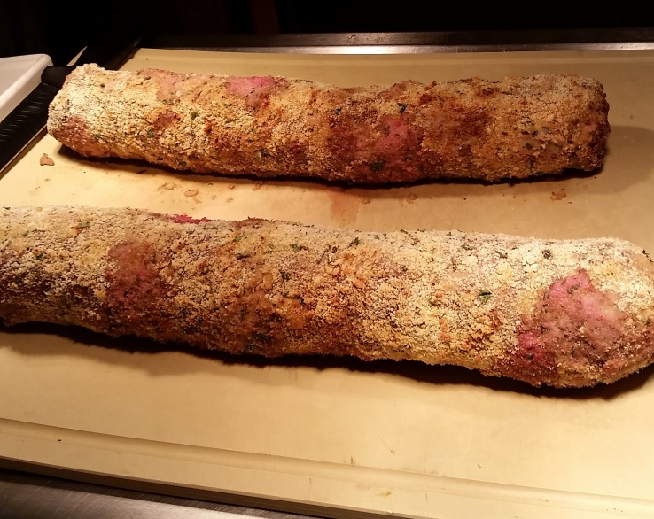
CARVING Coated Roast Beef with Mushroom Gravy and Béarnaise Sauce

Slide 14
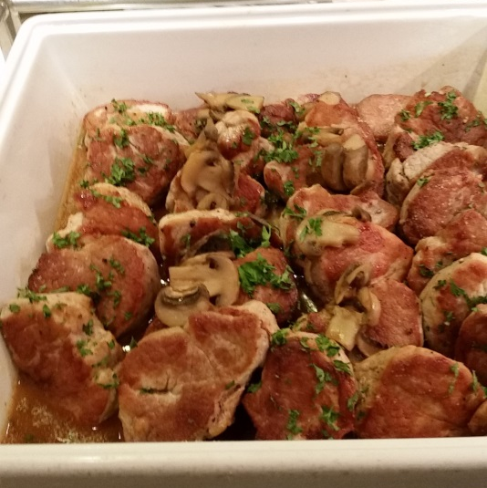
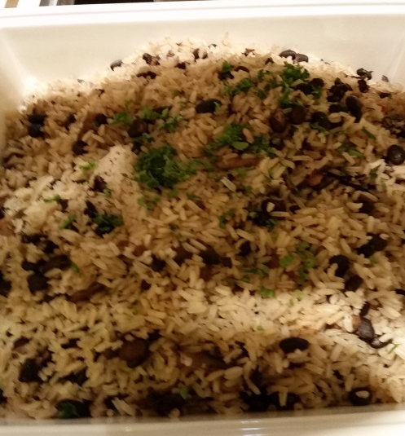
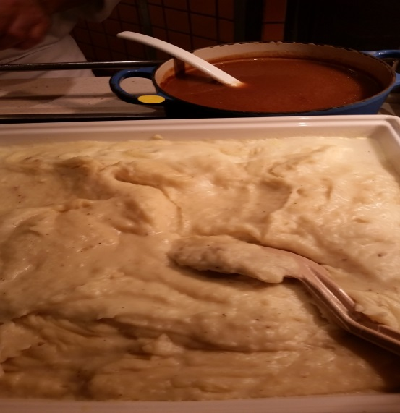
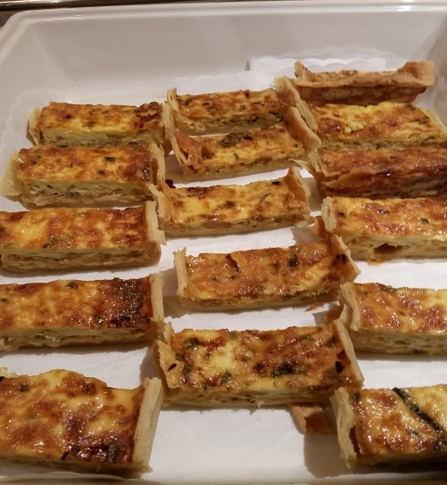
H6 & H7 Pork Tenderloin with Mushroom Sauce . (v) Mashed Potato with gravy, Rice & Beans with Mushrooms, Crab Quiche and Sauce

Slide 15
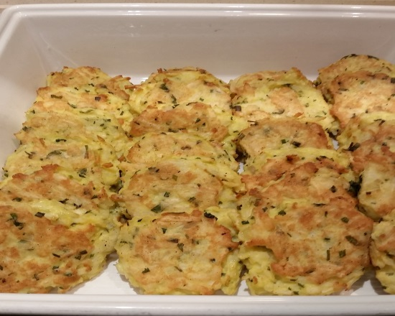
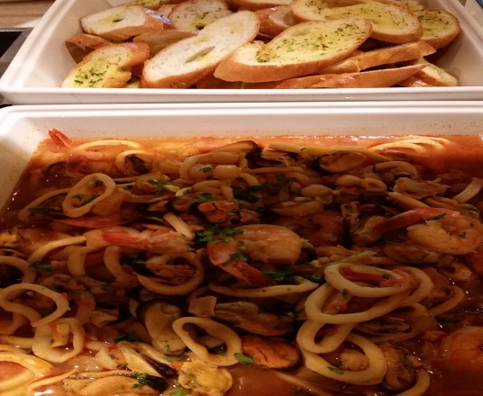
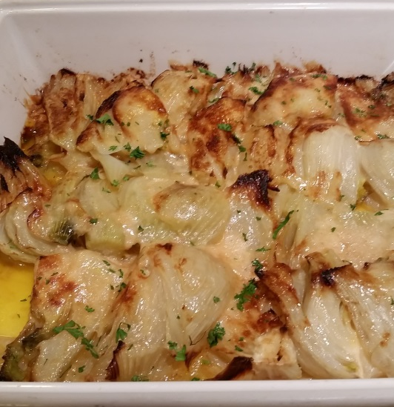
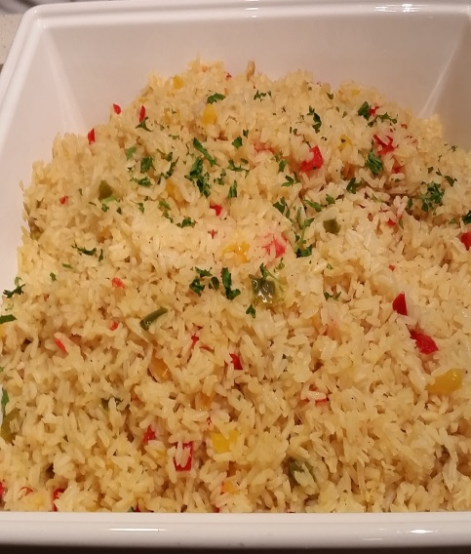
H8 & H9 Pilaf Rice with Confetti Peppers, Fennel Gratin with Parmesan Cheese Melted Butter , Stir Fried Shrimp with Seasonal Vegetables, (v) Coriander Roast Potato

Slide 16
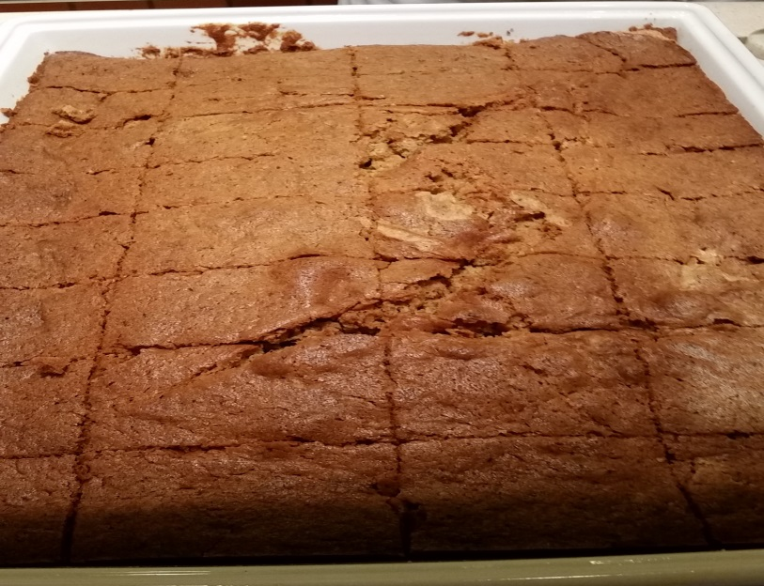
H 10 Hot Dessert

Slide 17
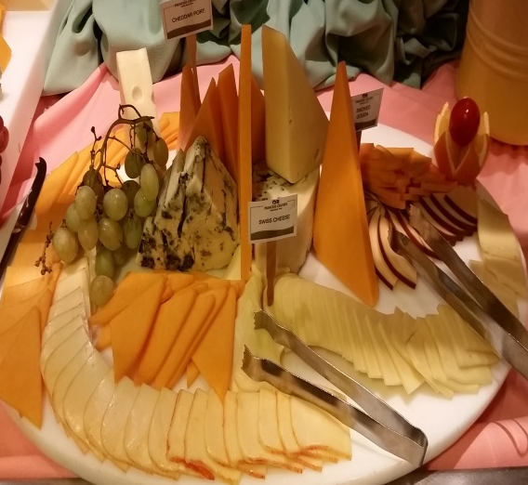
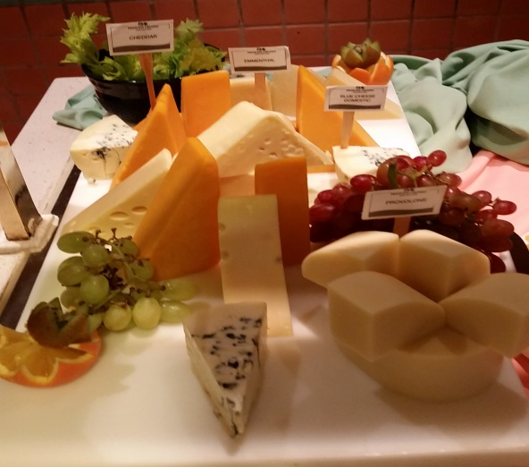
CO Cheese Counter

Slide 18
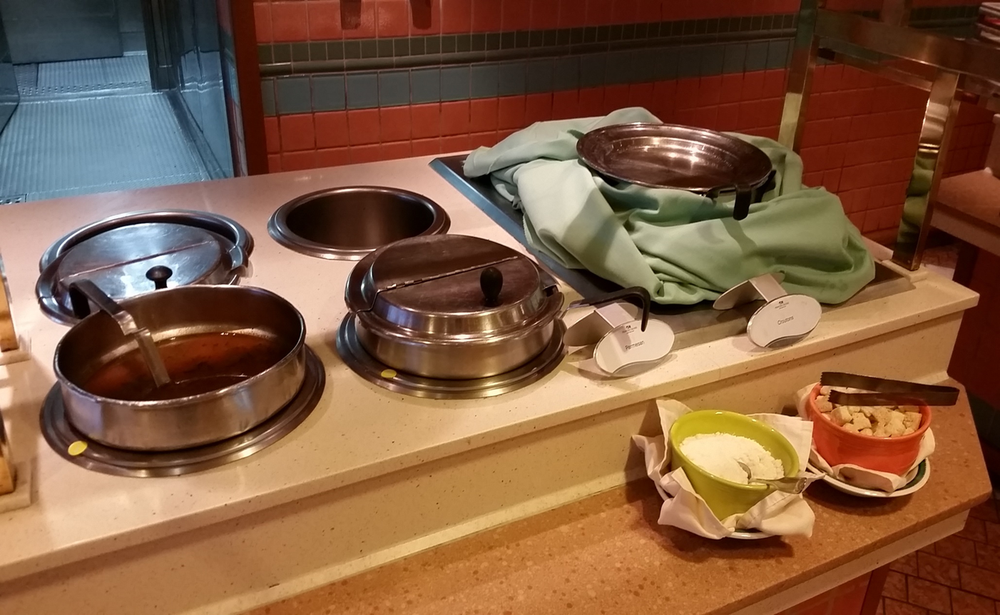
H11 Soup

