Slide 1
H10 Hot Dessert
H9 √ Orzotto with Vegetables Brunnoise, Dirty Rice
H8 Black Mussel Pot, Baked Cinnamon Pumpkin
H7 Succotash, Baked Sweet Potato
H6 Fried Kentucky Chicken, Mashed Potatoes
H5 Grilled Minute Steak Cowboy Style , Fried Steak Potatoes Plus
H4 Virginia Ham Steak Red Eye Gravy , Gratin Cauliflower
H3 Cornmeal Crusted Cat Fish Filet, Broccoli Florets
H2 Broiled King Klip Filet , Broiled Sliced Zucchini
H1 Rigatoni with Red Clams Sauce, Mac & Cheese
Roasted Tom Turkey
C6
Assorted Pate with Pickled
C3
DRESSINGS
C5
DESSERT 5 ASSORTED PASTRY
C4
SALAD BAR
H11 Island Seafood ChowderJamaican Beef Consommé with Mini Cream Puffs
C0
Assorted Cheese Plates
C1
Avocado Boat with Seafood , Grilled Vegetables Marinated Olive Oil and Basil, American Potato & Egg Salad, Beef Salad
C8
ASSORTED BREAD ,
C7
SLICE FRUIT and Fresh Fruits
C2
Cold Cuts
exit
entrance
C0:_ 2nd Commis
C1 – C4:___2nd Commis
C5 – C8:__ 1st Commis
H1 – H5:___2nd Commis
H11:____2nd Commis
CARVING:_ 2nd Commis
H6 – H10:__2nd Commis
HOT FILLER:__DCDP
COLD FILLER:___1st Commis
GAZEBO:__DCDP
INSIDE RUNNER:_2nd Commis
STARBOARD SIDE DINNER Dinner 02 Day 07

Slide 2
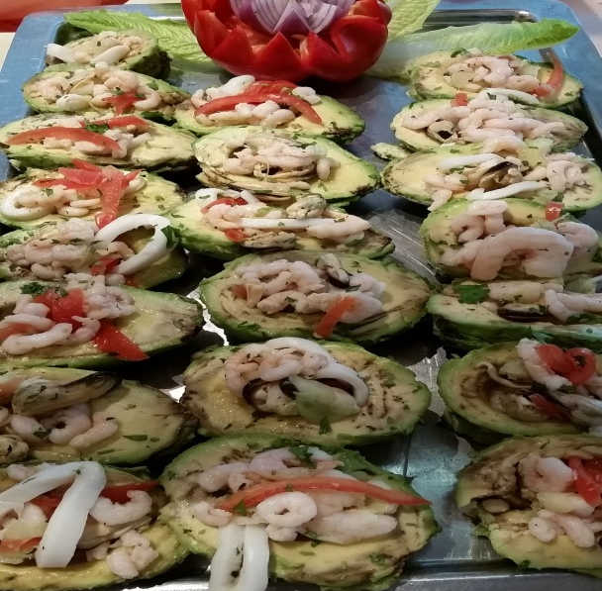
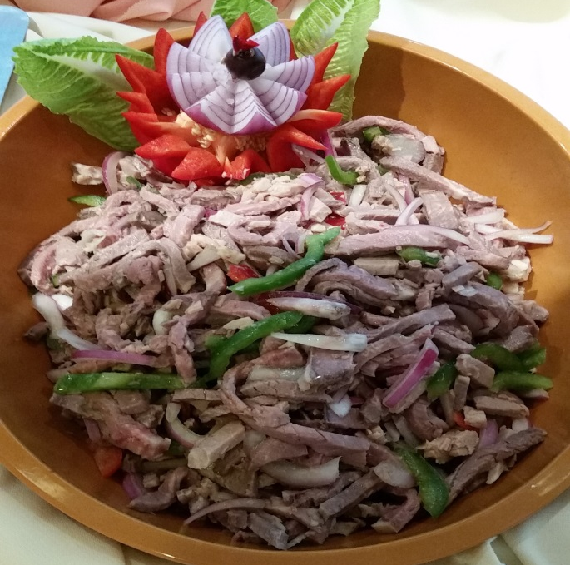
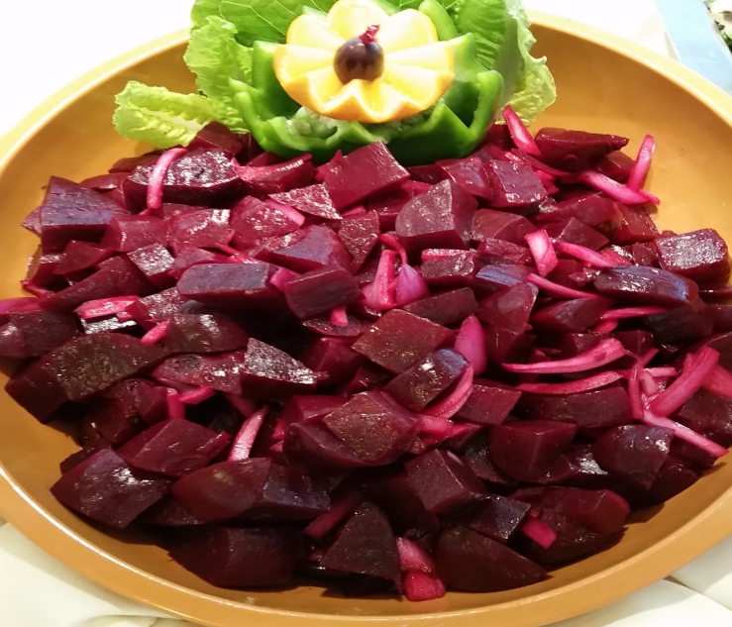
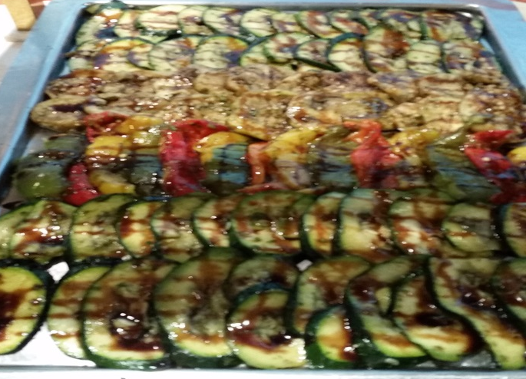
C 1 Compote Salad

Slide 3
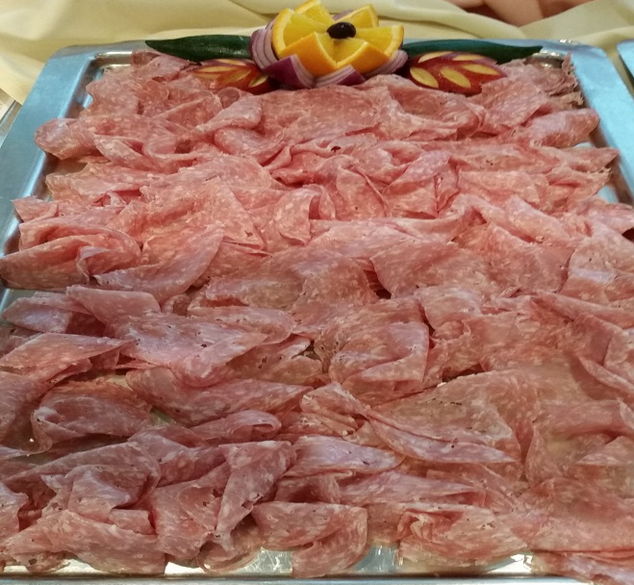
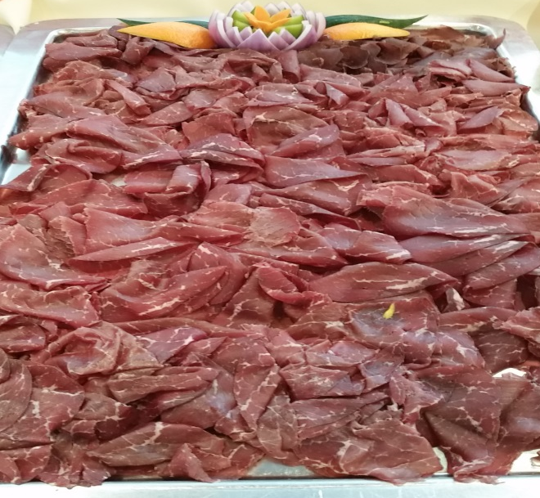
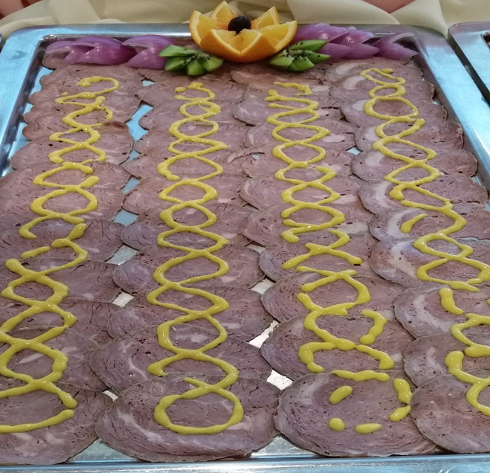
C 2 Assorted Cold Cuts

Slide 4
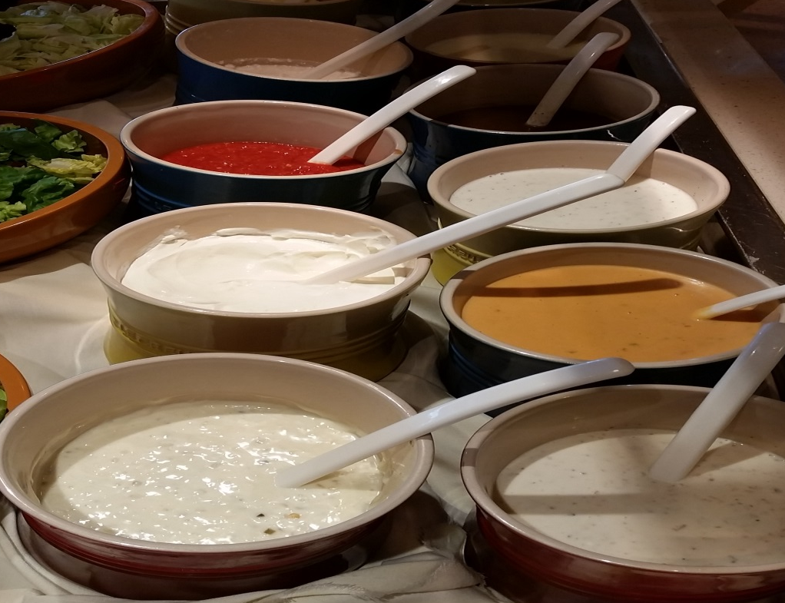
C3 DRESSING

Slide 5
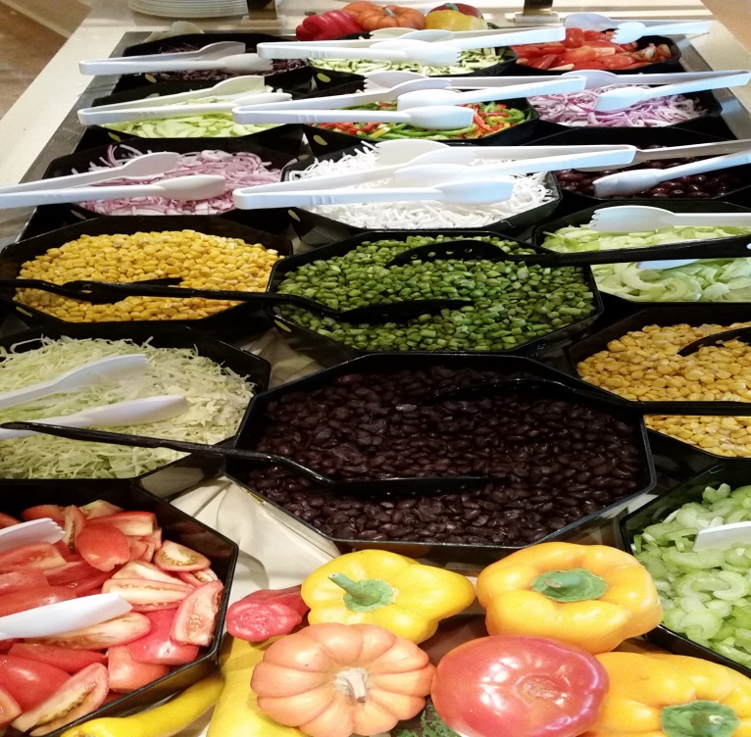
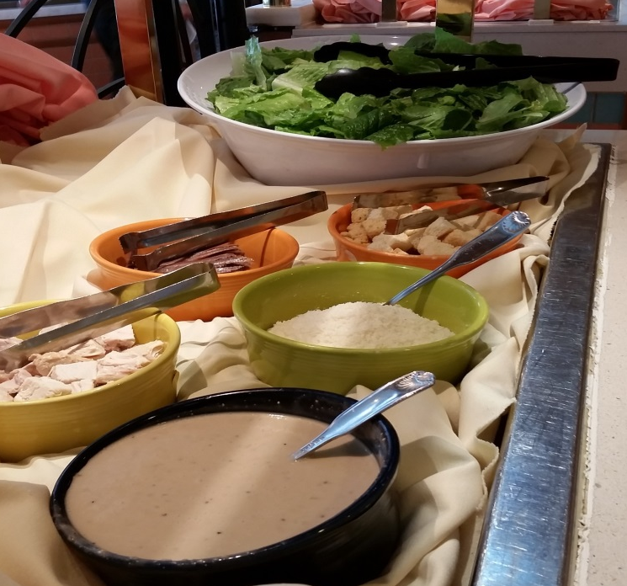
C4 SALAD BAR

Slide 6
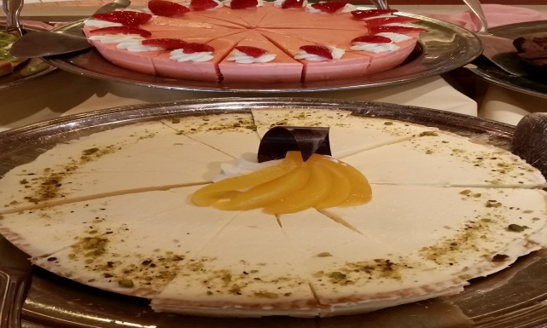
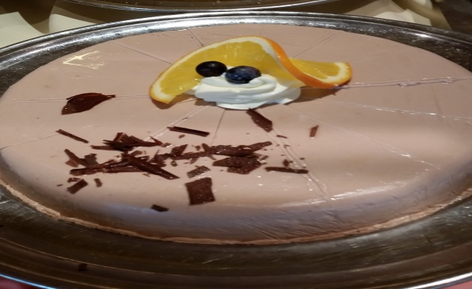
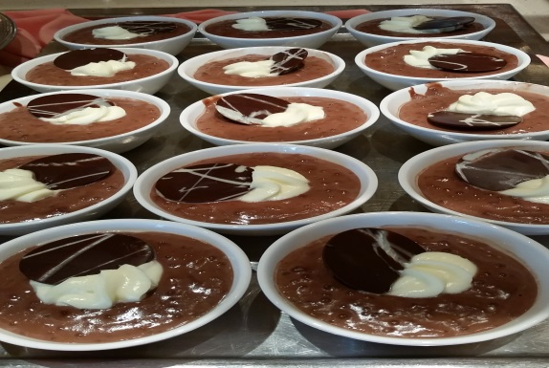
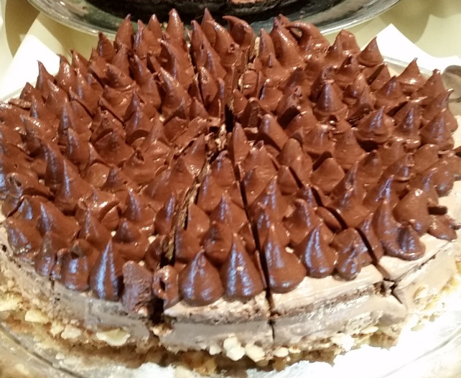
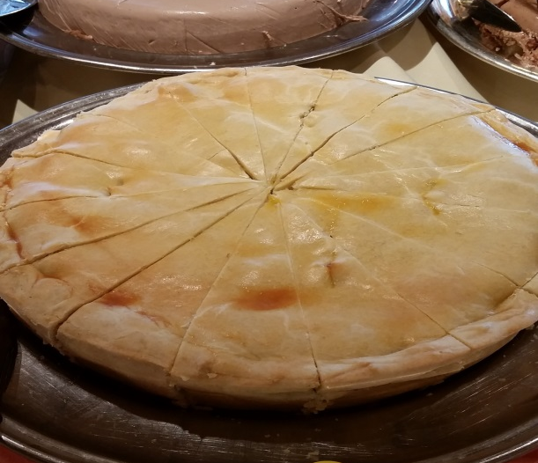
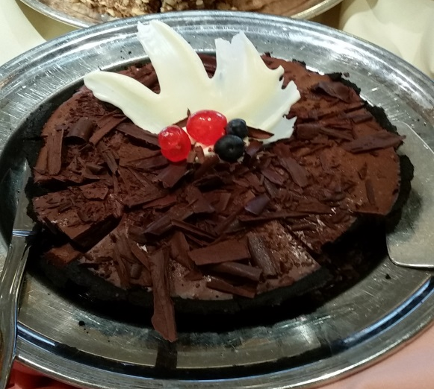
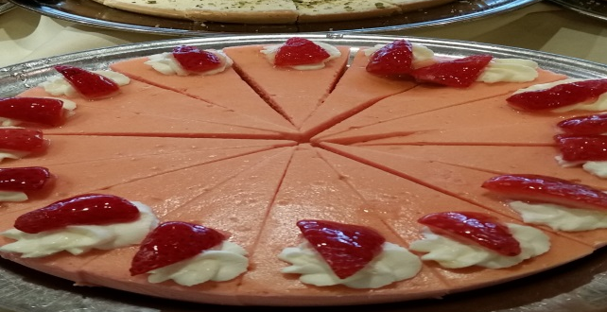
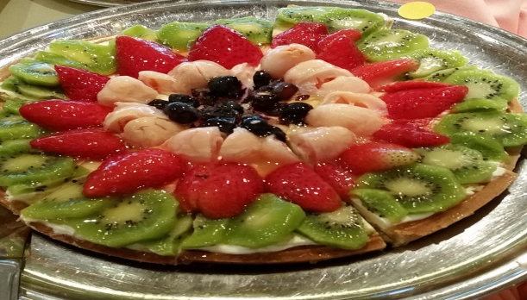
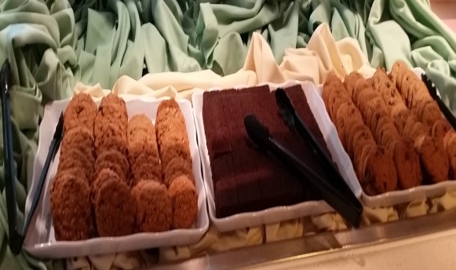
C5 DESSERT ASSORTED PASTRY

Slide 7
C6 PATE AND PICKLED

Slide 8
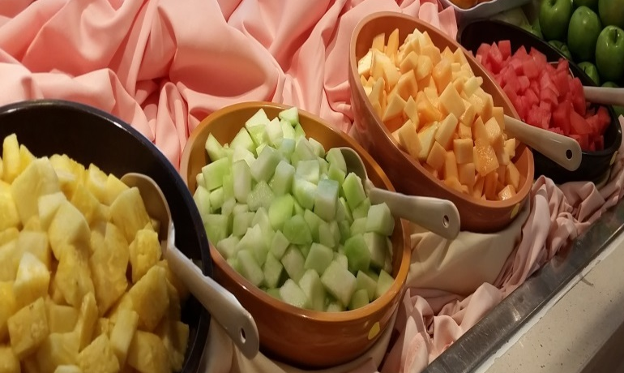
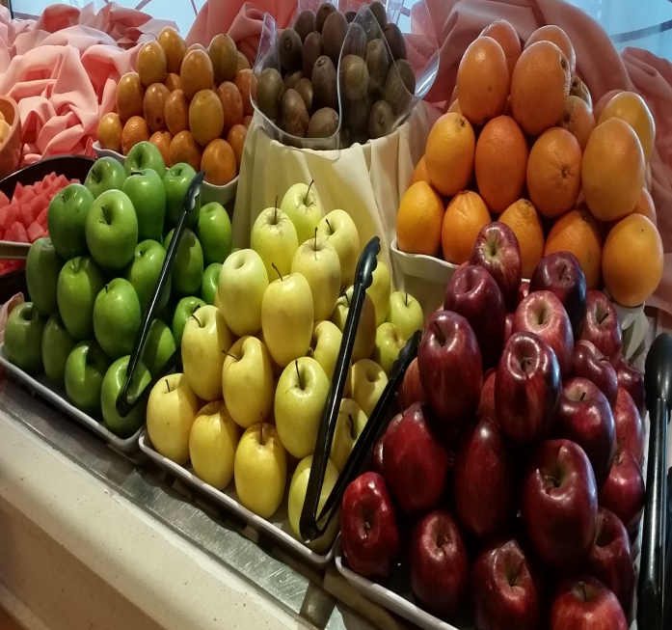
C7 Sliced Assorted Fruit and Fresh Fruit

Slide 9
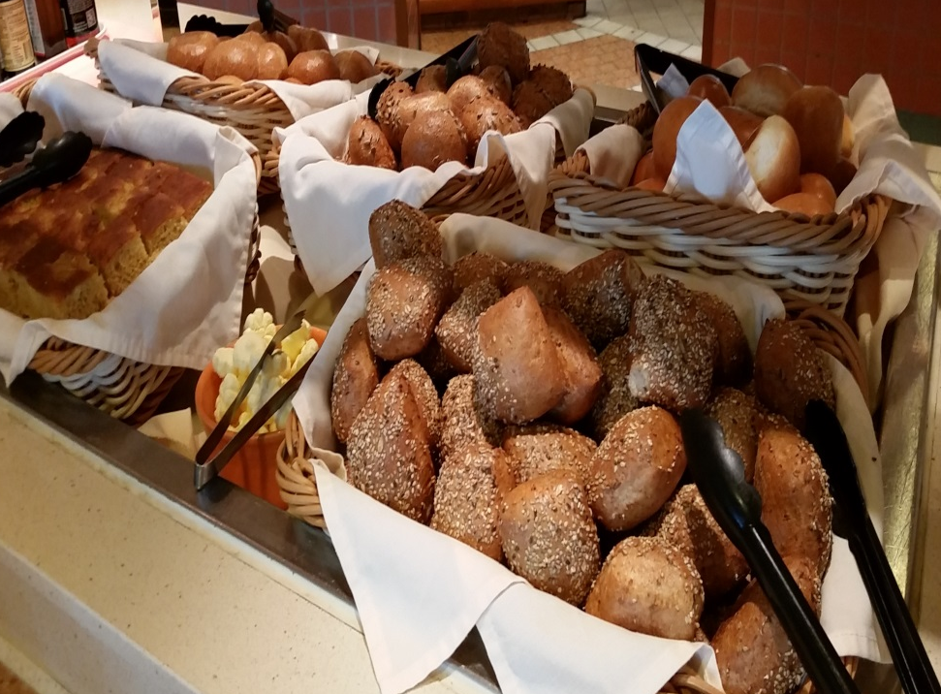
C8 ASSORTED BREAD

Slide 10
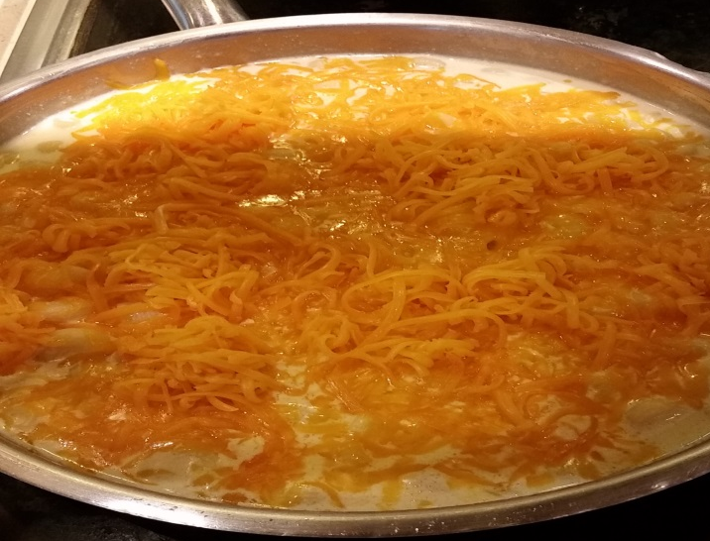
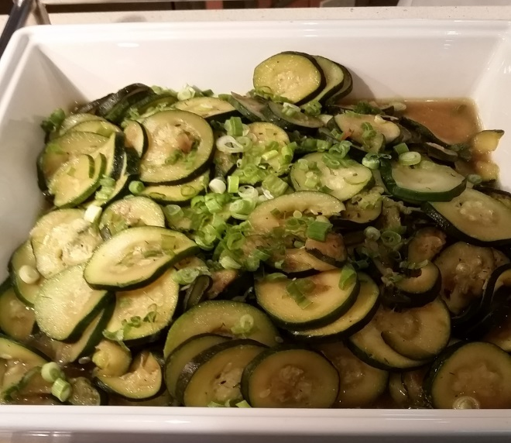
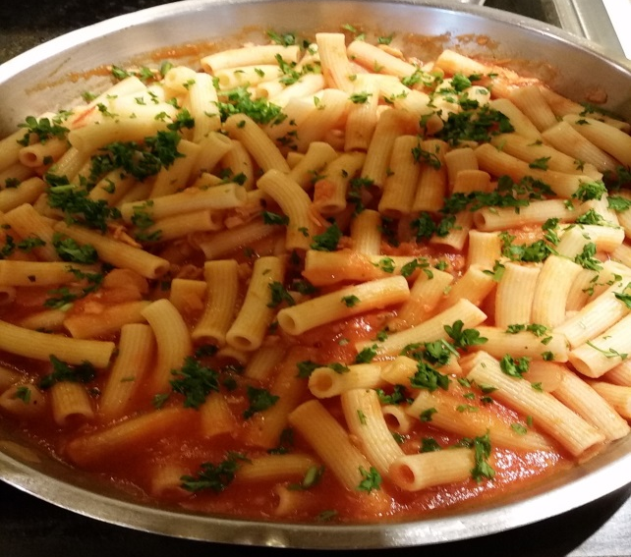
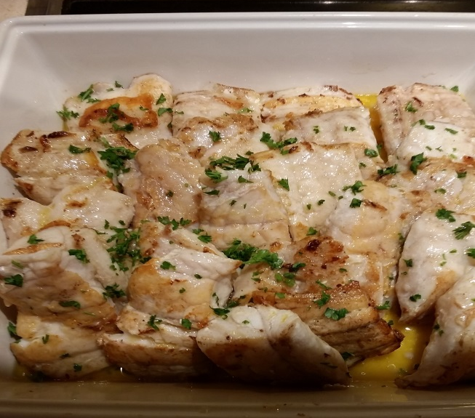
H1 & H 2 Pasta, Boiled Zucchini and King klip

Slide 11
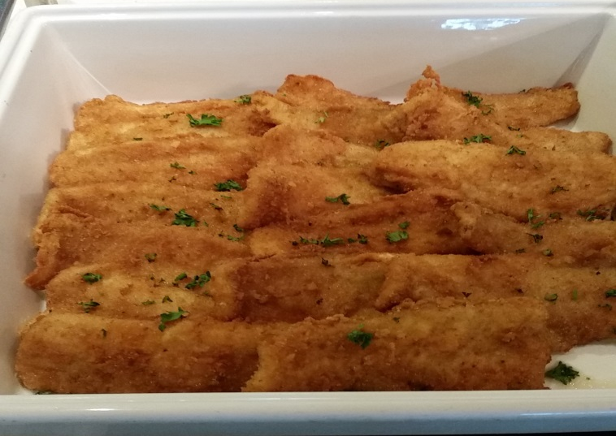
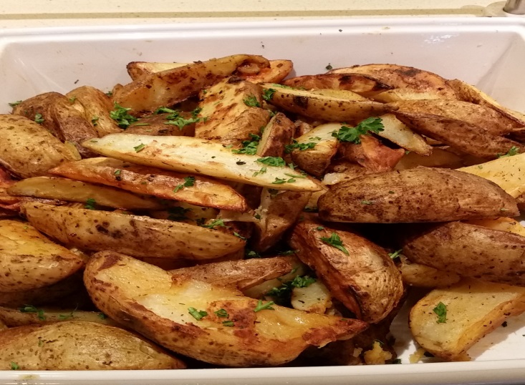
H 3 Cornmeal Crusted Cat Fish Filet, Broccoli Florets

Slide 12
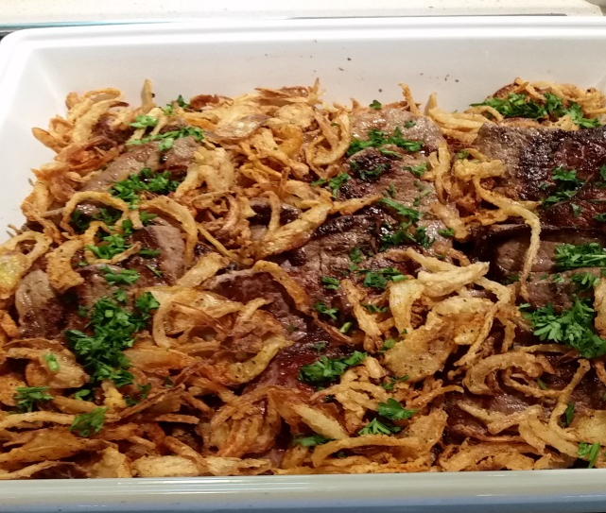
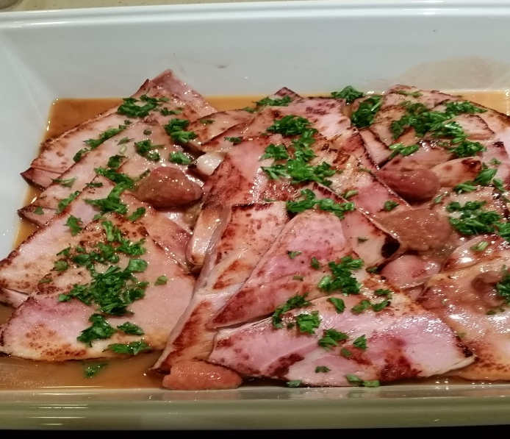
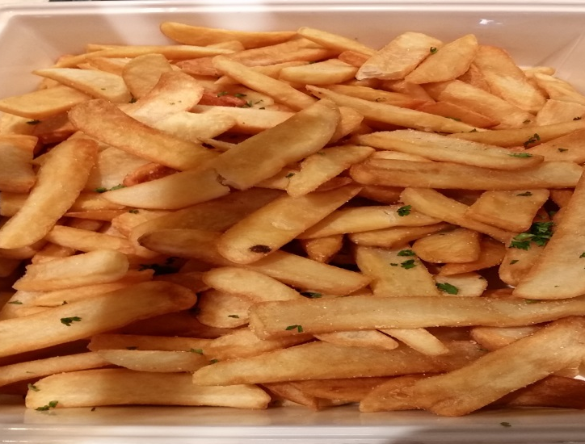
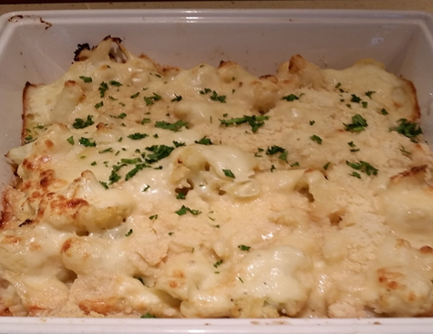
H4 & H5 Virginia Ham Steak Red Eye Gravy , Gratin Cauliflower , Steak and Steak fried Potatoes

Slide 13
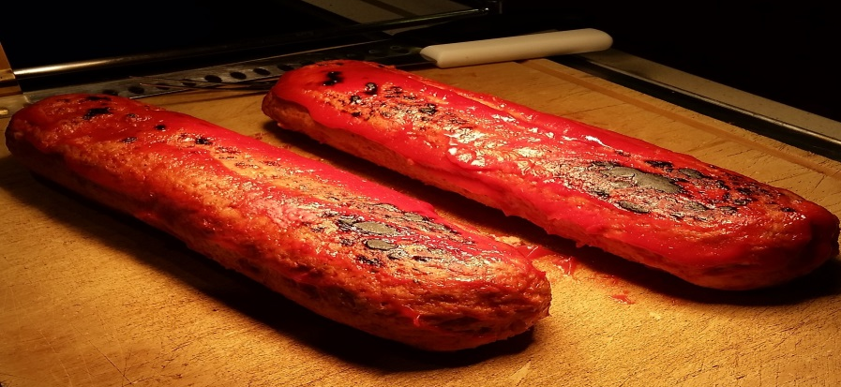
CARVING Meatloaf

Slide 14
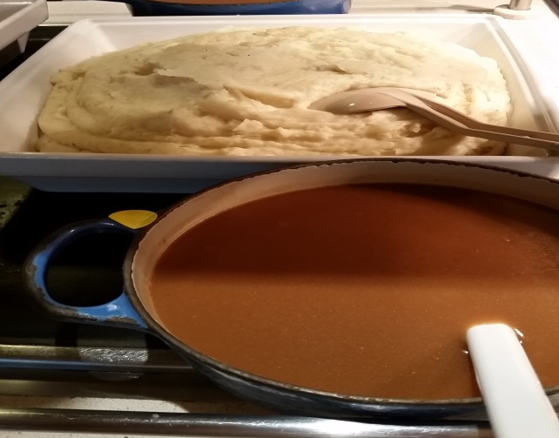
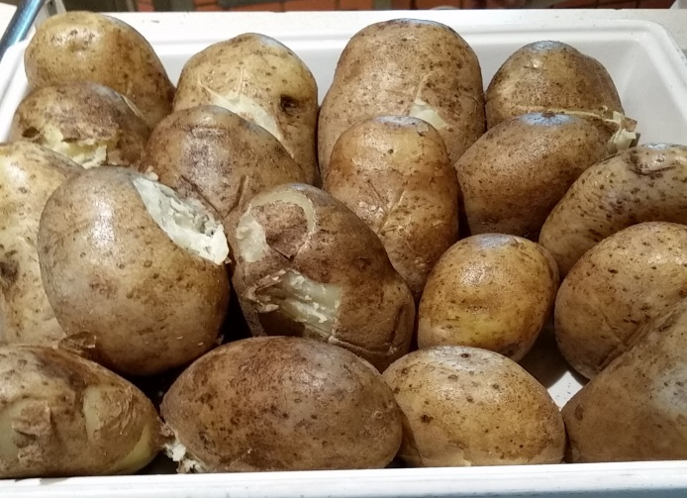
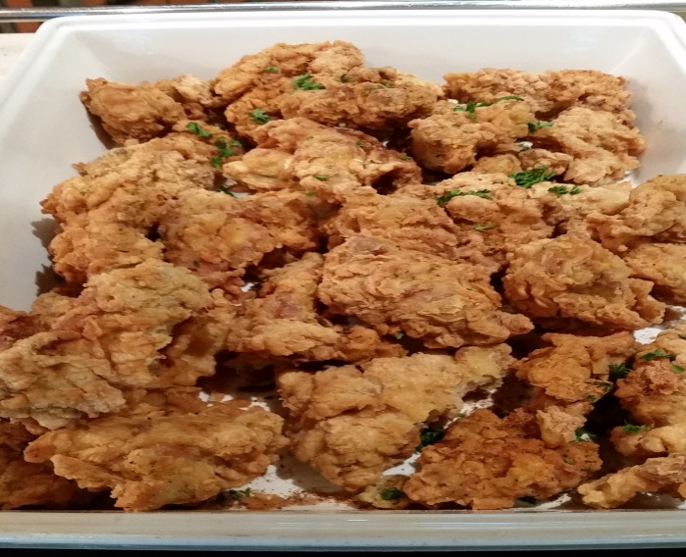
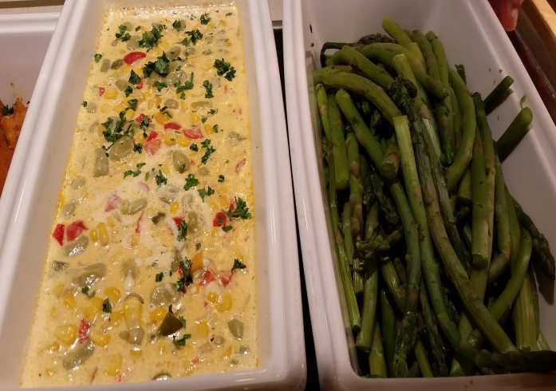
H6 & H7 Fried Kentucky Chicken, Mashed Potatoes, Succotash, Baked Sweet Potato

Slide 15
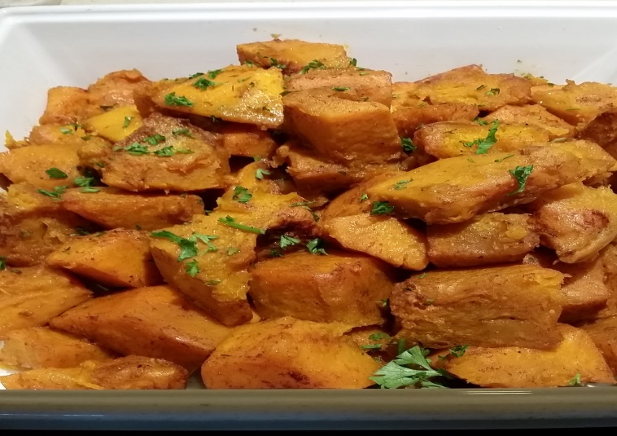
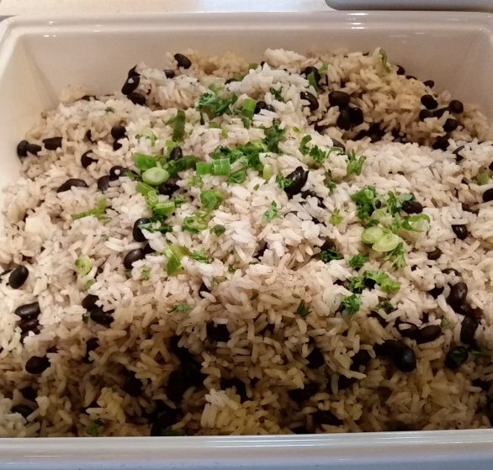
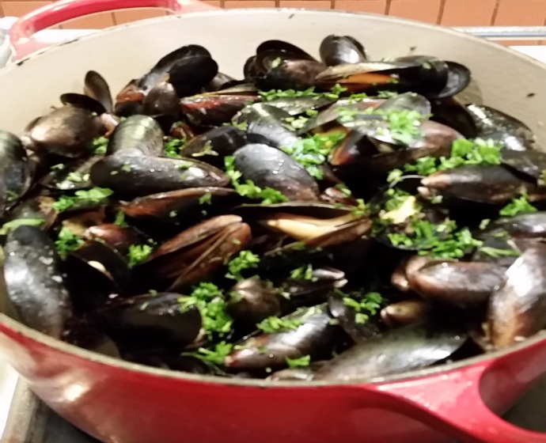
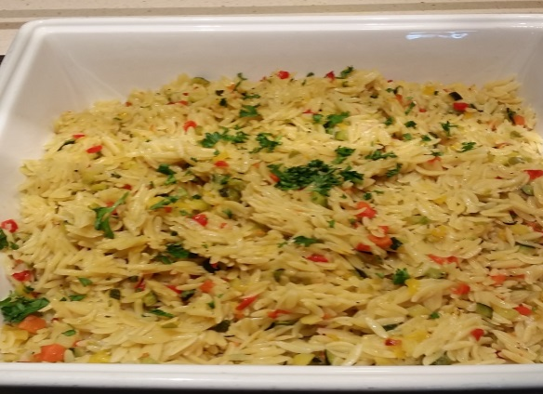
H8 & H9 Grilled Lamb Chops, Vegetable Ratatouille, Lentil Rice Pilaf and Roast Potatoes

Slide 16
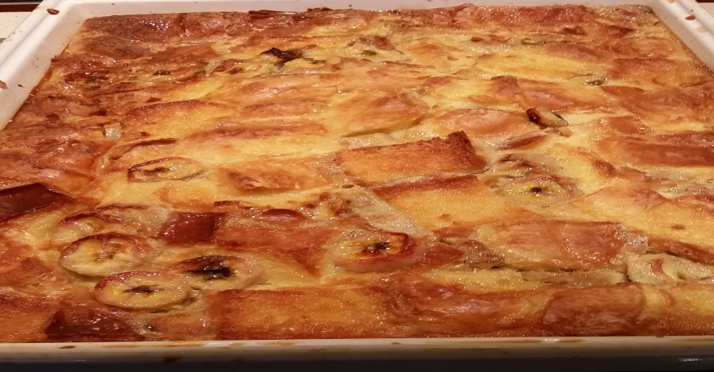
H 10 Hot Dessert

Slide 17
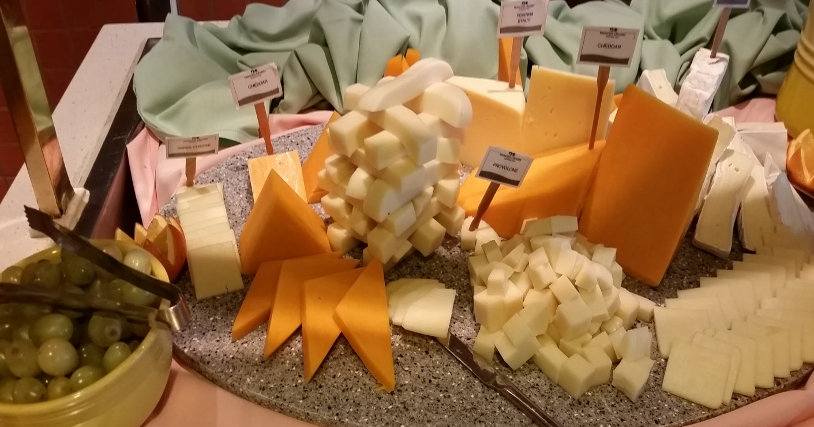
CO Cheese Counter

Slide 18
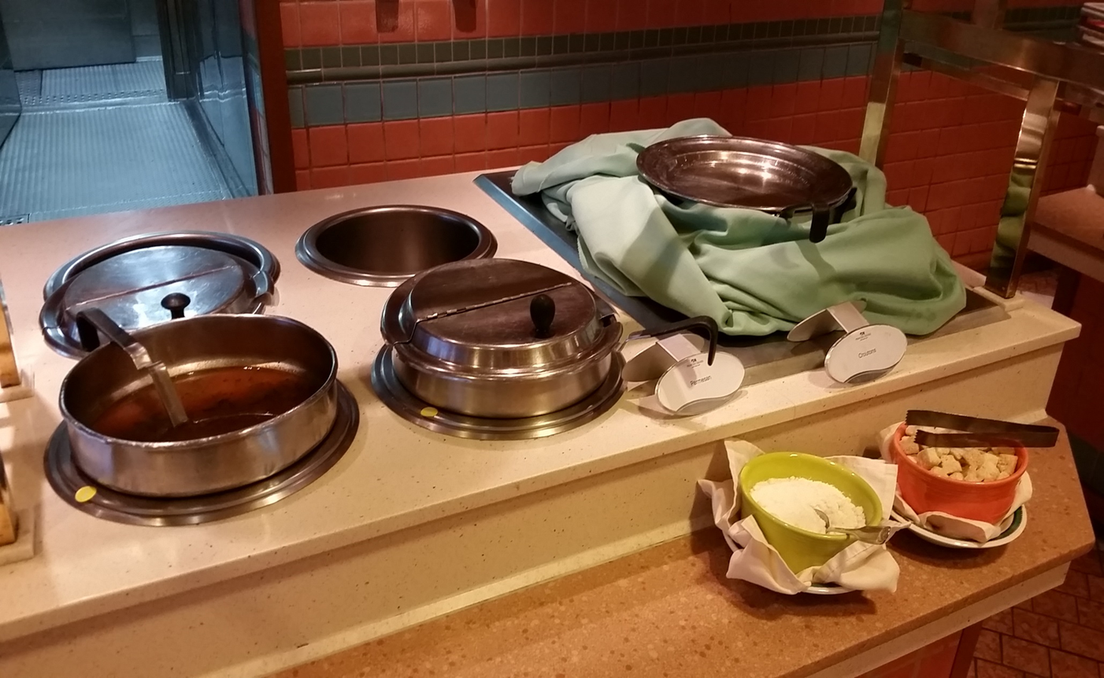
H11 Soup

