Slide 1
H10 Gulan Jamun, Shaji Tukda Indian Dessert
H9 √ Shahi Korma - Lamb Curry, Roasted New Potato with Curry Spices
H8 Beef & Bell Pepper Kebab with Cumin and Cilantro Gravy, Aloo Gobi- Potato & Cauliflower in Indian Spices
H7 Curried Potato & Pea Samosas, Malabar Jhinga Malai Shrimps in Coconut Milk
H6 Chicken Makhanwala, Condiments Station + Poppadum + Chapati+Naan
H5 Turkey Paillard with Butter & Sage, Mashed Potatoes
H4 Tadka Dal- Lentil Curry, Cauliflower Indian Style
H3 Pork Vindaloo (Wild), Vegetable Korma-South
H2 Grilled Black Cod Filet with Citrus & Soy Sauce, Hyderabadi - Vegetable Biryani
H1 Pasta Tomato Sauce, Cheese Tortellini in Light Curry sauce with green peas
Chicken Tikka, Beef Trip Tip with Onions Gravy
C6
Raita Cucumber Dill Salad
C3
DRESSINGS
C5
DESSERT 5 ASSORTED PASTRY
C4
SALAD BAR
H11 Tamater aur Dhal Shorba Parsley Mulligatawny Cream Soup
C0
Assorted Cheese Plates
C1
Cucumber Salad, Chick Pea & Onion Salad Paneer Tikka Salad Makkai Salad
C8
ASSORTED BREAD ,
C7
SLICE FRUIT and Fresh Fruits
C2
Cold Cuts Mortadella-Prosciutto-Salami-Pancetta, Coppa
exit
entrance
C0:_ 2nd Commis
C1 – C4:___2nd Commis
C5 – C8:__ 1st Commis
H1 – H5:___2nd Commis
H11:____2nd Commis
CARVING:_ 2nd Commis
H6 – H10:__2nd Commis
HOT FILLER:__DCDP
COLD FILLER:___1st Commis
GAZEBO:__DCDP
INSIDE RUNNER:_2nd Commis
STARBOARD SIDE DINNER Indian Dinner

Slide 2
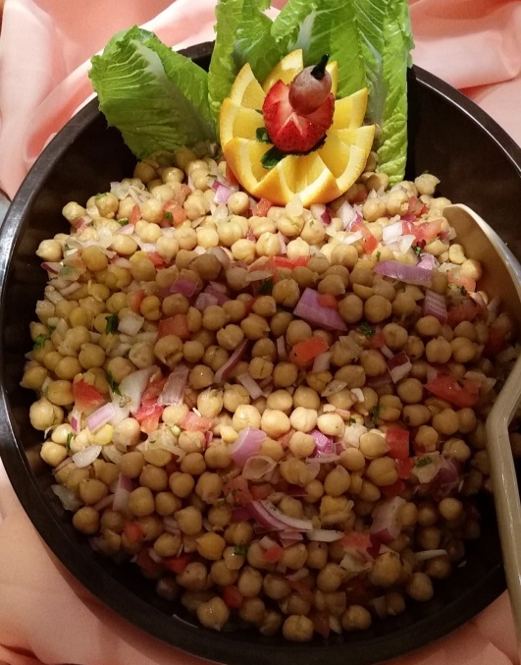
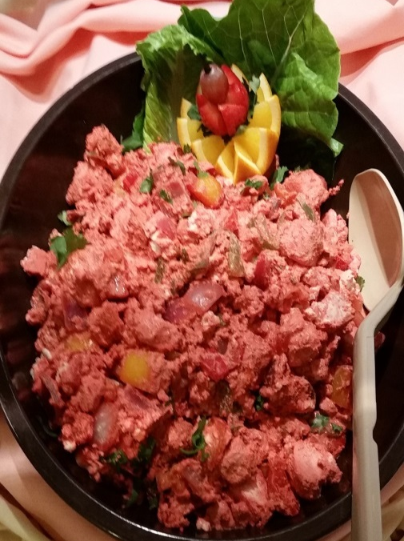
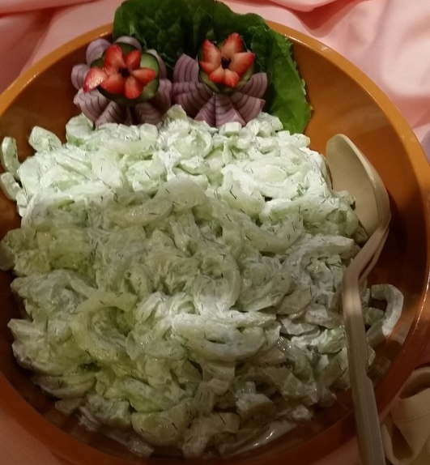
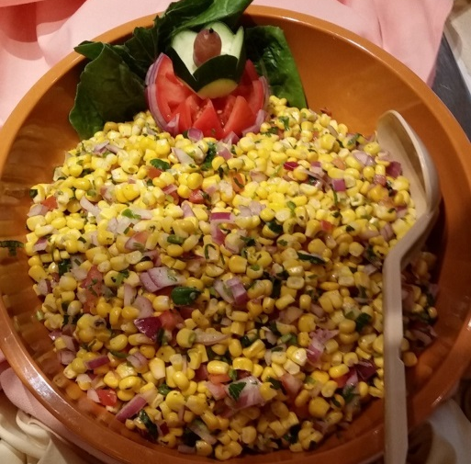
C 1 Compote Salad

Slide 3
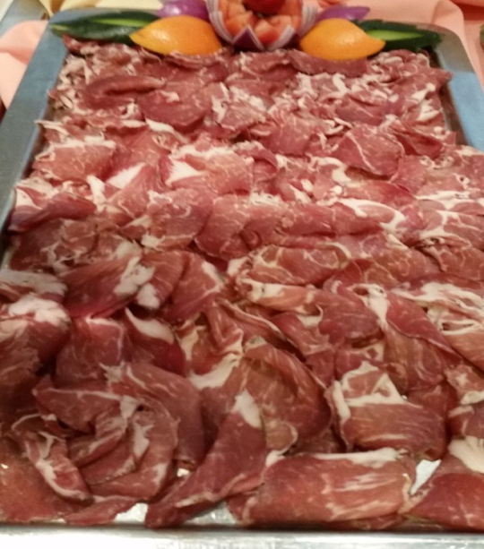
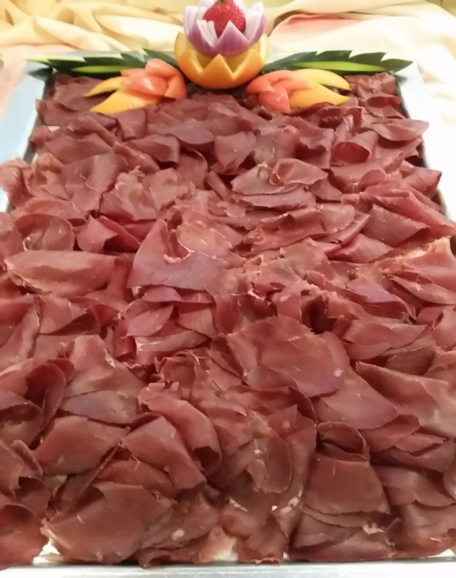
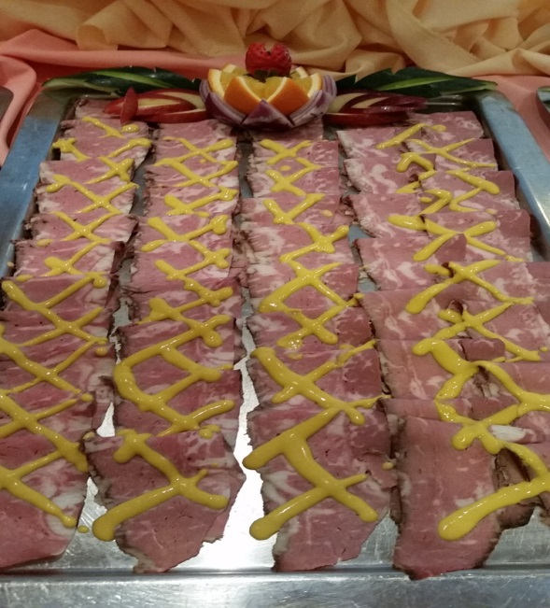
C 2 Assorted Cold Cuts

Slide 4
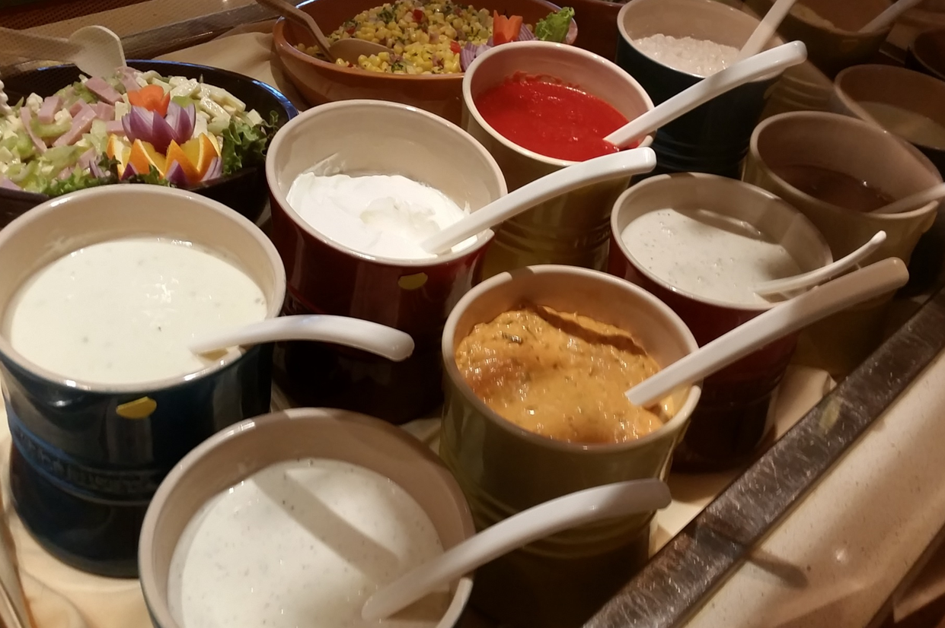
C3 DRESSING

Slide 5
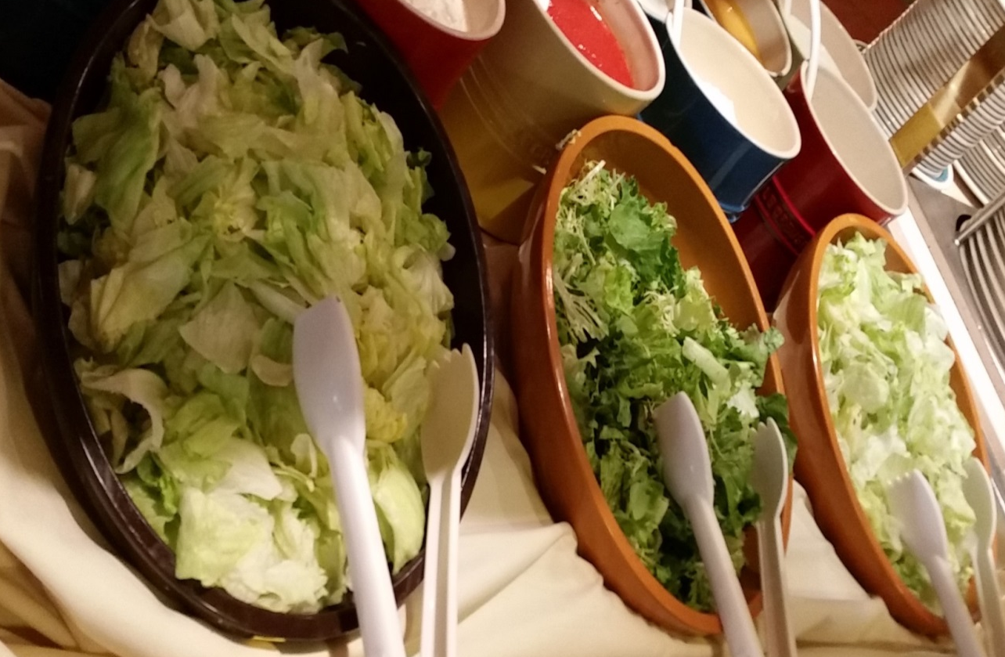
C4 SALAD BAR

Slide 6
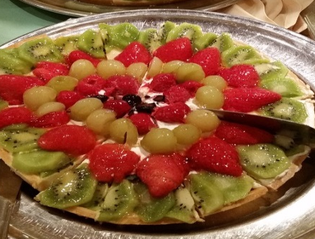
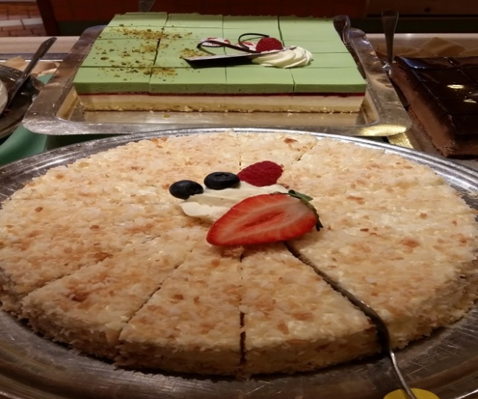
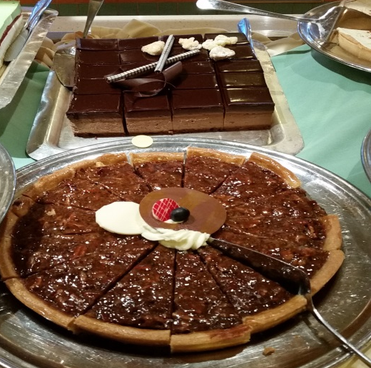
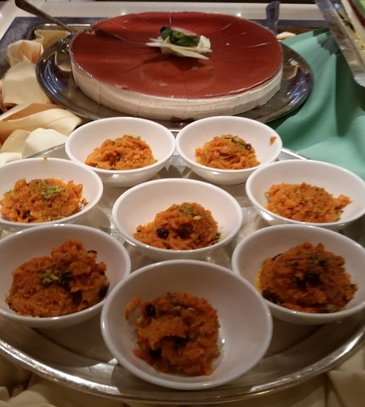
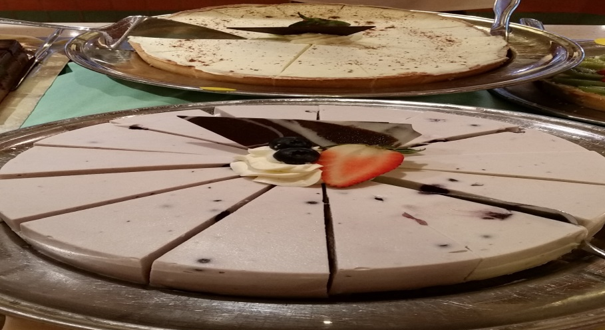
C5 DESSERT ASSORTED PASTRY

Slide 7
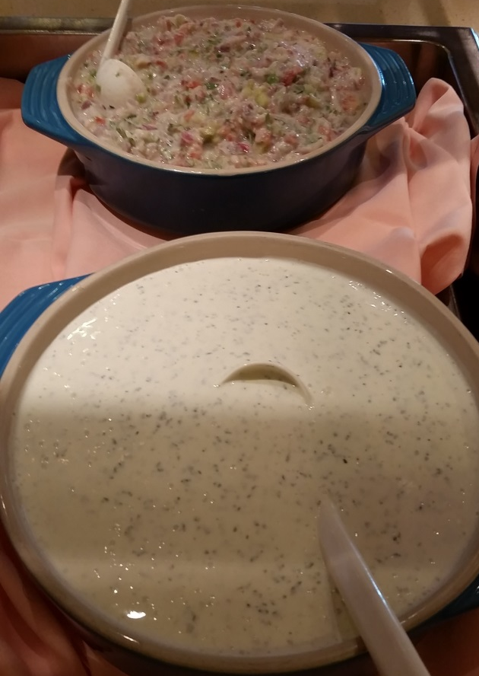
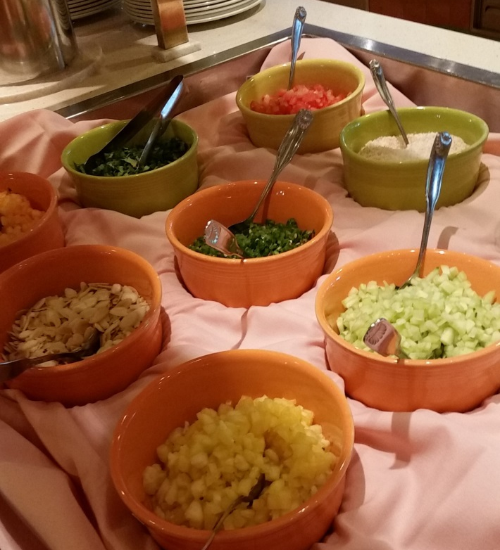
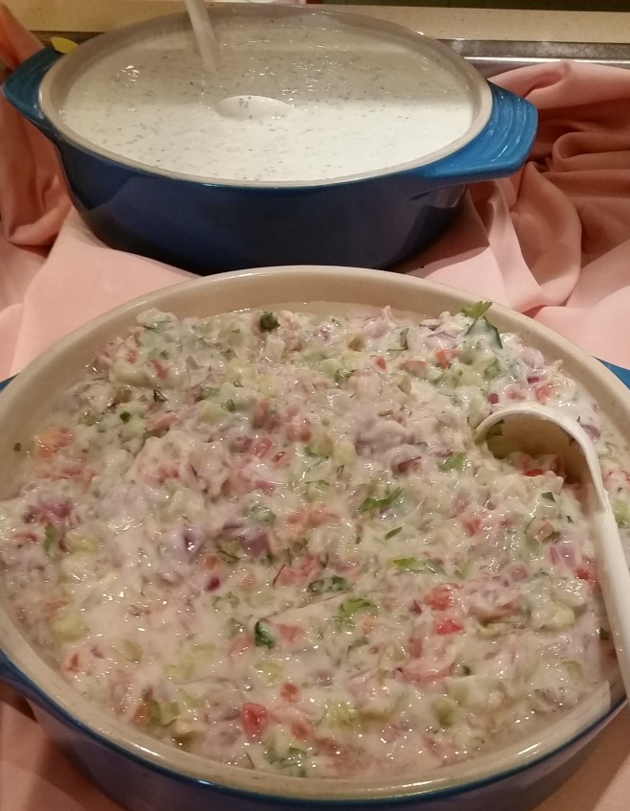
C6 RAITA AND CONDIMENTS

Slide 8
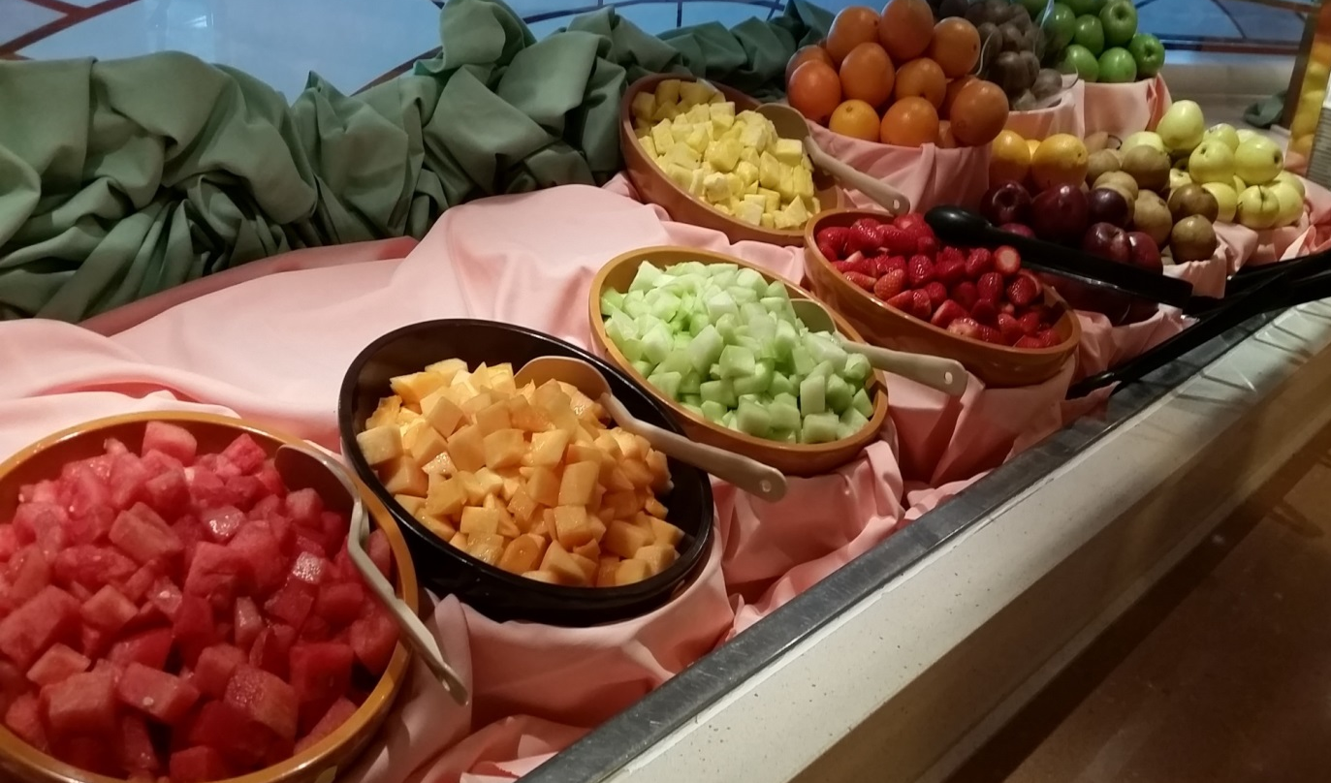
C7 Sliced Assorted Fruit and Fresh Fruit

Slide 9
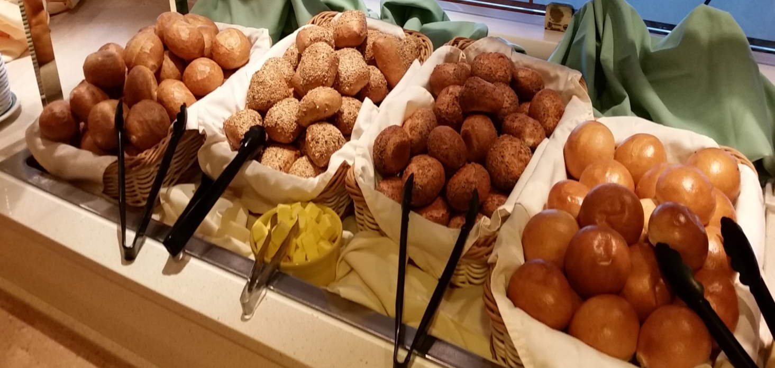
C8 ASSORTED BREAD

Slide 10
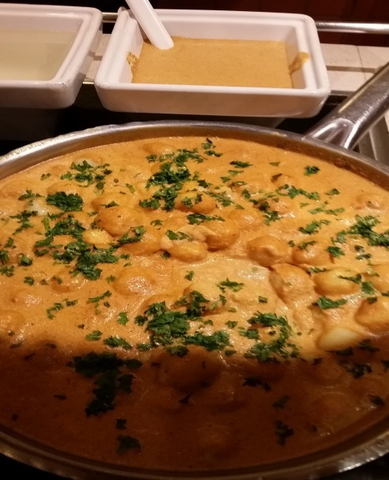
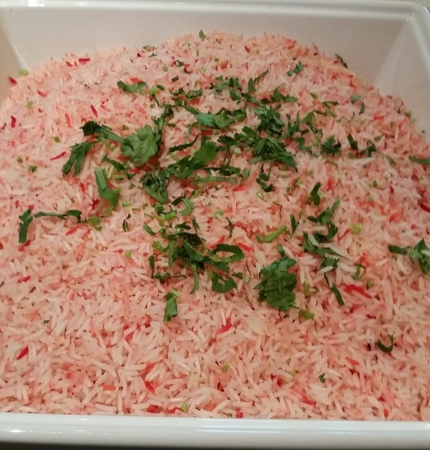
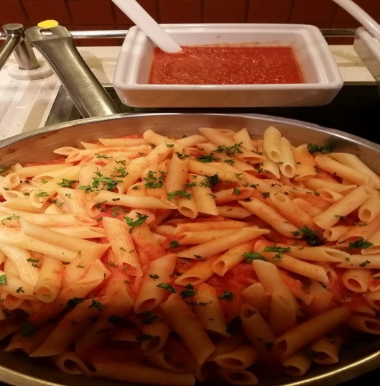
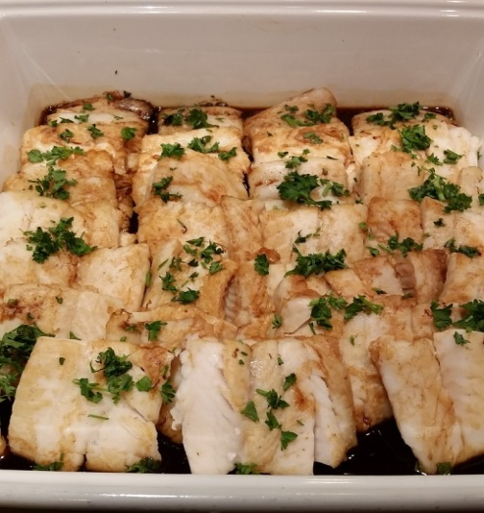
H1 & H 2 Pasta, Biryani and Fish

Slide 11
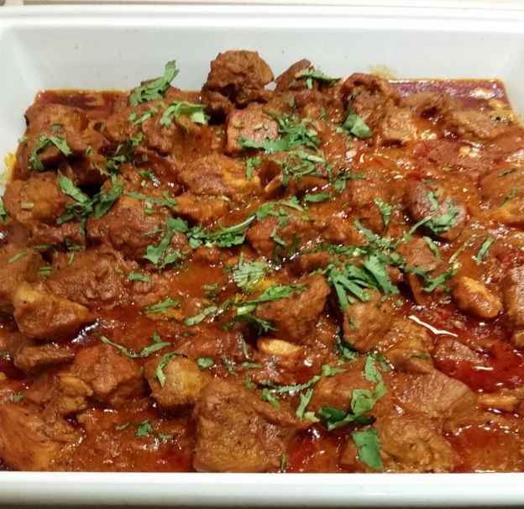
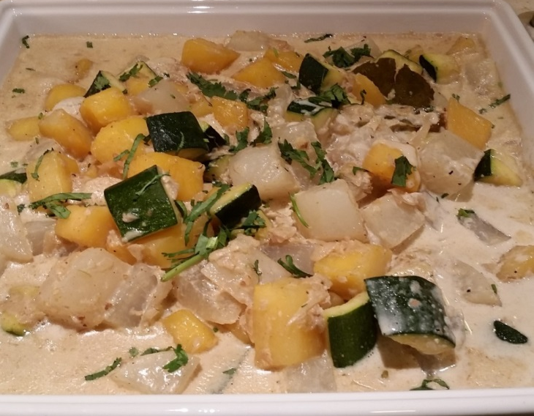
H 3 Pork Vindaloo and Vegetable Korma

Slide 12
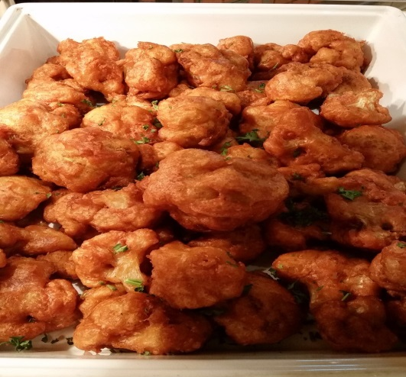
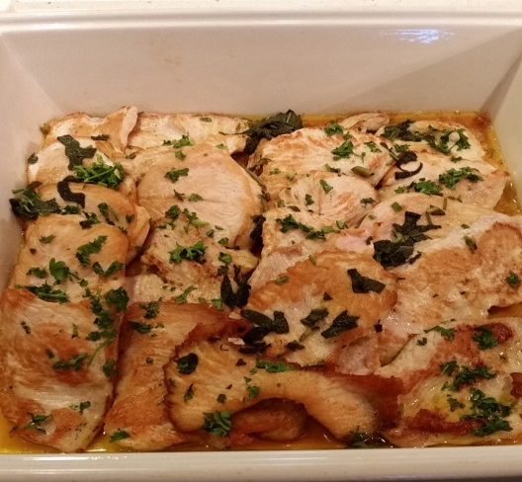
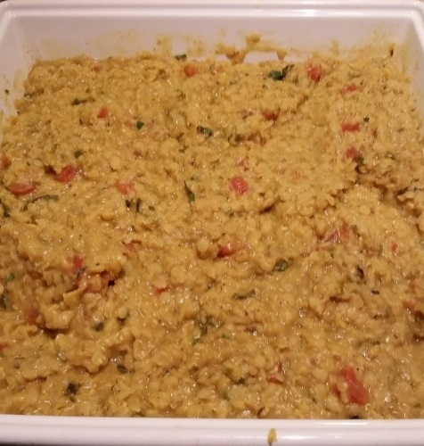
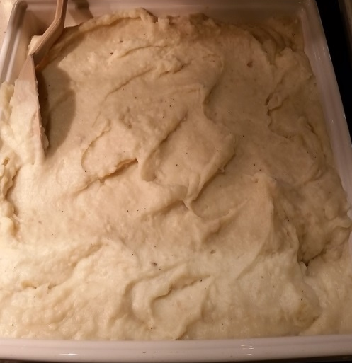
H4 & H5 Fried Cauliflower, Daal Tadka, Turkey Paillard and Mashed Potato

Slide 13
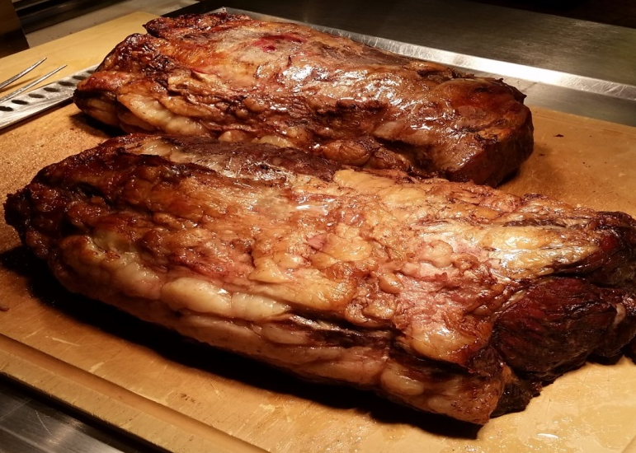
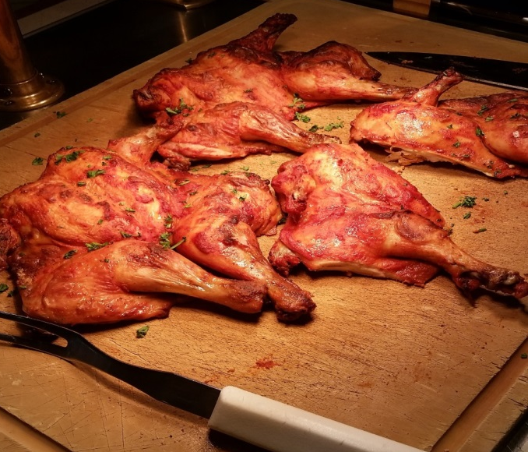
CARVING Prime Rib, Tandoori Chicken

Slide 14
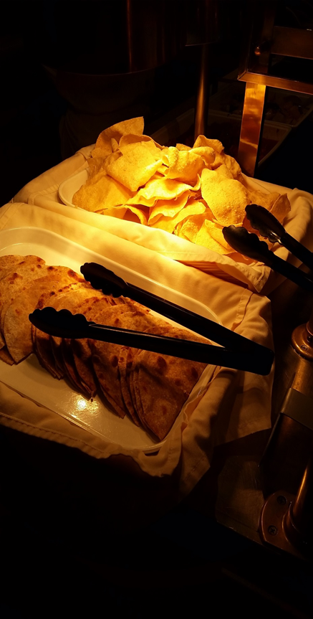
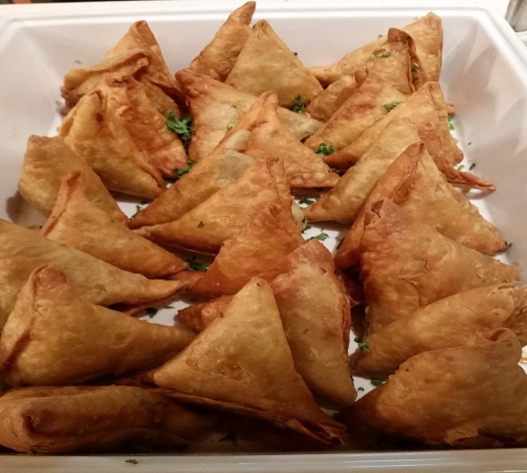
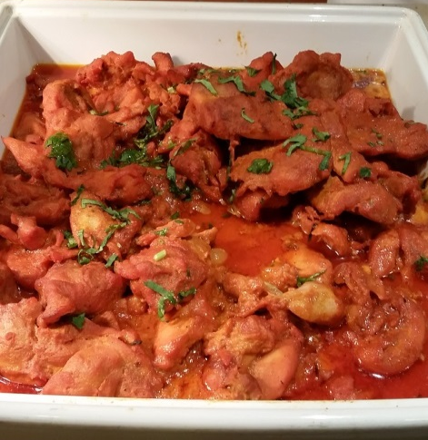
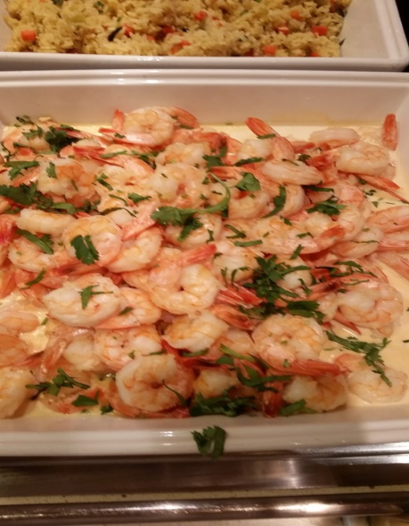
H6 & H7 Naan, Pappadams, Peas and Potato Samosa and Jhinga Madras Style

Slide 15
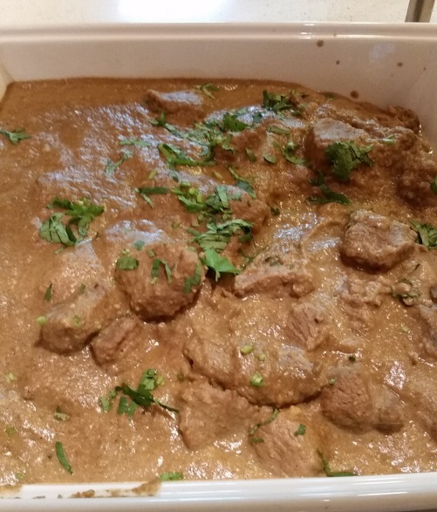
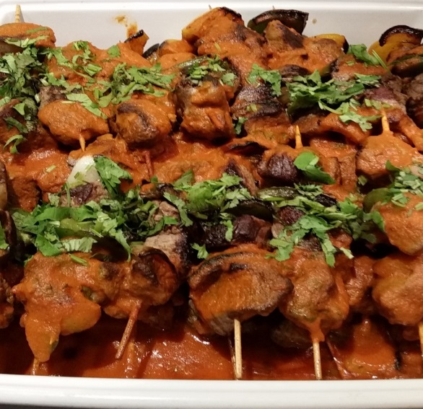
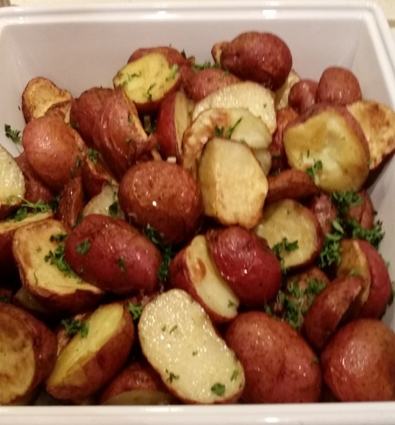
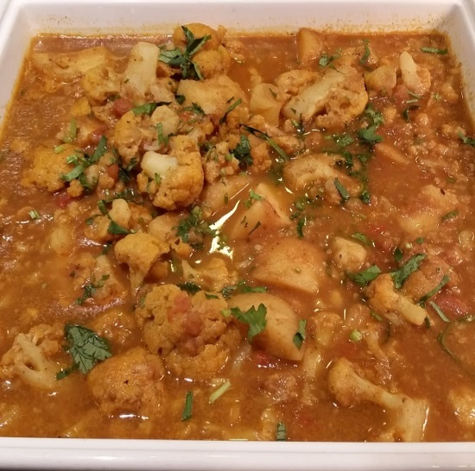
H8 & H9 Lamb Curry, Potato & Cauliflower Curry, Beef & Bell pepper Kebab and Roast Potatoes

Slide 16
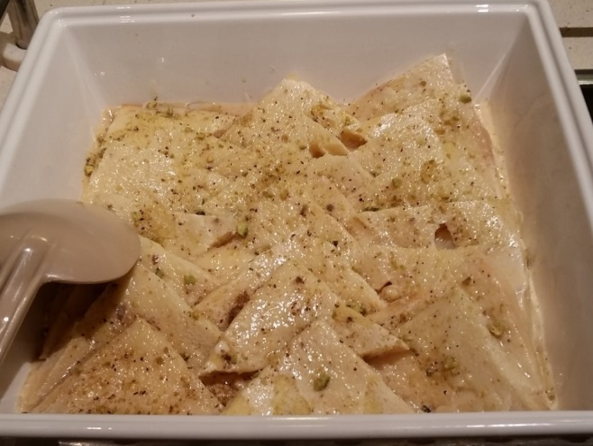
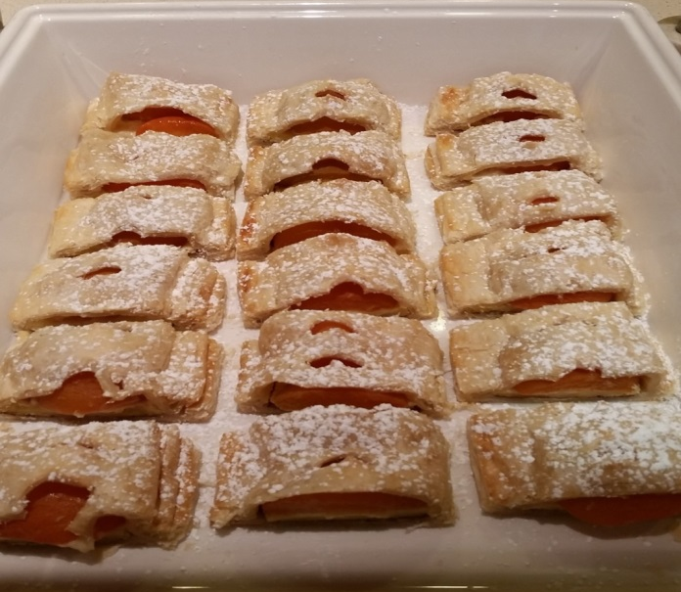
H 10 Hot Dessert

Slide 17
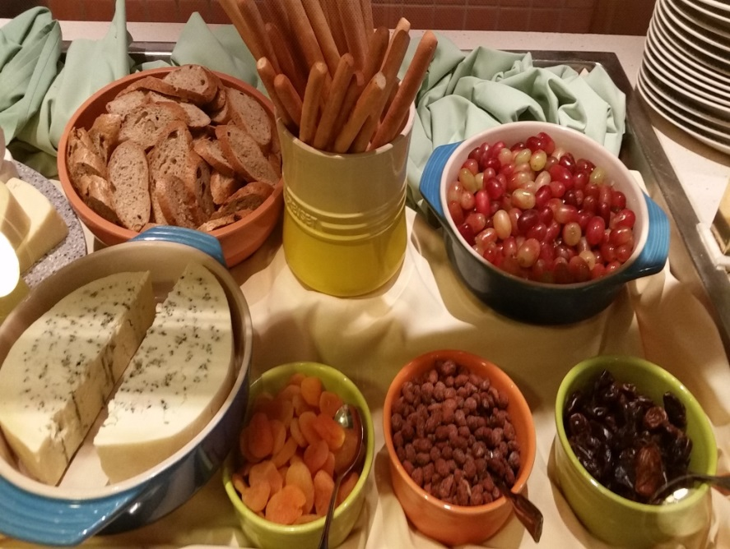
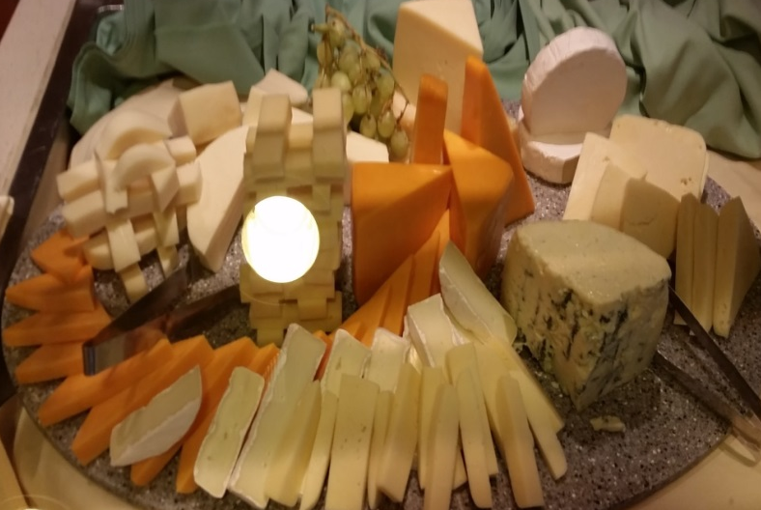
CO Cheese Counter

Slide 18
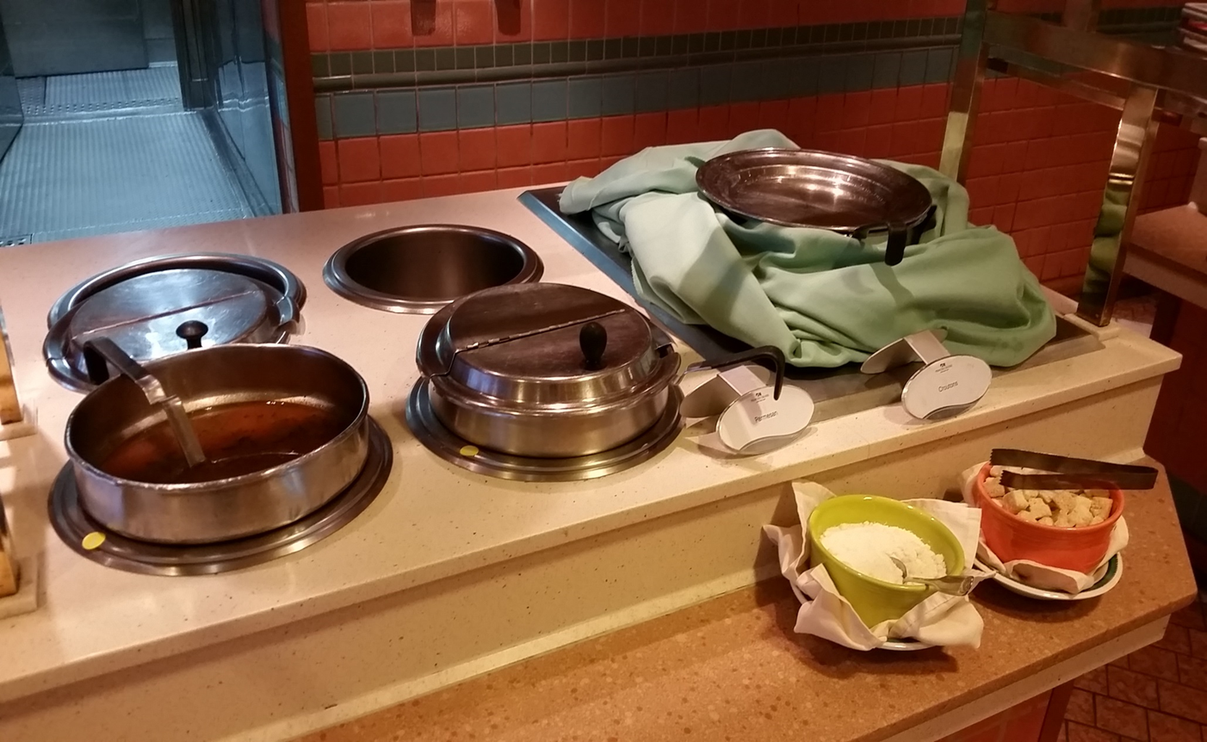
H11 Soup

