Slide 1
H10 Hot Dessert
H9 √ Pork Belly , Roast Country Skin Potatoes
H8 Jerk Chicken , Green, Red and Yellow Peppers Stew
H7 (v) Sautéed Peas and Carrots, Braised Cabbage with Caraway Seeds
H6 Jamaican Lamb Curry , Mashed Potatoes
H5 Buffalo Chicken Wing, Frijoles de la Olla
H4 Bahamian Fish Stew , Johnny cakes , Rice and Beans
H3 La Bandera Beef with rice, (v) Brussels Sprout
H2 Broiled Tilapia Red Curry Sauce , Almond Broccoli
H1 √ Wagon Wheel Pasta with Braised Oxtail Ragout , Pasta Alfredo
Roast Beef Striploin
C6
Pate Maison , Country Style with Pickles
C3
DRESSINGS
C5
DESSERT 5 ASSORTED PASTRY
C4
SALAD BAR
H11
Puerto Rico Asopao Soup Roasted Garlic Cream Soup Chilled Blended Coconut Soup
C0
Assorted Cheese Plates
C8
ASSORTED BREAD ,
C1
(v) Tomato Celery Apple and Crab Salad , Pate Maison , Country Style with Pickles, Cucumber Salad
C7
SLICE FRUIT and Fresh Fruits
C2
Three types of Cold cuts depends on Available
exit
entrance
C0:_ 2nd Commis
C1 – C4:___2nd Commis
C5 – C8:__ 1st Commis
H1 – H5:___2nd Commis
H11:____2nd Commis
CARVING:_ 2nd Commis
H6 – H10:__2nd Commis
HOT FILLER:__DCDP
COLD FILLER:___1st Commis
GAZEBO:__DCDP
INSIDE RUNNER:_2nd Commis
STARBOARD SIDE DINNER Caribbean Day 03

Slide 2
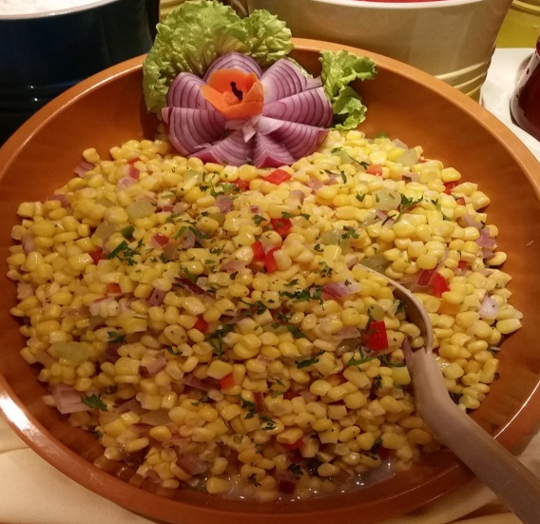
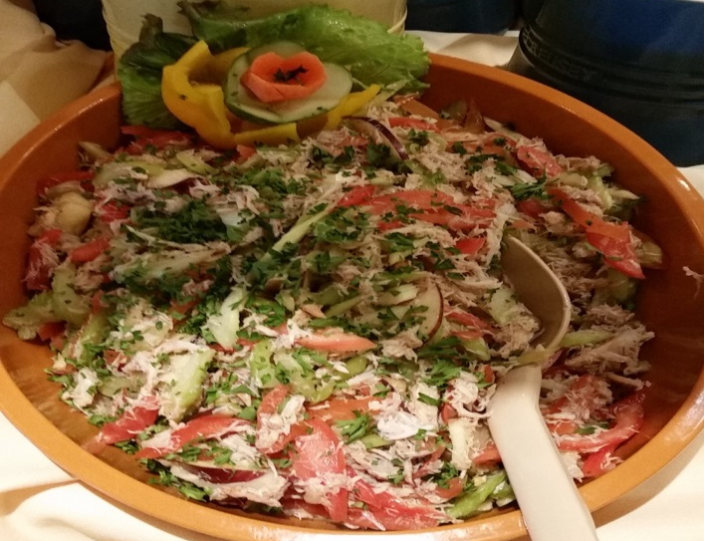
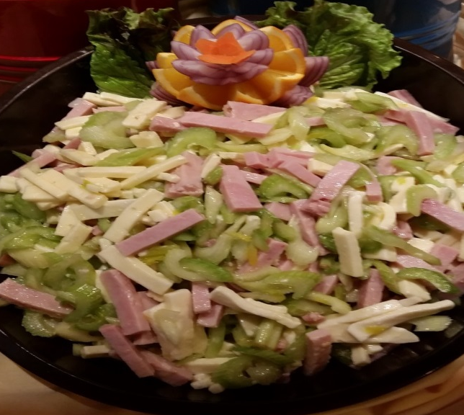
C 1 Compote Salad

Slide 3
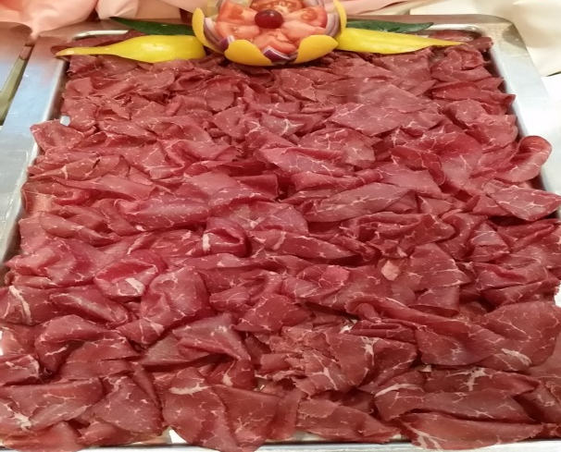
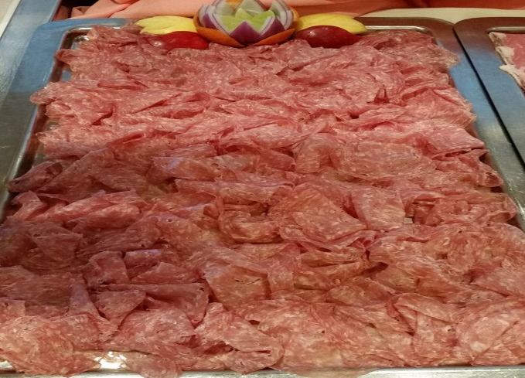
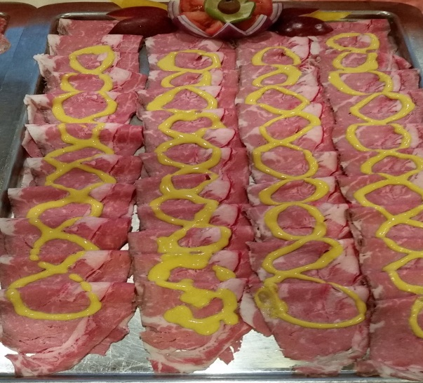
C 2 Assorted Cold Cuts

Slide 4
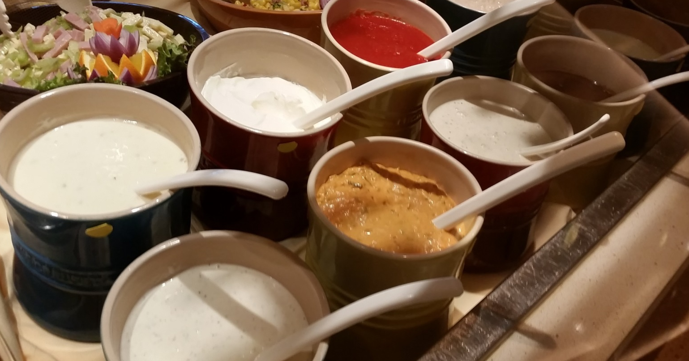
C3 DRESSING

Slide 5
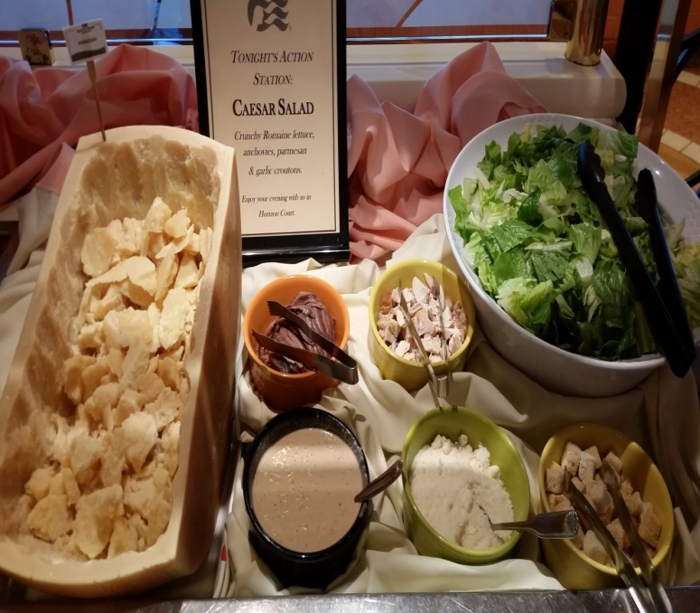
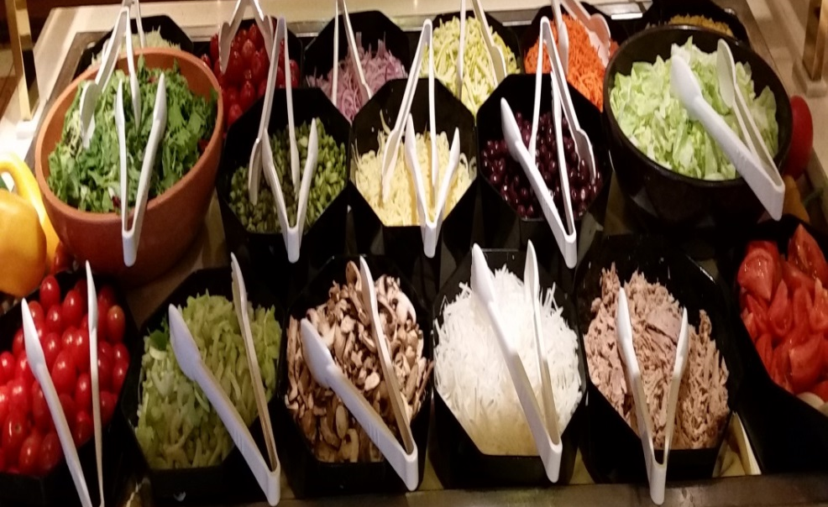
C4 SALAD BAR

Slide 6
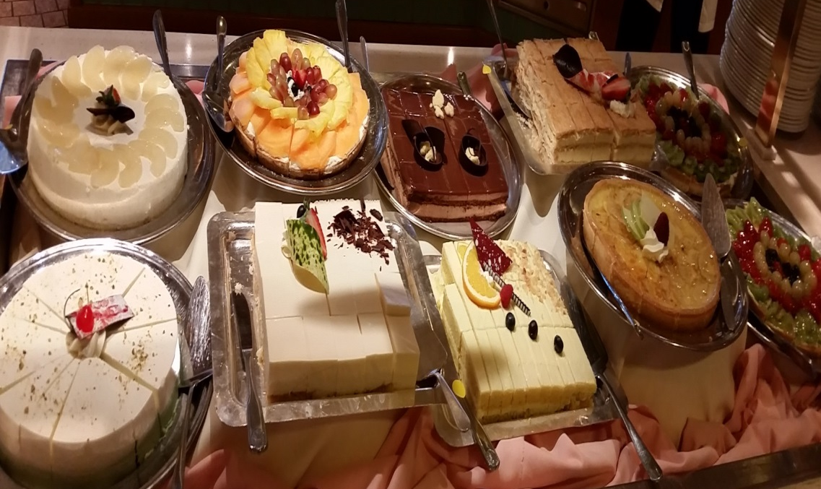
C5 DESSERT ASSORTED PASTRY

Slide 7
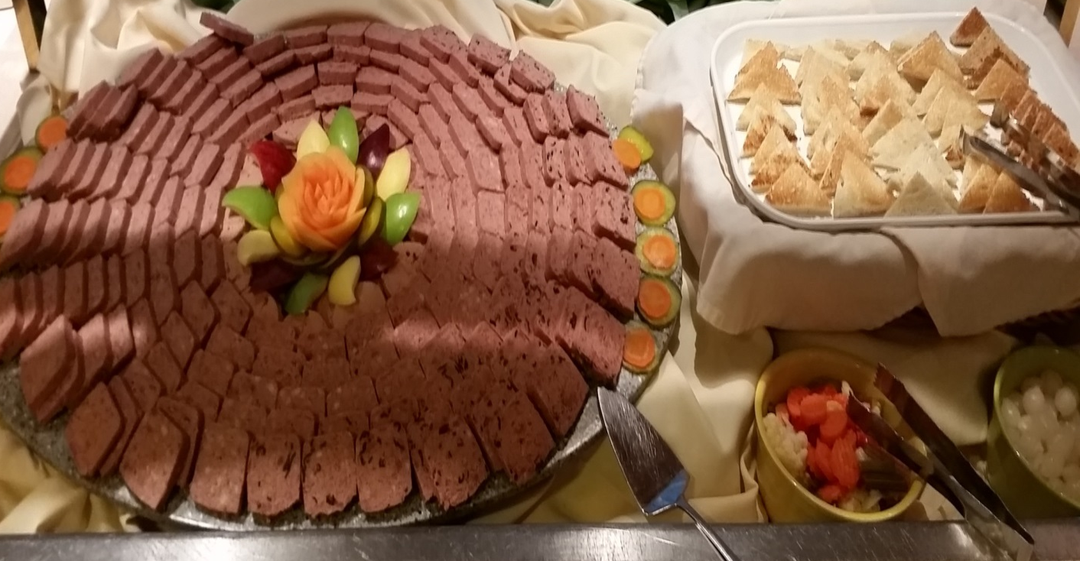
C6 PATE MAISON, COUNTRY STYLE WITH PICKLES

Slide 8
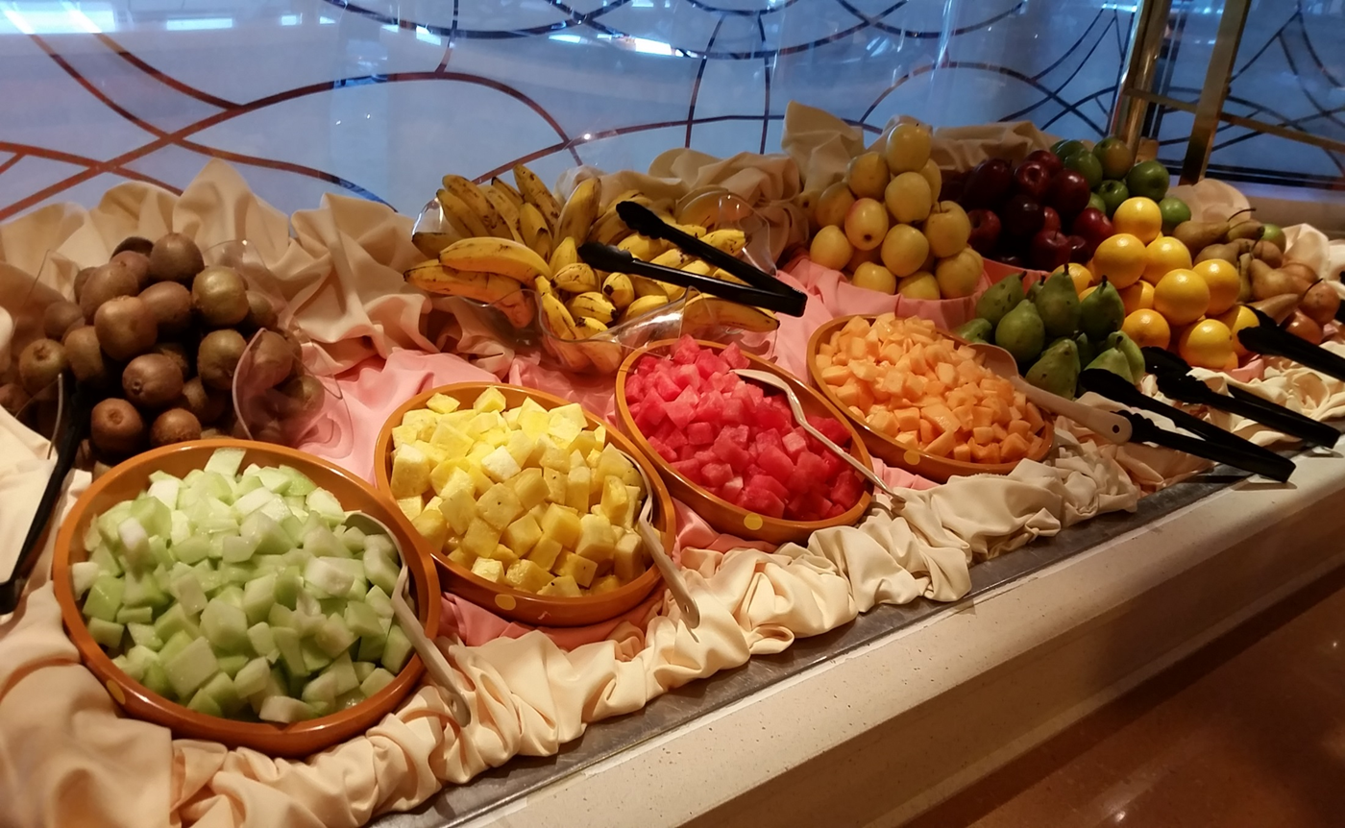
C7 Sliced Assorted Fruit and Fresh Fruit

Slide 9
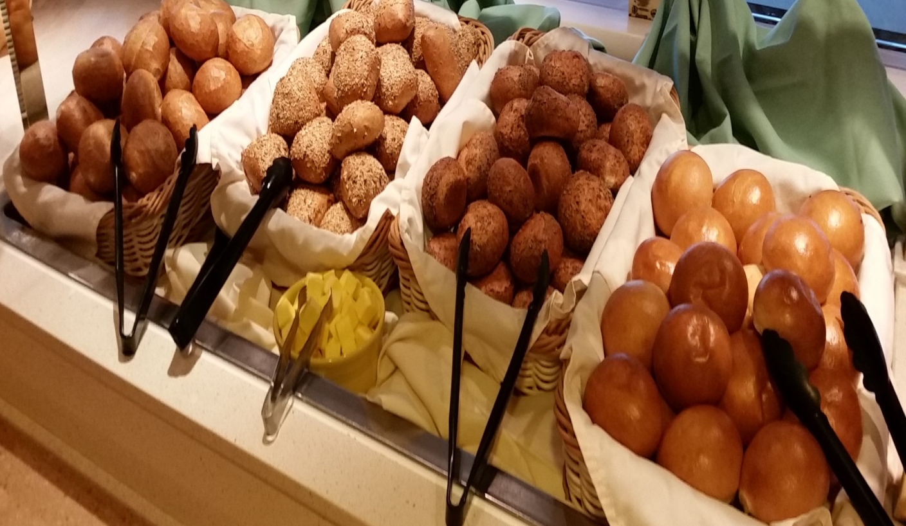
C8 ASSORTED BREAD

Slide 10
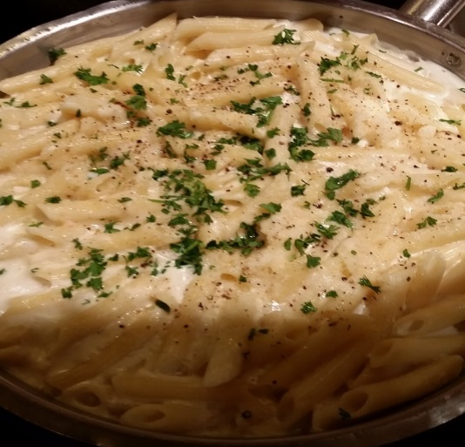
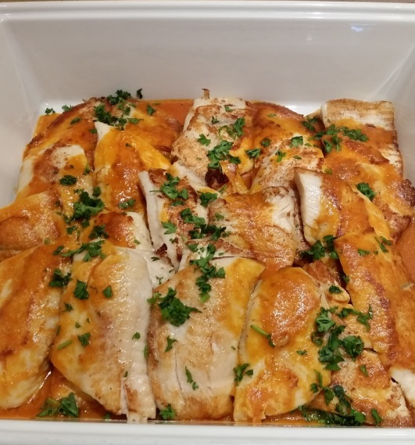
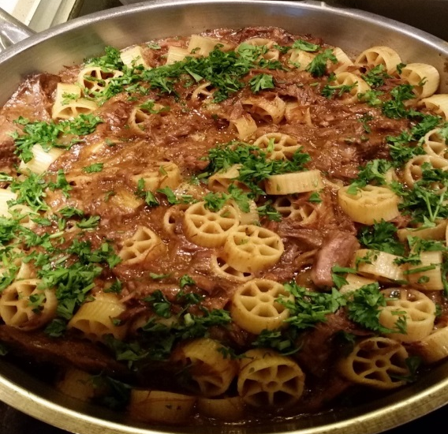
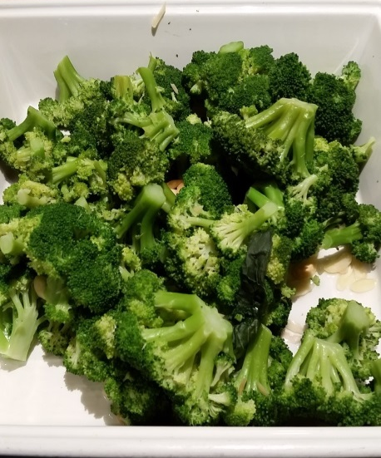
H1 & H 2 PASTA, FISH & ALMOND BROCCOLI

Slide 11
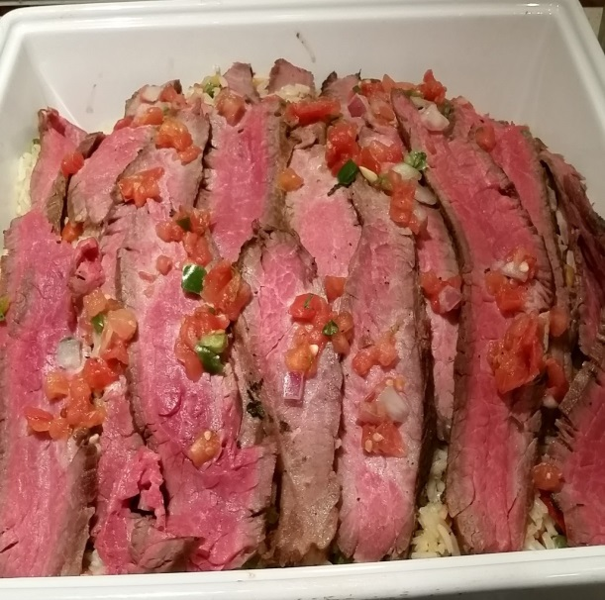
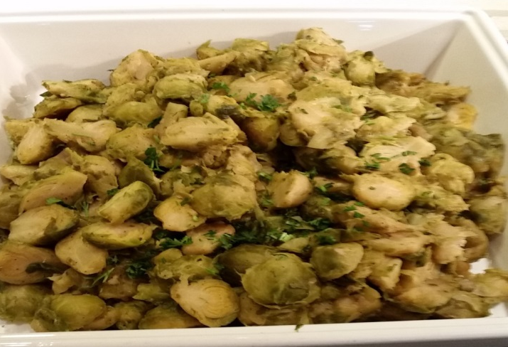
H 3 La Bandera Beef & Brussels Sprouts

Slide 12
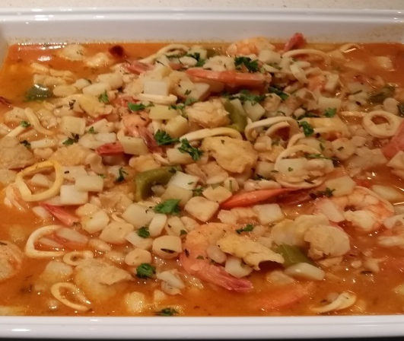
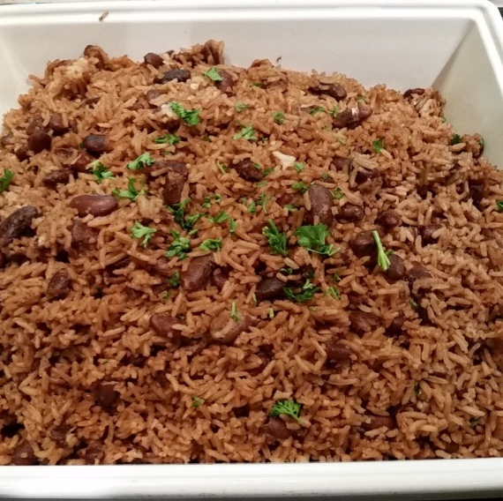
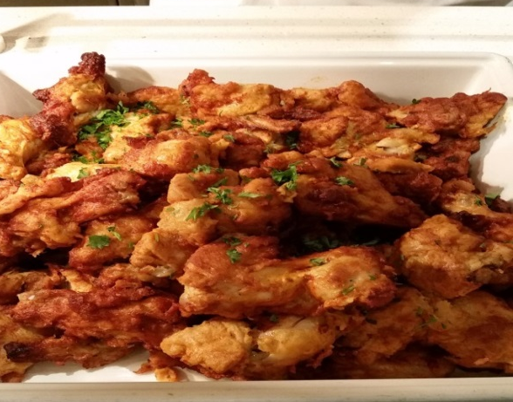
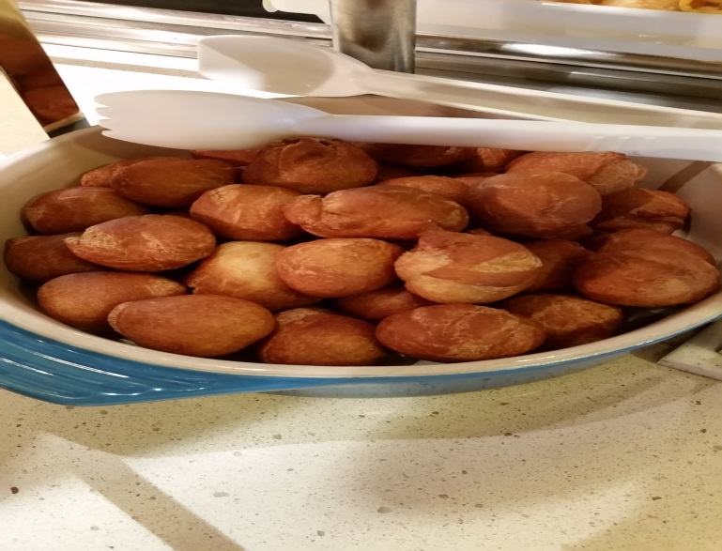
H4 & FISH STEW, RICE & CHICKEN WINGS

Slide 13
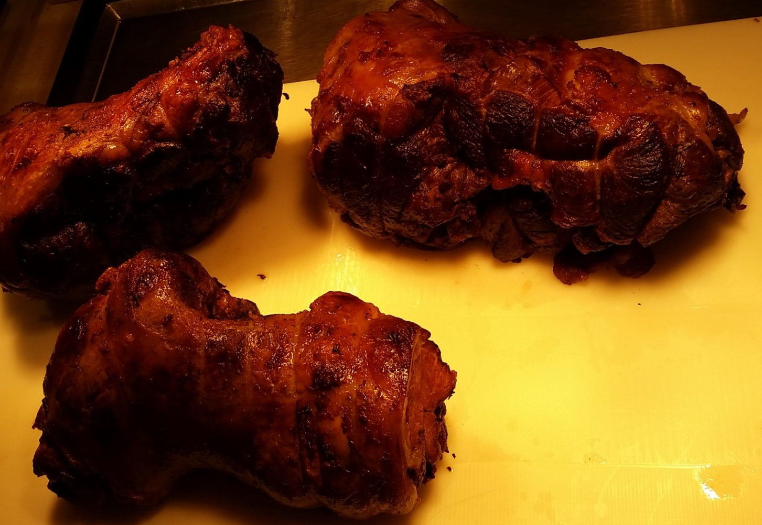
CARVING

Slide 14
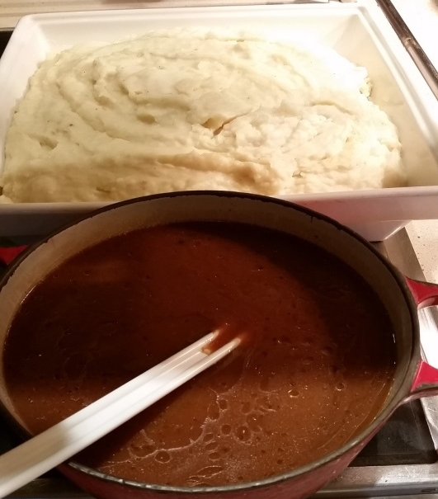
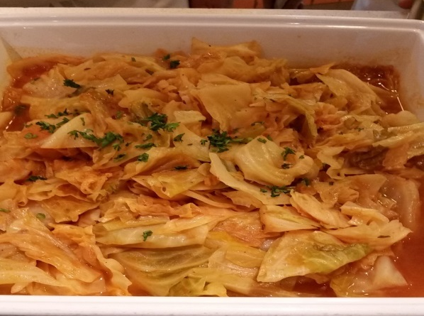
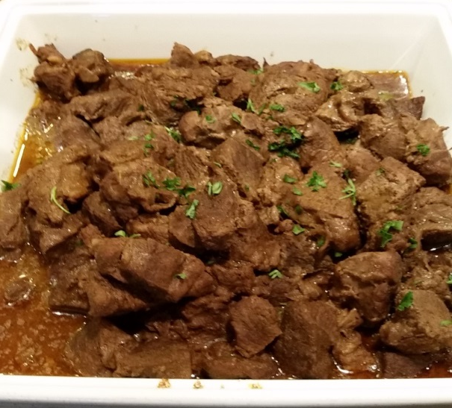
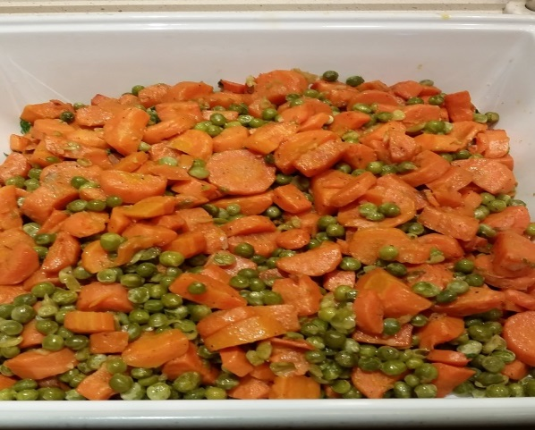
H6 & H7 Lamb curry, Mashed Potato and Cabbage, Sautéed Peas and Carrots

Slide 15
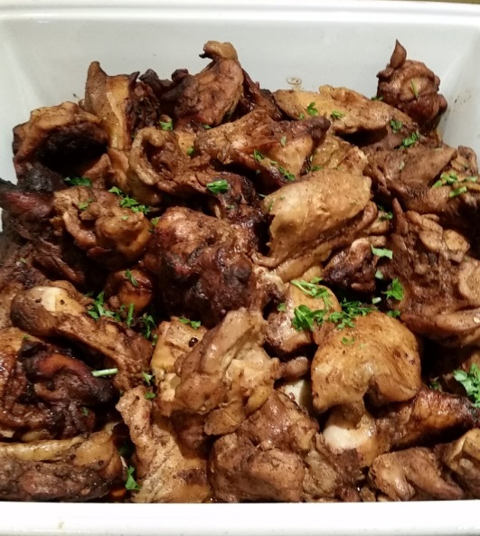
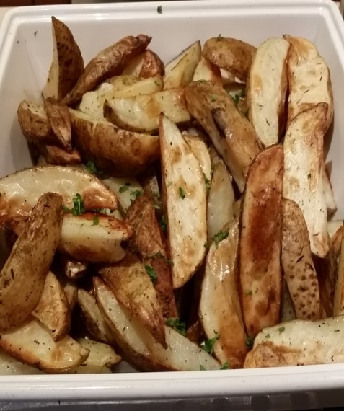
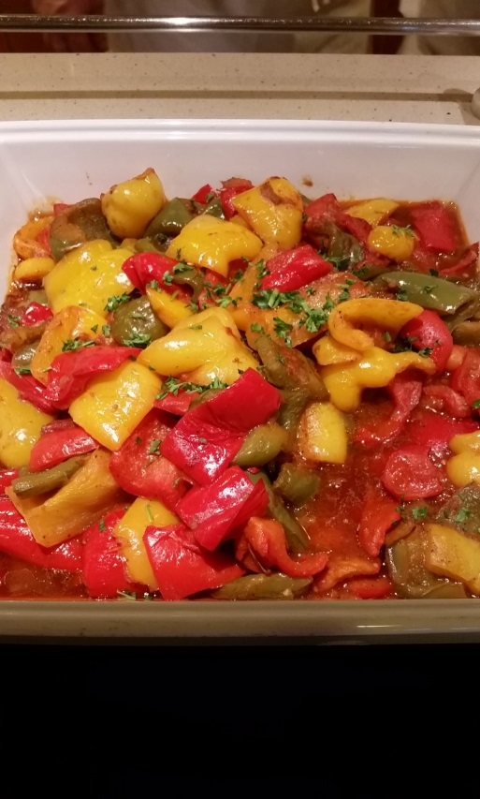
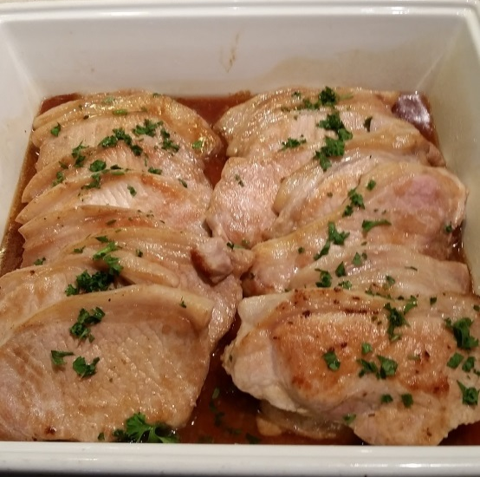
H8 & H9 Roast Chicken, Yellow and Red Peppers Stew, Pork Belly & Skin Potatoes

Slide 16
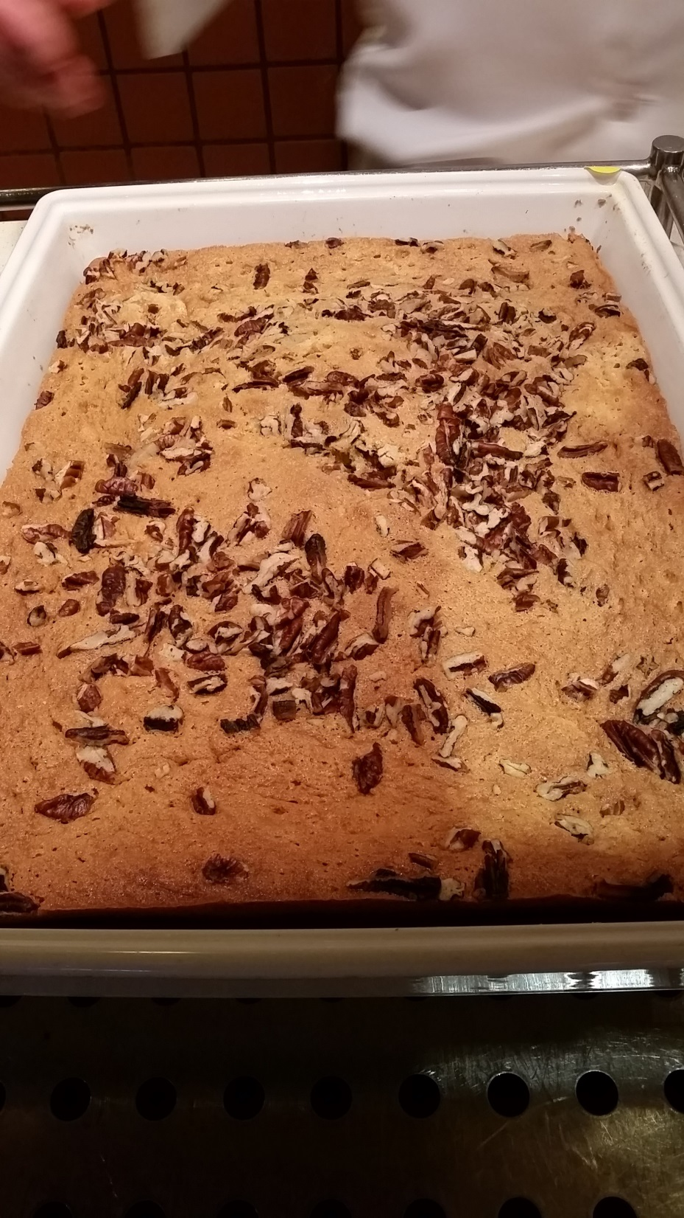
H 10 Hot Dessert

Slide 17
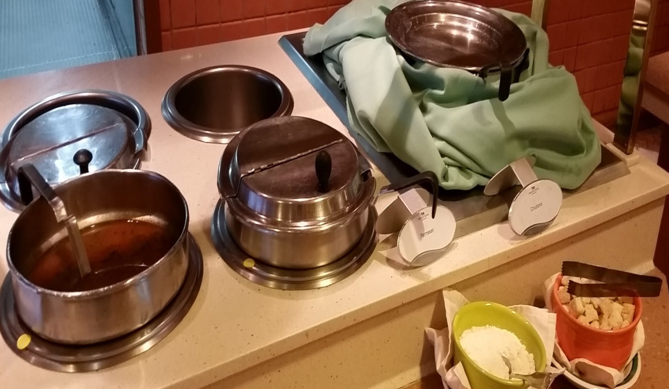
H11 Soup

Slide 18
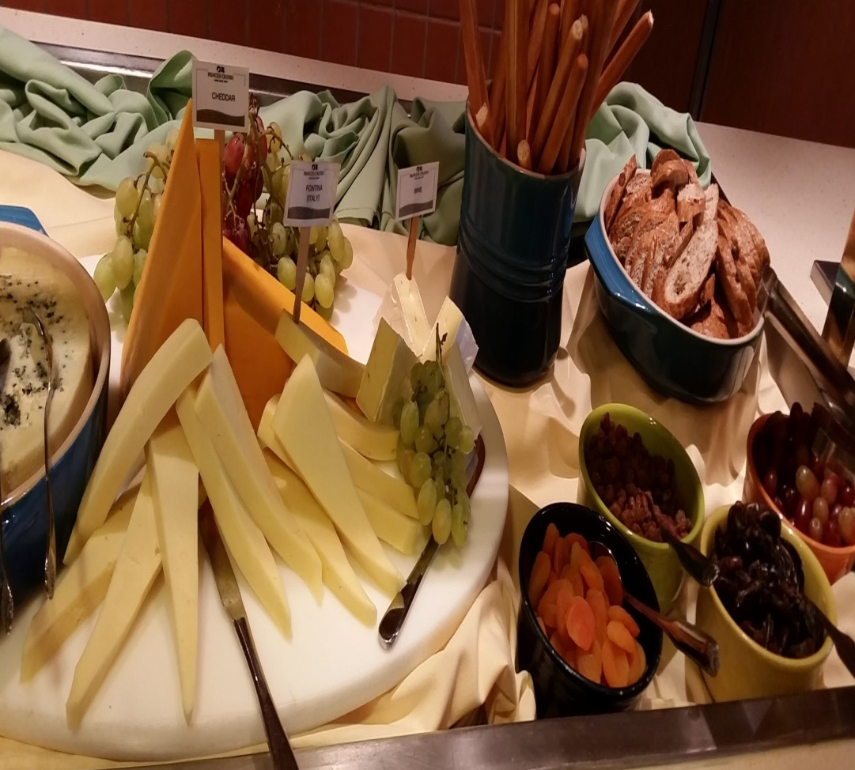
CO Assorted Cheese Plates

