Slide 1
H10 Hot Dessert
H9 √ Lentil and Pilaf Rice, √ Roast Potatoes with Garlic and Rosemary
H8 Grilled Lamb Chops, Vegetable Ratatouille
H7 Braised Short Ribs Vegetable Brunnoise , Corn Bread Coated Fried Eggplant
H6 Pork Tenderloin Medallions Chardonnay Wine Jus, Pesto Mashed Potatoes + Gravy
H5 Broiled Chicken Bacon, Mushy Peas
H4 Green Mussels Creole , Provençale Tomato with Chopped Parsley & Basil
H3 Nantucket Sautéed Shrimp & Tomato Broth, Vichy Carrots
H2 Salmon with Lemon Butter Sauce, Braised Swiss Chard
H1 Meat Ravioli with Porcini Mushrooms Sauce, Penne Cherry Tomato Julienne Spinach
Beef Wellington , Truffle-Madeira Demi-Glace
C6
Assorted Pate with Pickled
C3
DRESSINGS
C5
DESSERT 5 ASSORTED PASTRY
C4
SALAD BAR
H11 Roasted Tomato Cream Soup Jamaican Pepper Pot Soup
C0
Assorted Cheese Plates
C1
Vegetarian Thai Wrap with Spring Onions, Tofu, Rice Vinegar , Marinated Mushrooms , Tomato and Asparagus, Surimi Salad
C8
ASSORTED BREAD ,
C7
SLICE FRUIT and Fresh Fruits
C2
Cold Cuts
exit
entrance
C0:_ 2nd Commis
C1 – C4:___2nd Commis
C5 – C8:__ 1st Commis
H1 – H5:___2nd Commis
H11:____2nd Commis
CARVING:_ 2nd Commis
H6 – H10:__2nd Commis
HOT FILLER:__DCDP
COLD FILLER:___1st Commis
GAZEBO:__DCDP
INSIDE RUNNER:_2nd Commis
STARBOARD SIDE DINNER Captain Gala

Slide 2
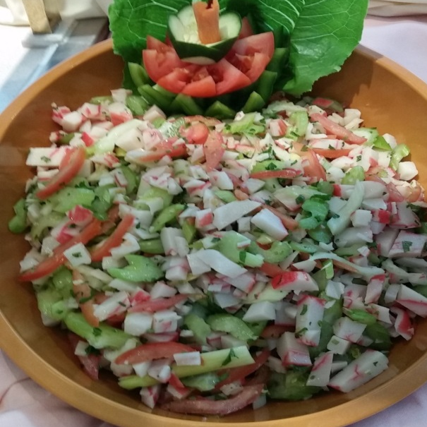
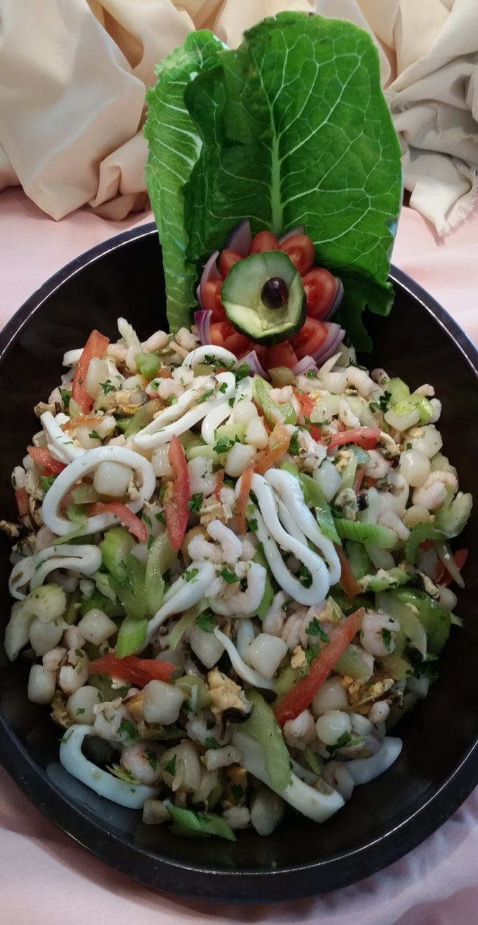
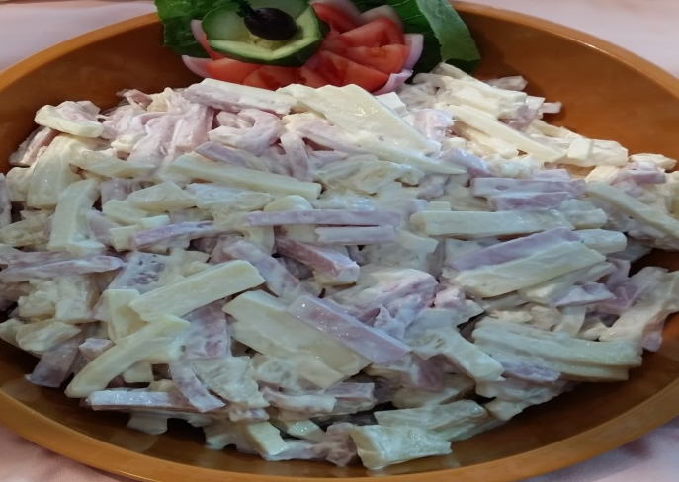
C 1 Compote Salad

Slide 3
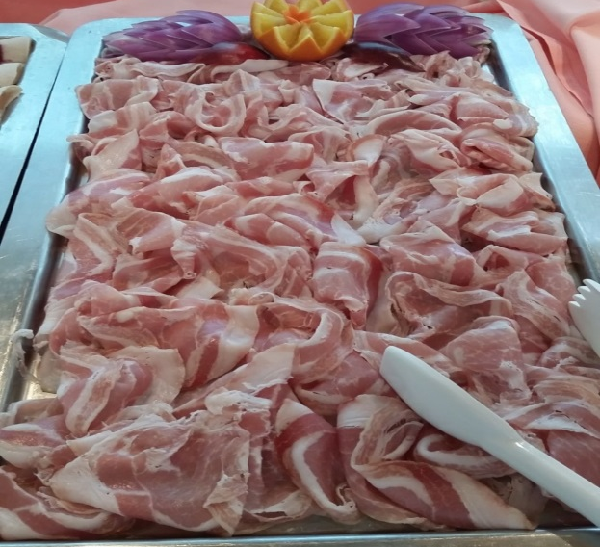
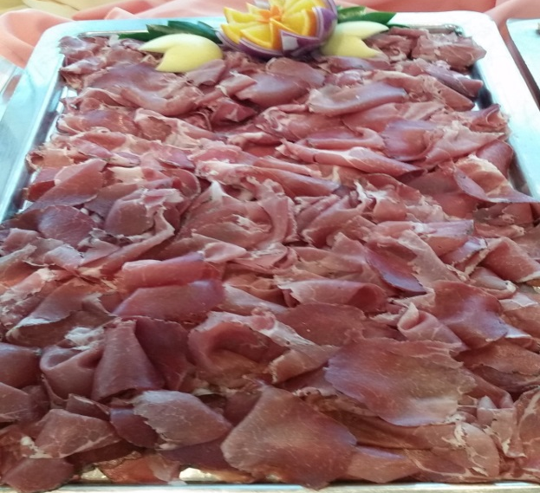
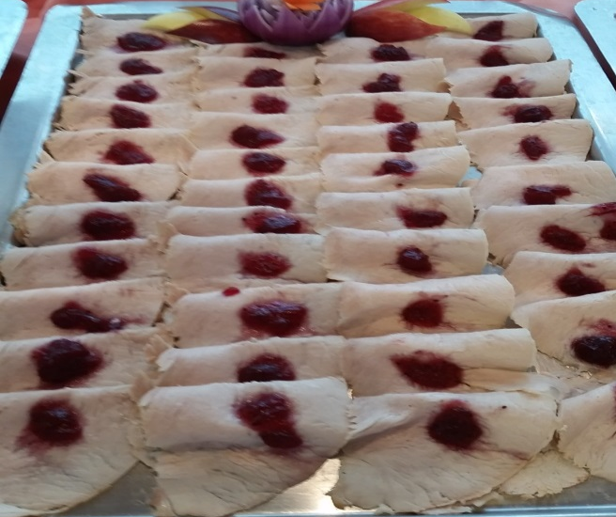
C 2 Assorted Cold Cuts

Slide 4
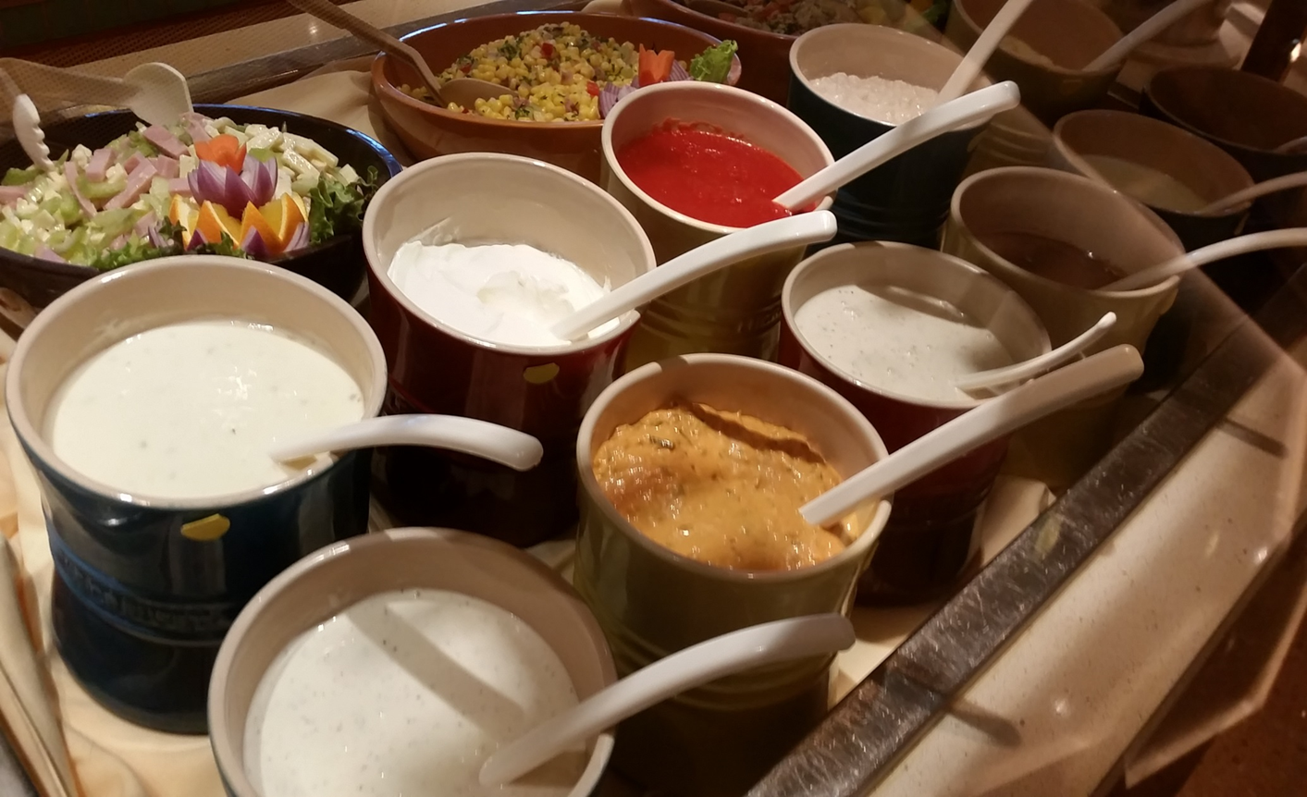
C3 DRESSING

Slide 5
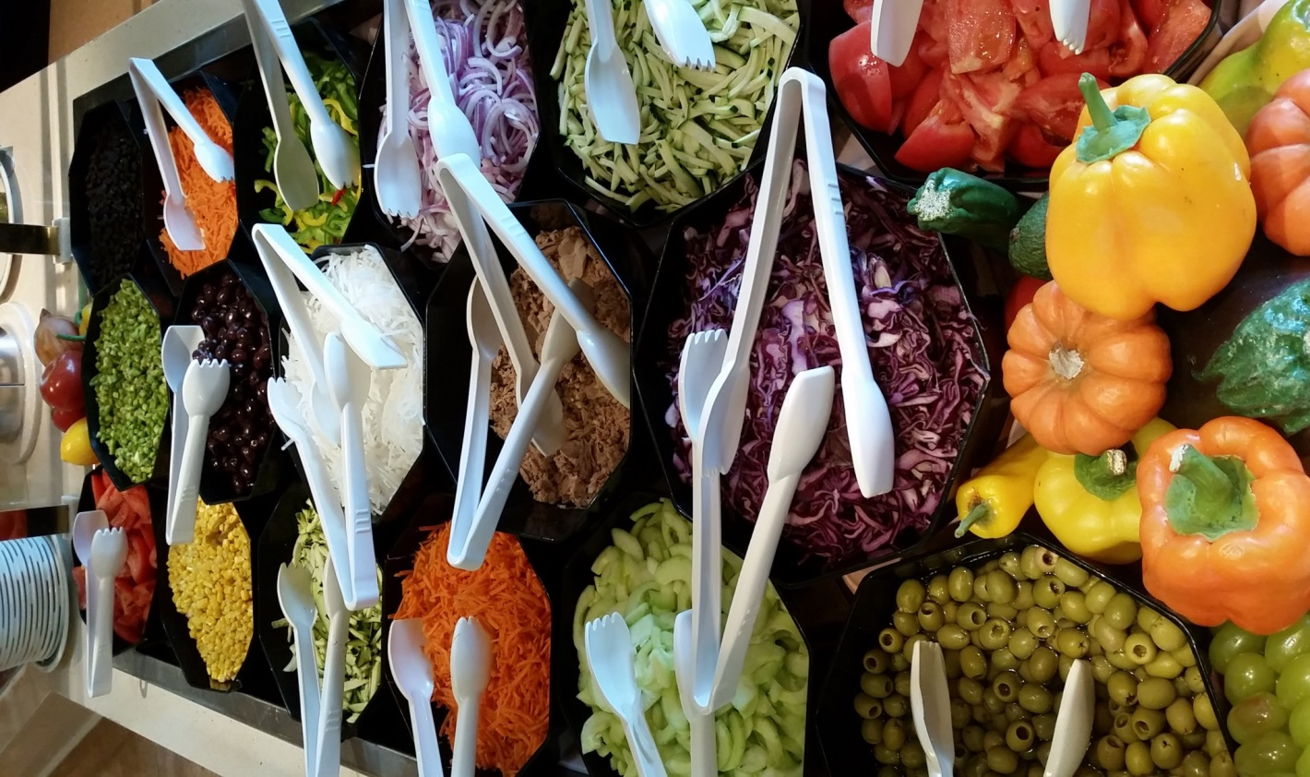
C4 SALAD BAR

Slide 6
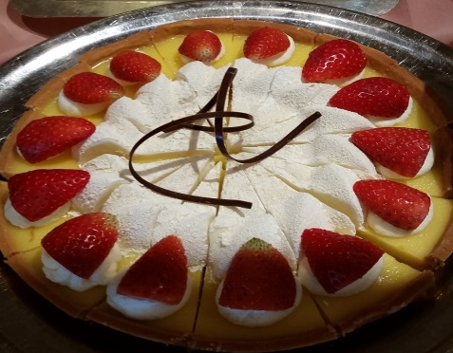
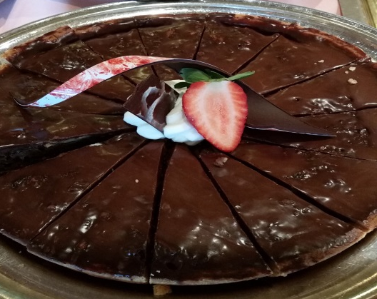
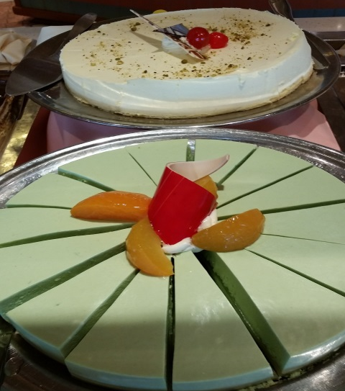
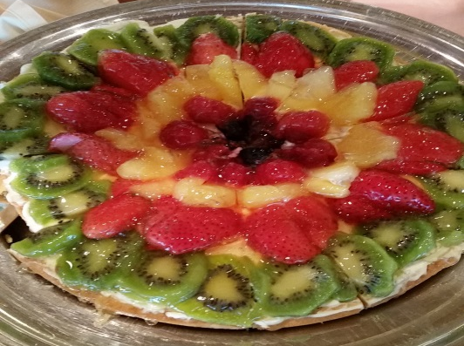
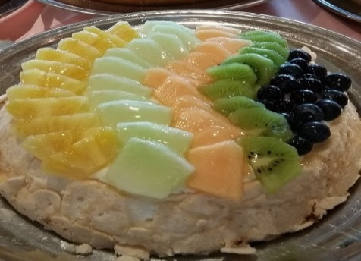
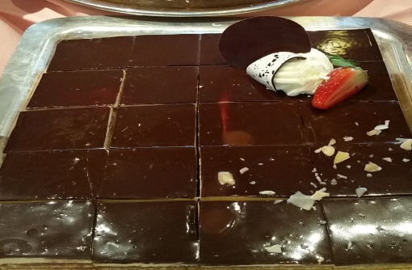
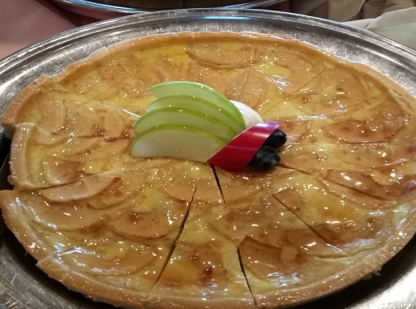
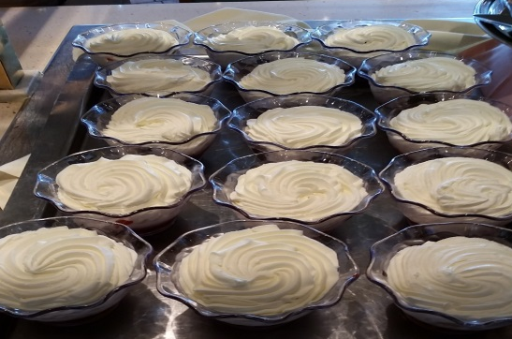
C5 DESSERT ASSORTED PASTRY

Slide 7
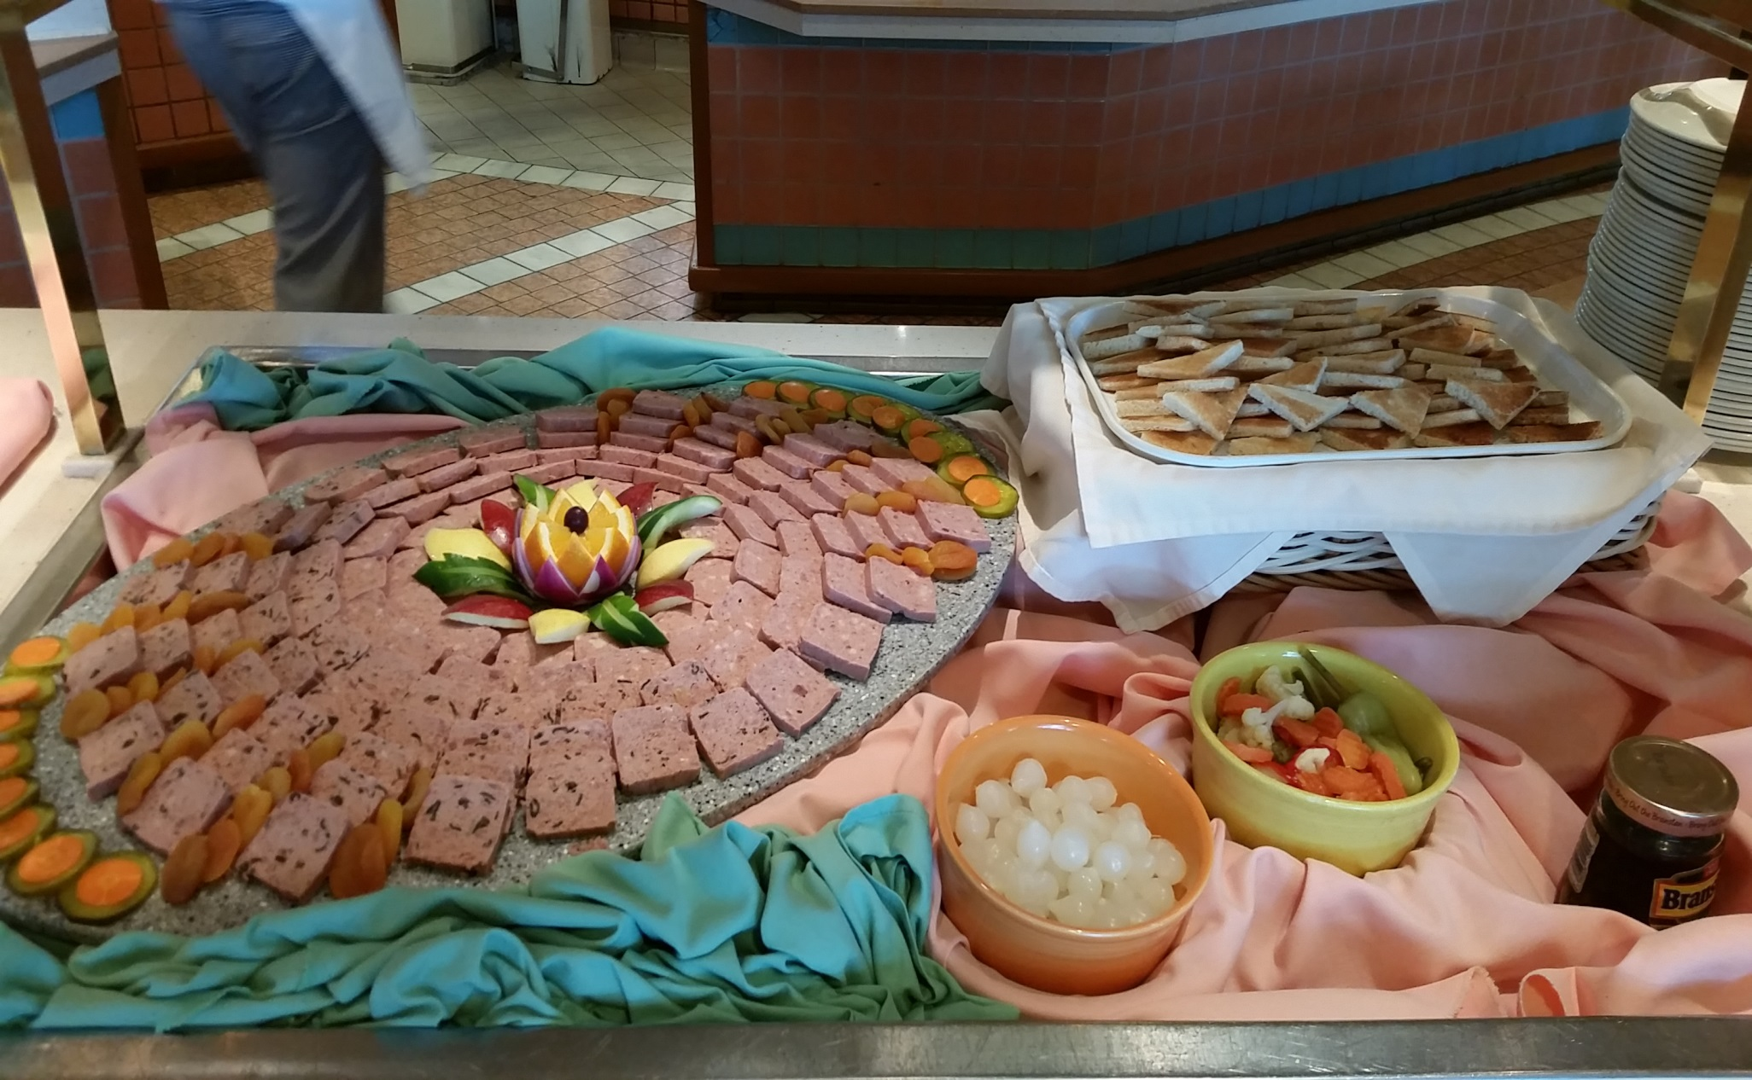
C6 PATE AND PICKLED

Slide 8
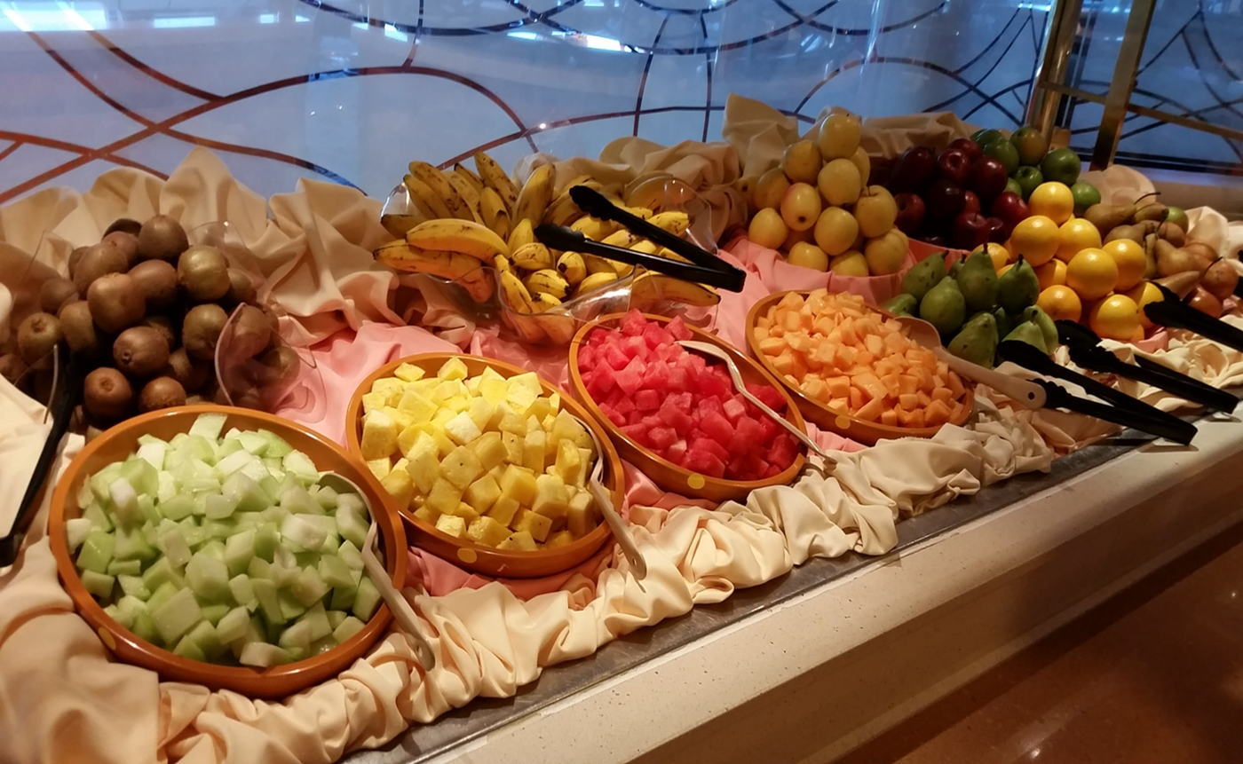
C7 Sliced Assorted Fruit and Fresh Fruit

Slide 9
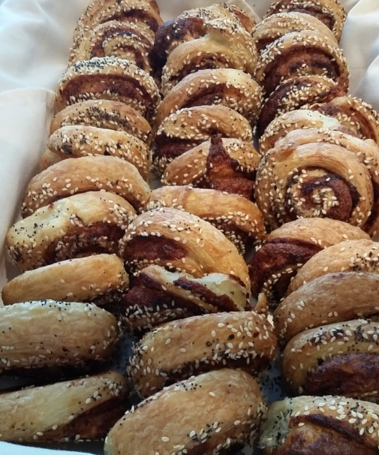
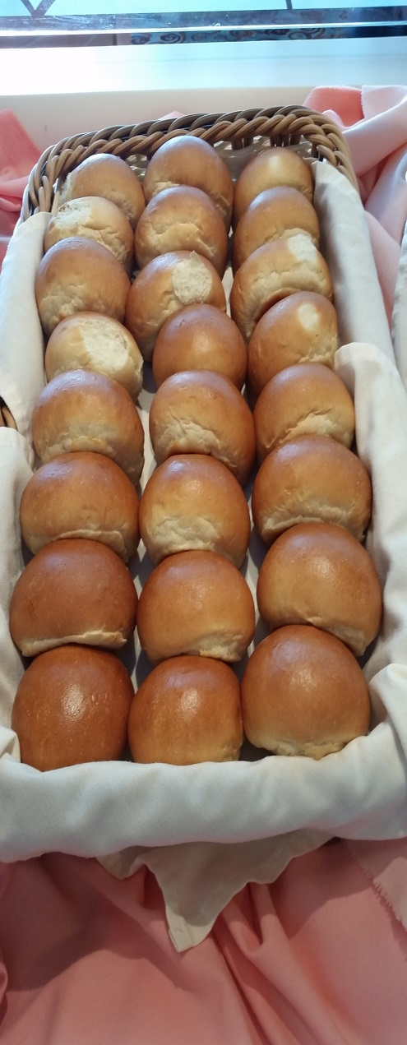
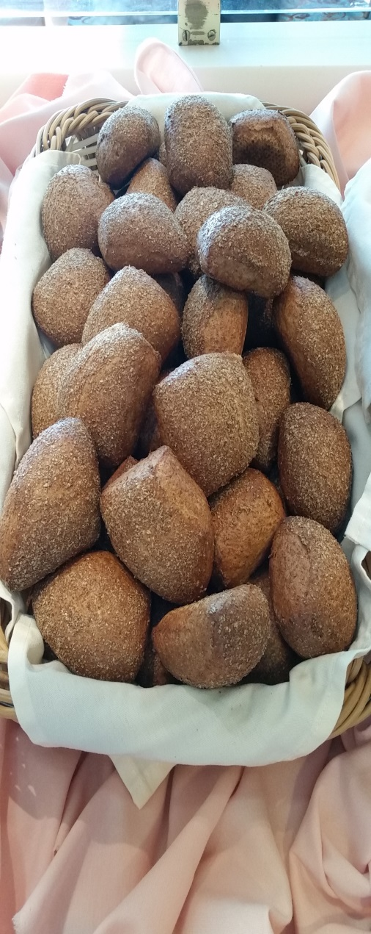
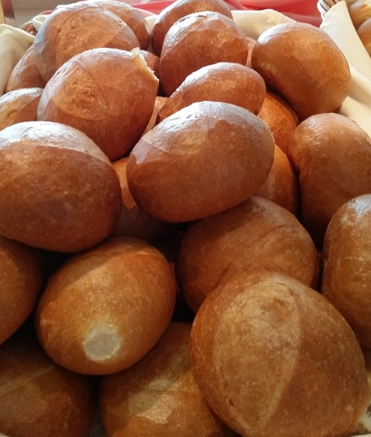
C8 ASSORTED BREAD

Slide 10
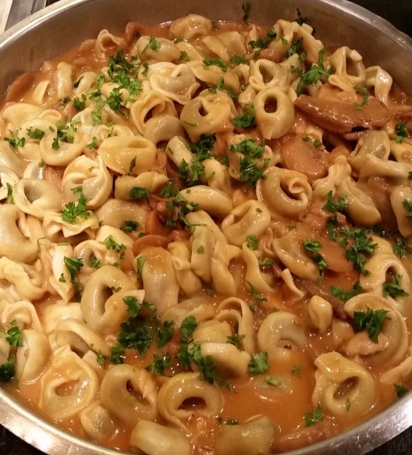
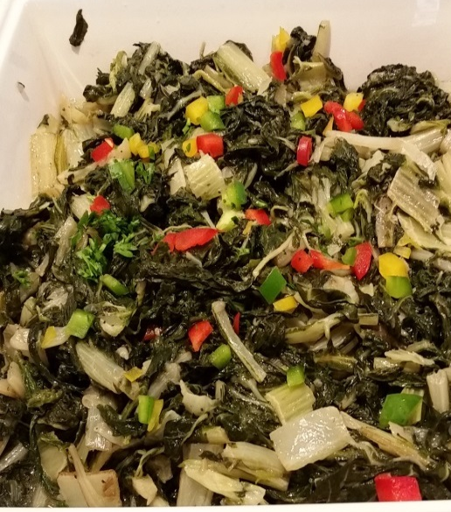
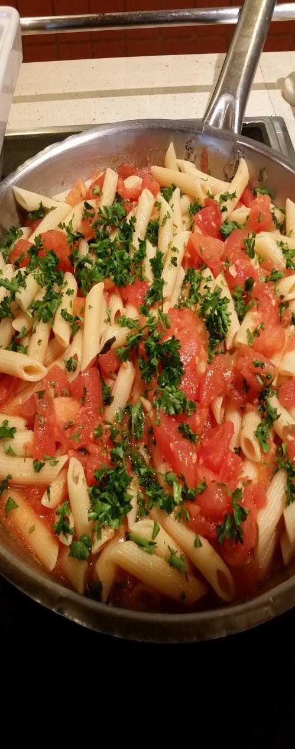
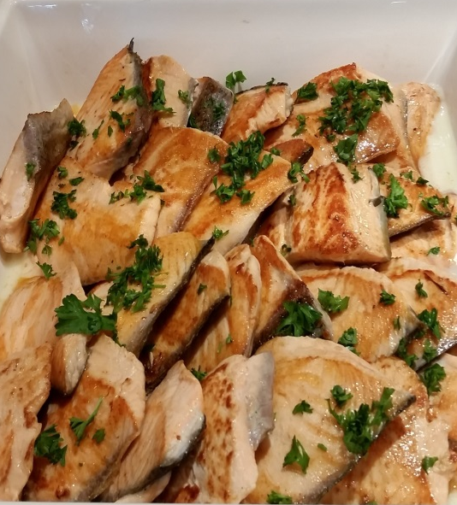
H1 & H 2 Pasta, Braised Swiss Chard and Salmon with lemon Butter

Slide 11
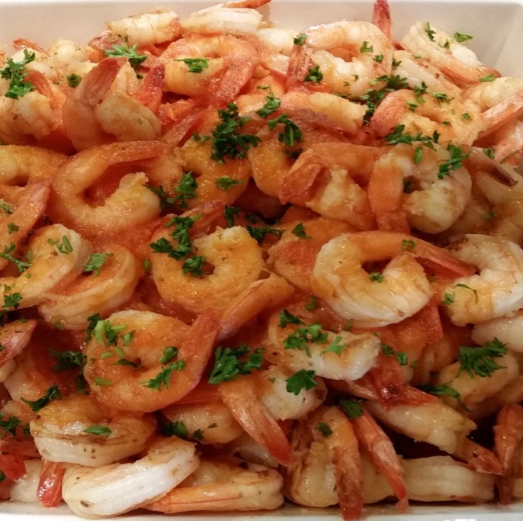
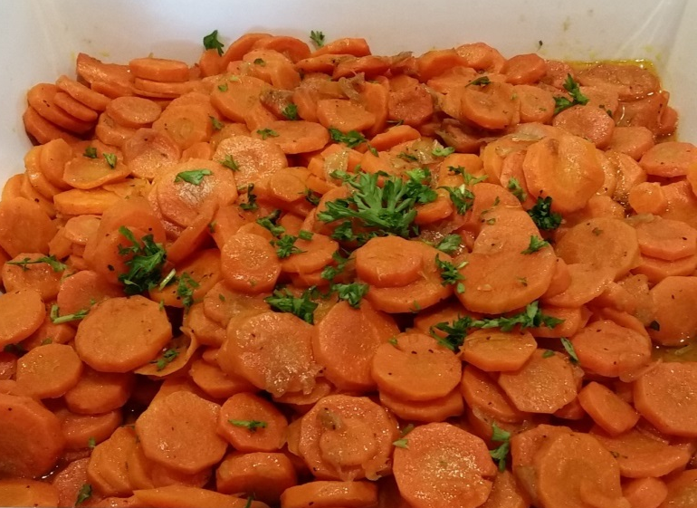
H 3 Nantucket Sautéed Shrimp & Tomato Broth, Vichy Carrots

Slide 12
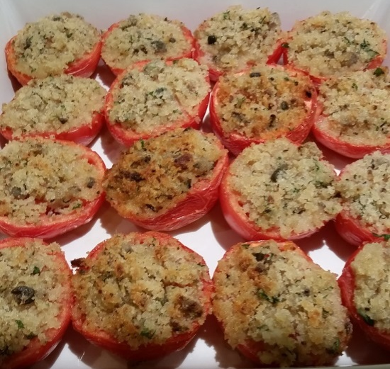
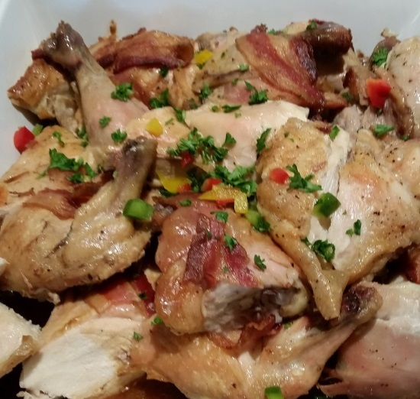
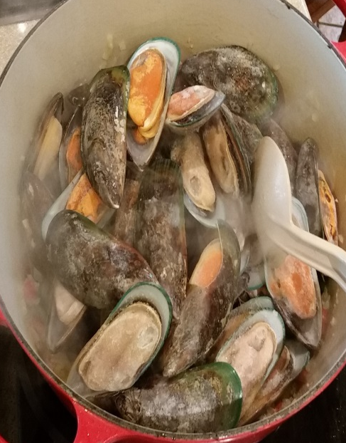
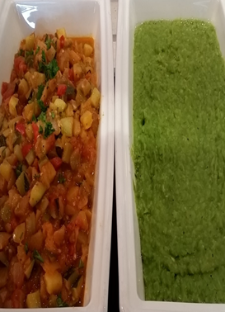
H4 & H5 Green Mussels Creole , Provençale Tomato, Chicken and Mushy Peas

Slide 13
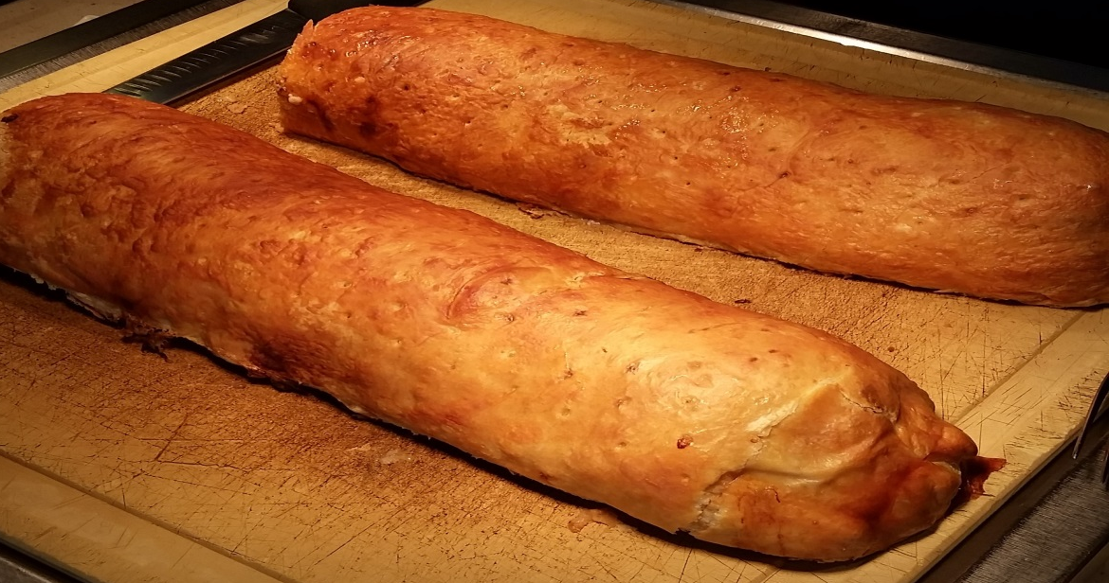
CARVING Beef Wellington , Truffle-Madeira Demi-Glace

Slide 14
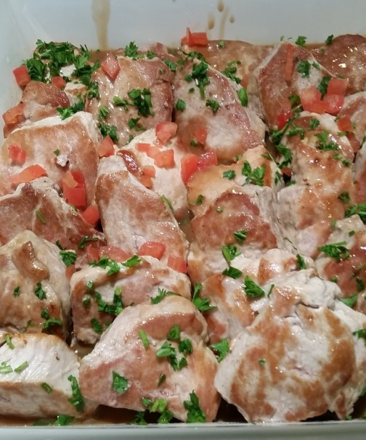
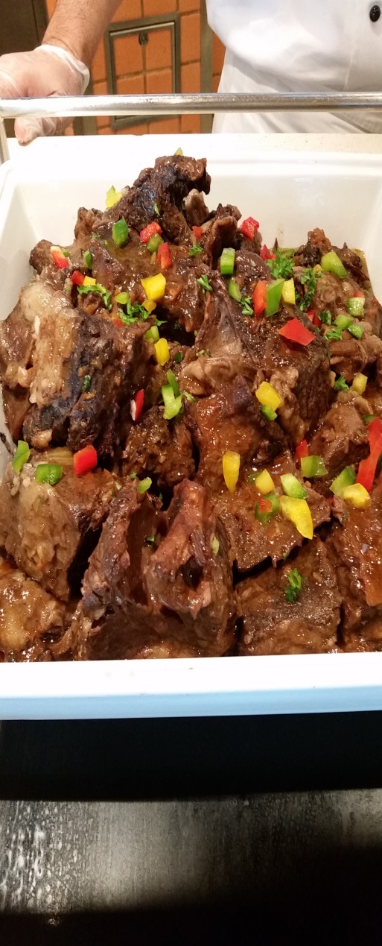
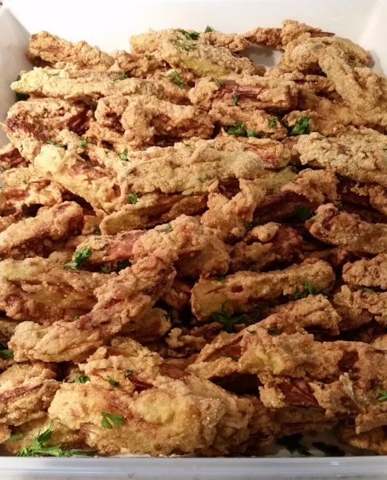
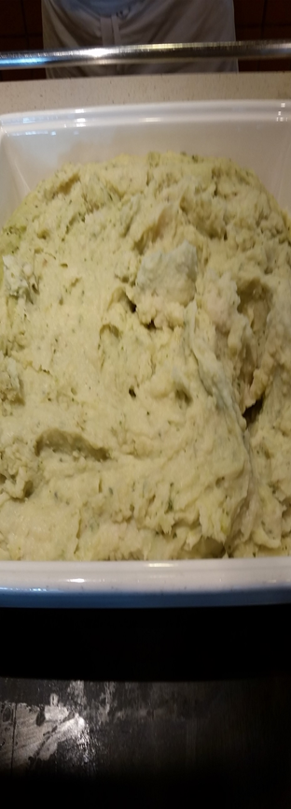
H6 & H7 Pork Tenderloin Medallions, Pesto Mashed Potatoes, Beef Short Ribs and Fried Eggplant

Slide 15
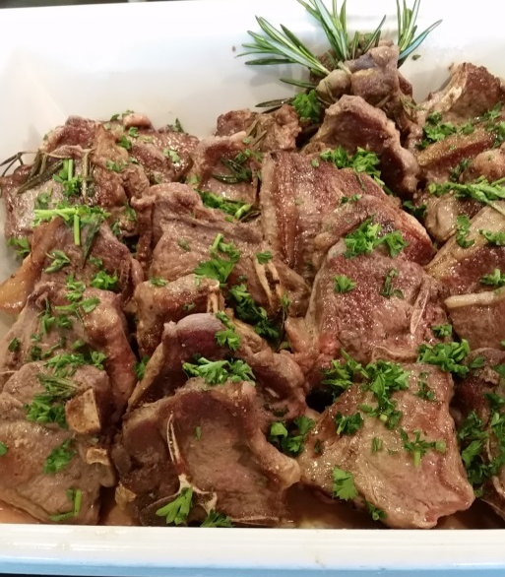
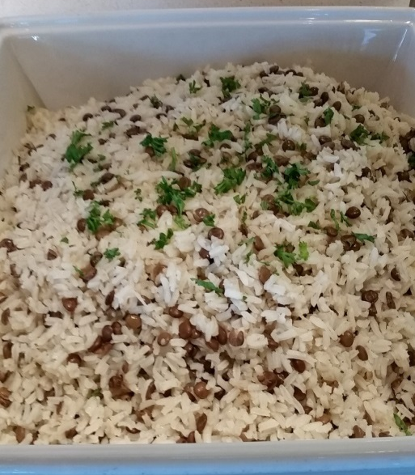
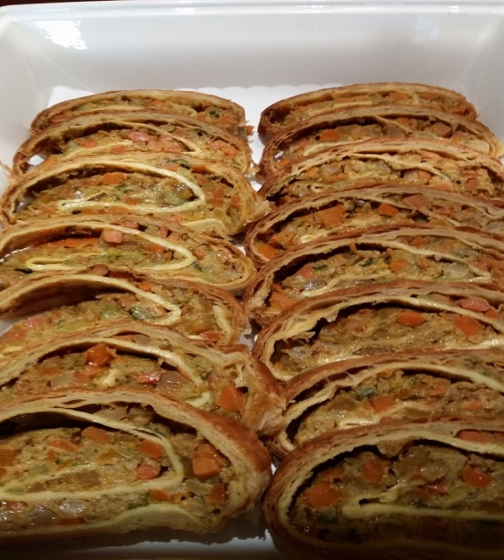
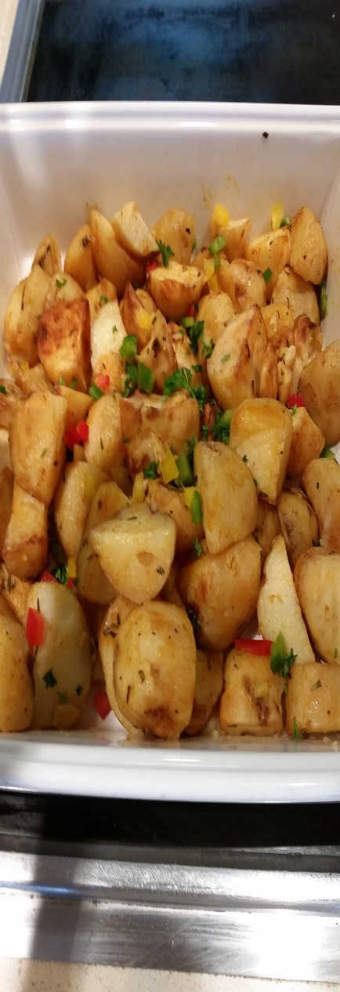
H8 & H9 Grilled Lamb Chops, Vegetable Ratatouille, Lentil Rice Pilaf and Roast Potatoes

Slide 16
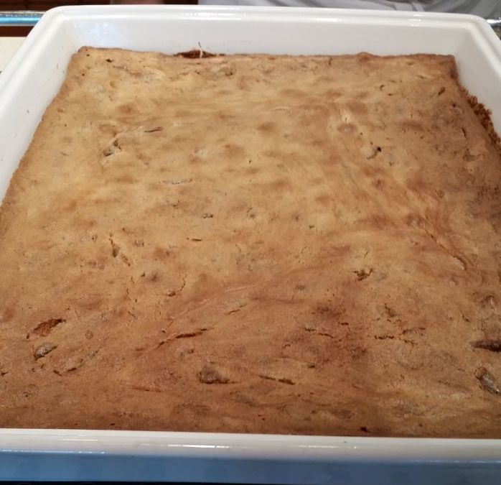
H 10 Hot Dessert

Slide 17
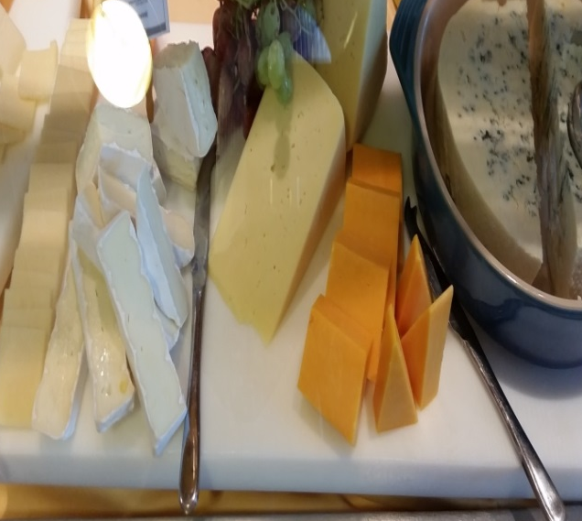
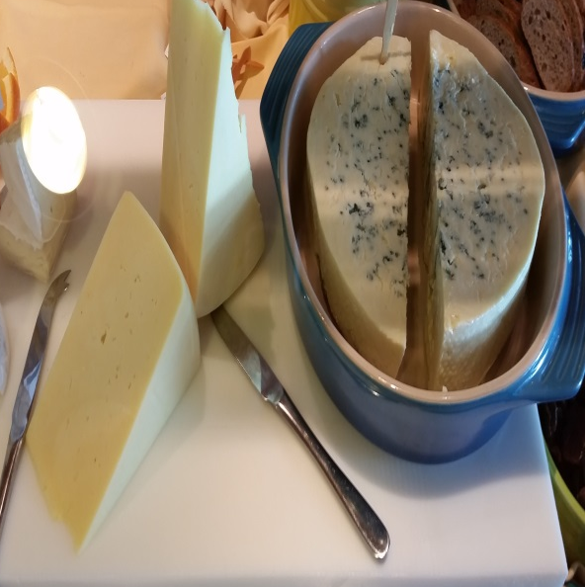
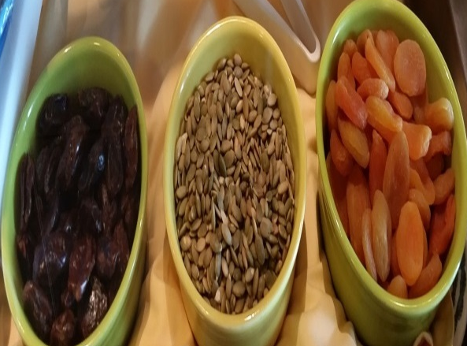
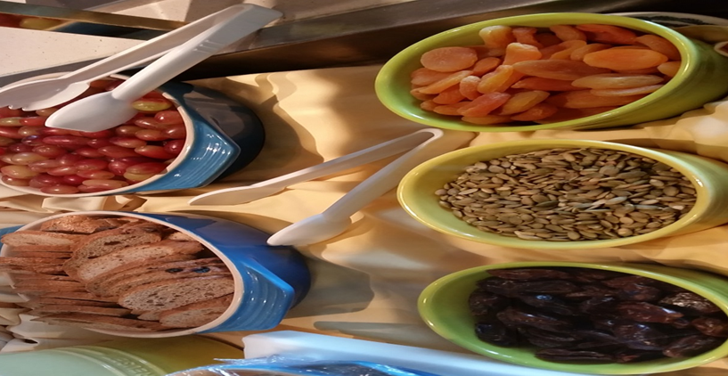
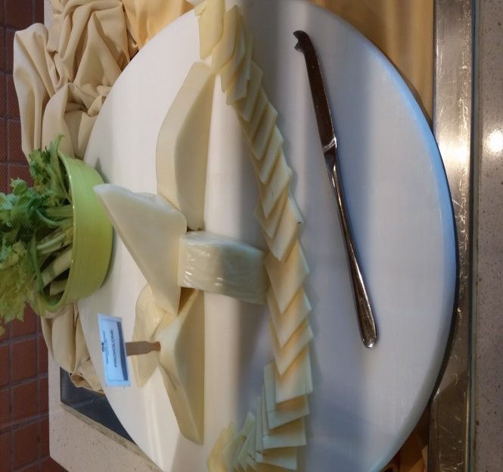
CO Cheese Counter

Slide 18
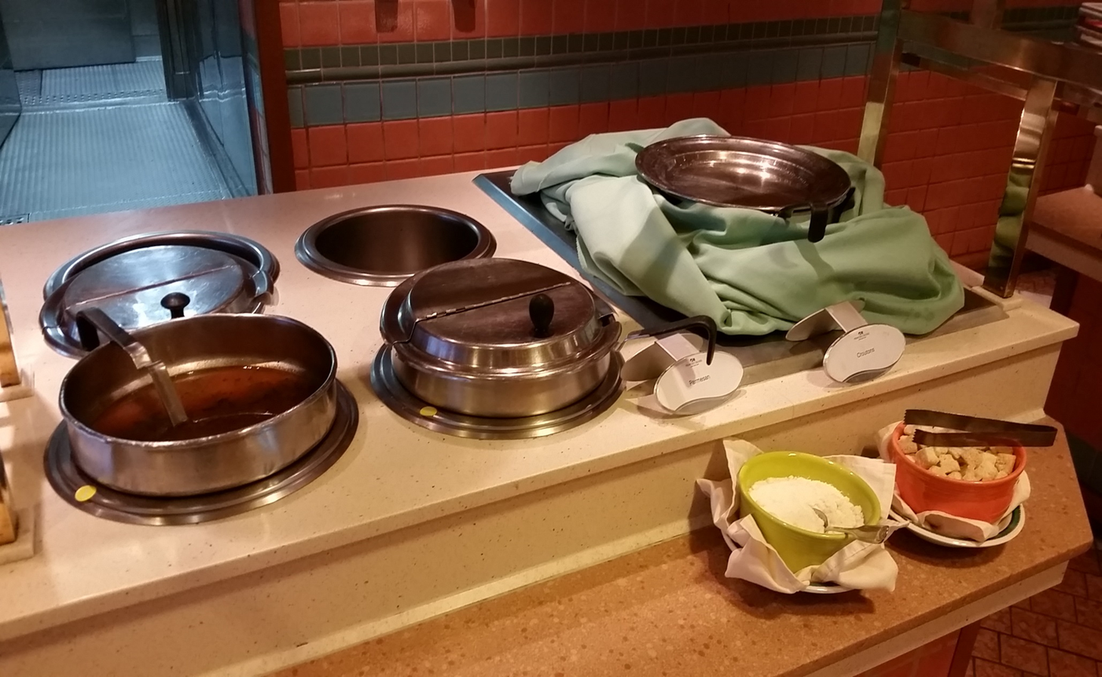
H11 Soup

