Slide 1
H10 Hot Dessert
H9 √ Roast Seasoned Mustard Chicken, Kalbsgeschnetzeltes
H8 Pan Fried Tilapia Filet, Garlic Broccoli
H7b Beef Goulash, Poached Spätzle with Sage and Butter
H6 (v) Tomato Onions Quiche , (v) Garlic Mashed Potato + Boiled Potato + Fried Potatoes
H5 Braised Red Cabbage, Braised Sauerkraut
H4 Veal Schnitzel, German Potato Salad
H3 Sausage Weisswurst - Poached with Parsley , Sausage Frankfurt, Sausage Debreziner
H2 Sausage Keilbasa -Grilled Bratwurst
H1 Pasta Marinara Sauce
Kümmelbraten Caraway Crusted Roasted Leg of Pork, Smoked Pork Loin Baked In Sour Rye Bread Dough
C6
ASSORTED CHEESE PLATERS
C3
Cucumber Salad, Bayrischer Wurst Salad , Beetroot Salad, Pickled Giardiniera
C5
DESSERT 5 ASSORTED PASTRY
C4
SALAD BAR
H11
Cheese Sauce, Paprika Onion Sauce & Bavarian Split Pea Soup Garnished with Smoked Ham
C0
Shrimp Cocktail
C8
ASSORTED BREAD ,
C1 Liverwurst Pate, Black Forest -Bierschinken, Bier Wurst, Lyonerwurst Pepper, Jaagdwurst, Landjaeger
C7
SLICE FRUIT and Fresh Fruits
C2
Three types of Cold cuts depends on Available
exit
entrance
C0:_ 2nd Commis
C1 – C4:___2nd Commis
C5 – C8:__ 1st Commis
H1 – H5:___2nd Commis
H11:____2nd Commis
CARVING:_ 2nd Commis
H6 – H10:__2nd Commis
HOT FILLER:__DCDP
COLD FILLER:___1st Commis
GAZEBO:__DCDP
INSIDE RUNNER:_2nd Commis
STARBOARD SIDE DINNER Bavarian Day

Slide 2
C 1 Assorted Pate

Slide 3
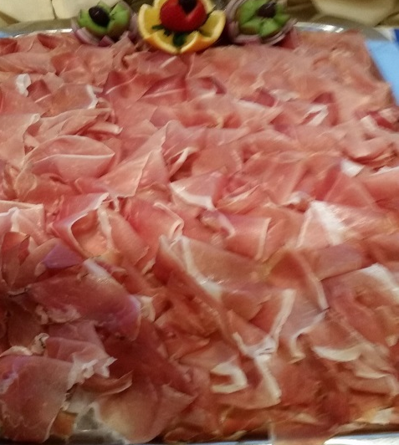
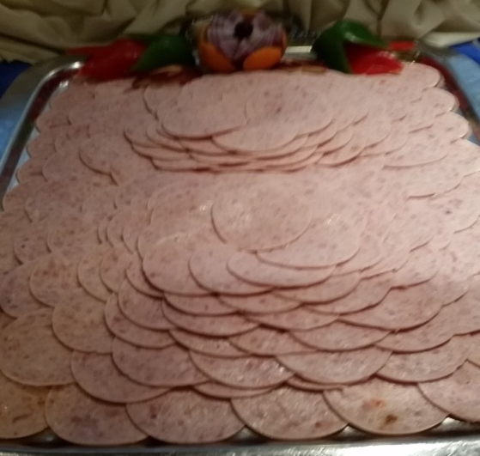
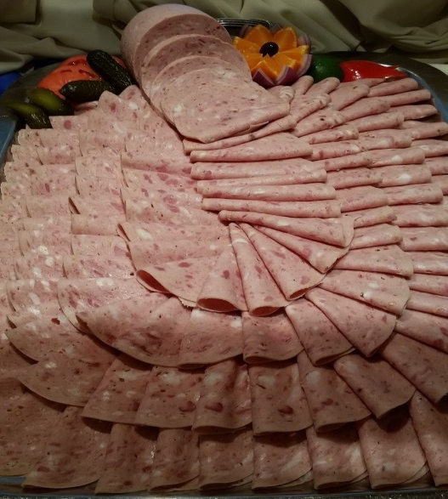
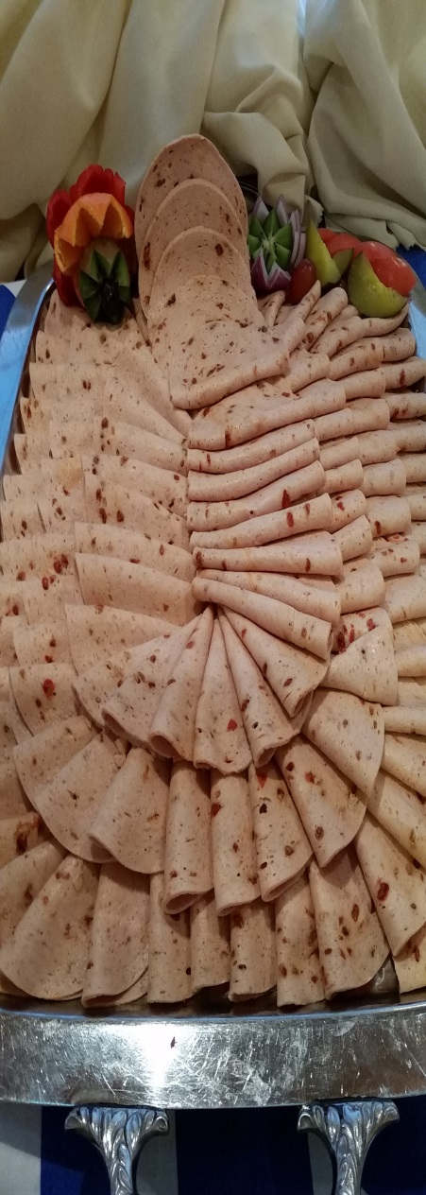
C 2 Assorted Cold Cuts

Slide 4
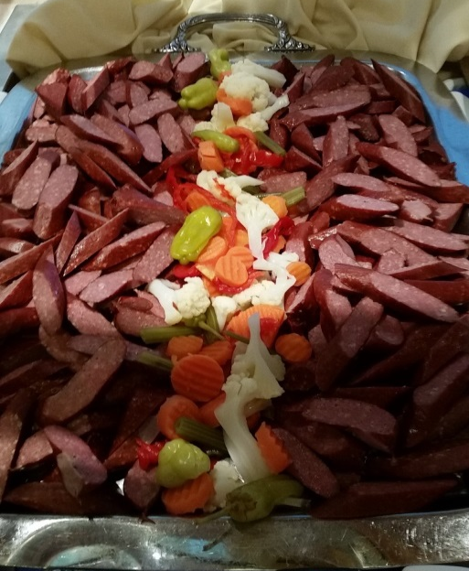

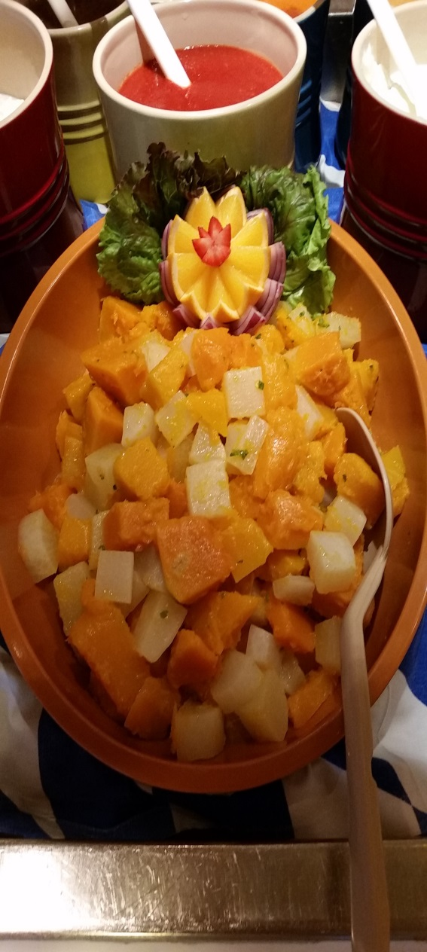
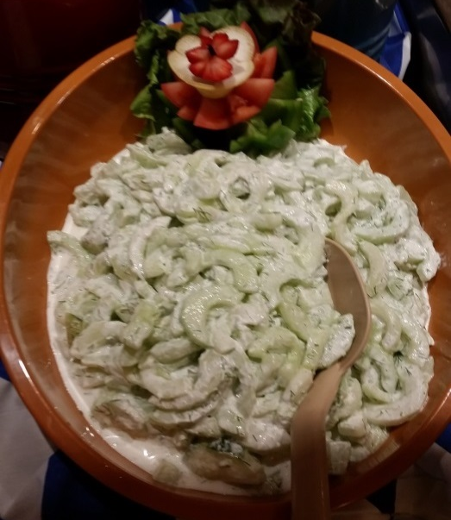
C3 COMPOTE SALAD

Slide 5
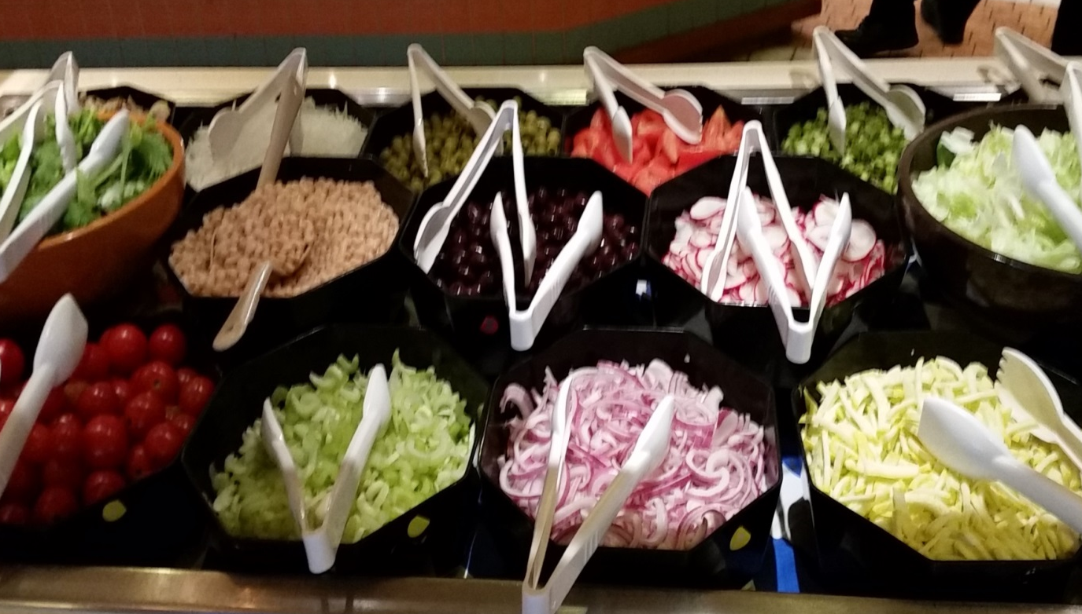
C4 SALAD BAR

Slide 6
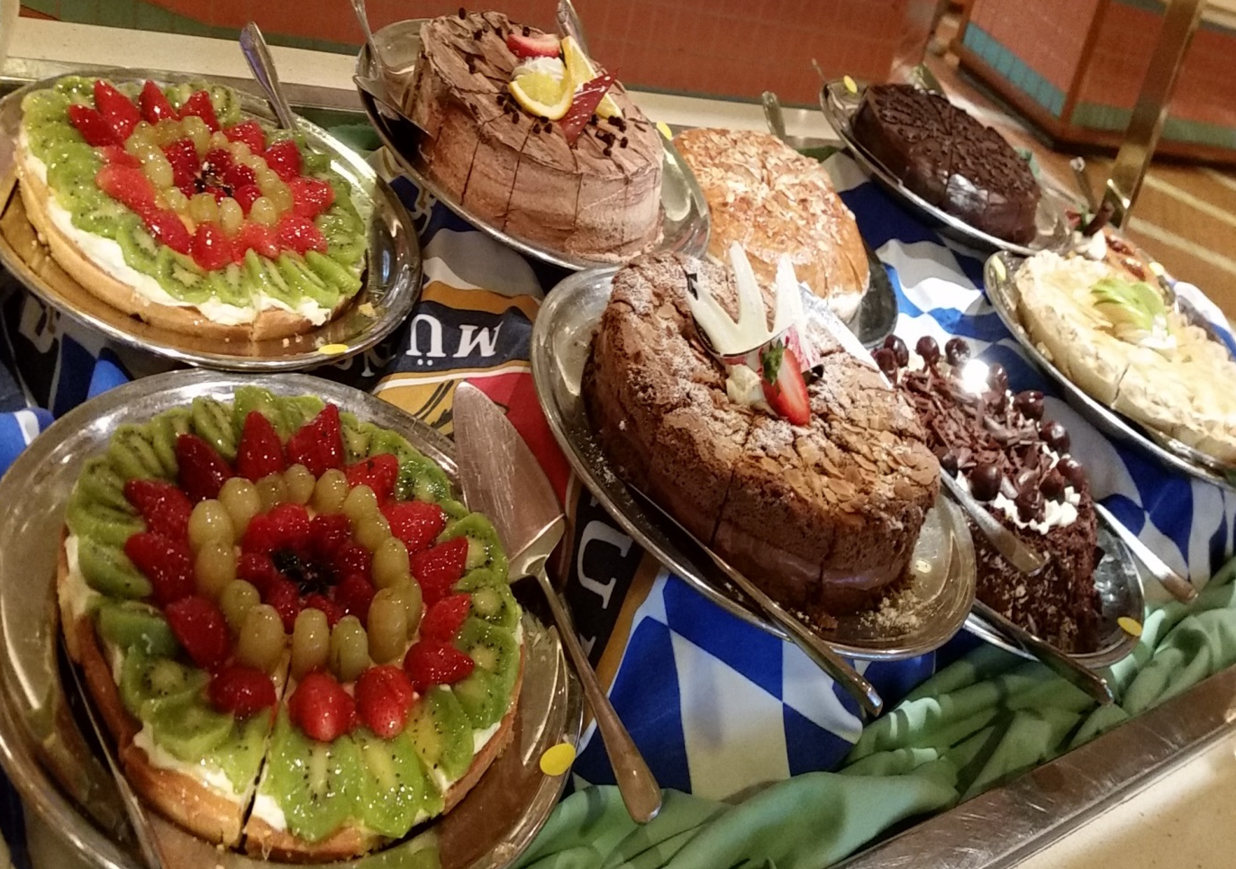
C5 DESSERT ASSORTED PASTRY

Slide 7
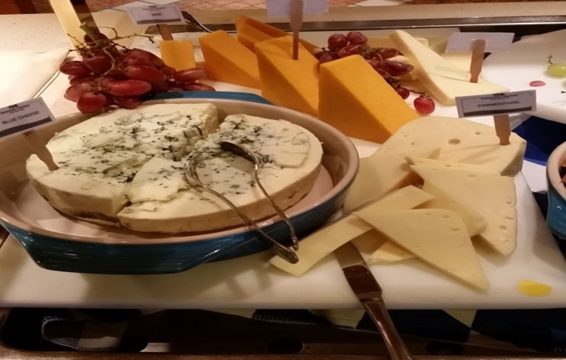
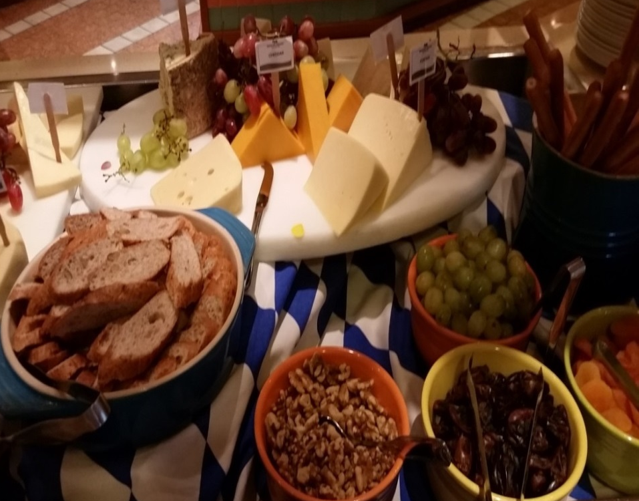
C6 CHEESE COUNTER

Slide 8
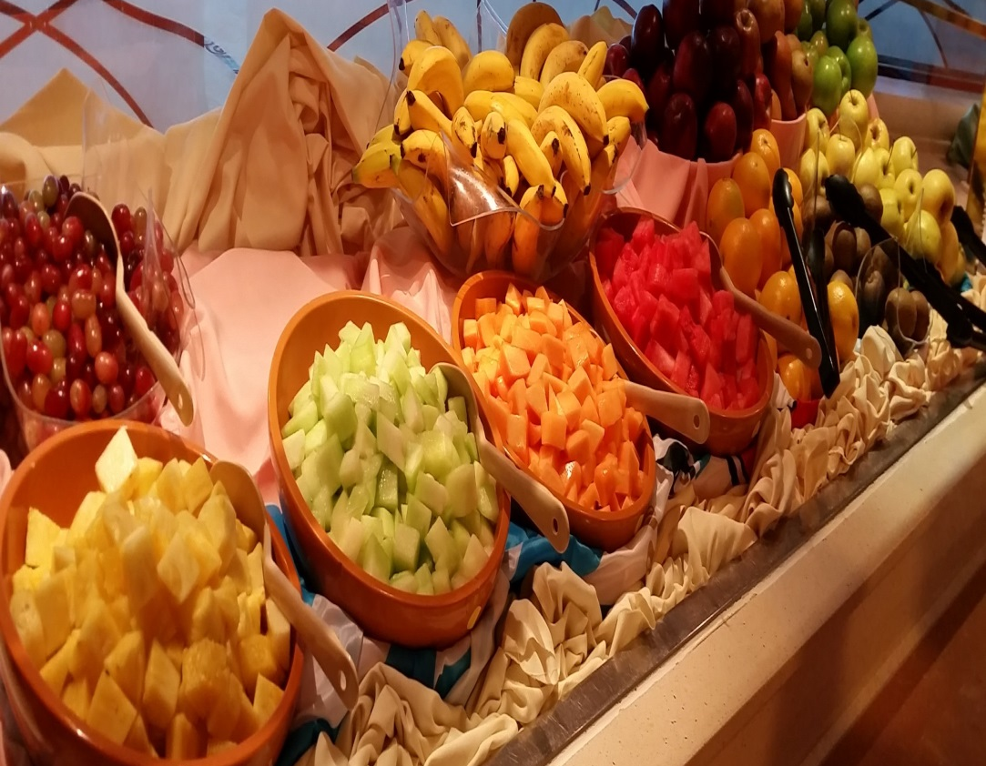
C7 Sliced Assorted Fruit and Fresh Fruit

Slide 9
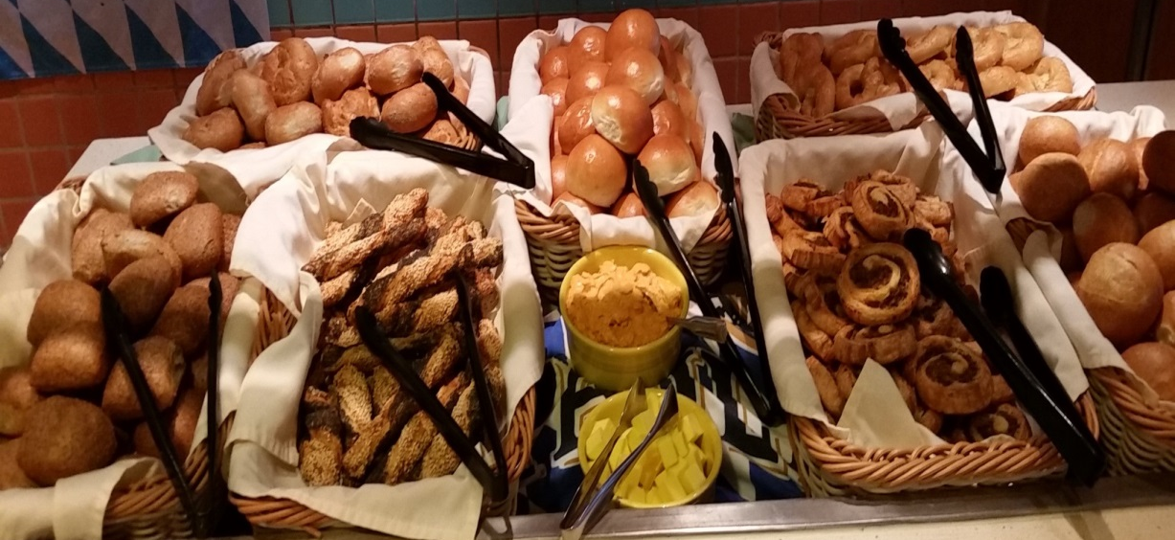
C8 ASSORTED BREAD

Slide 10
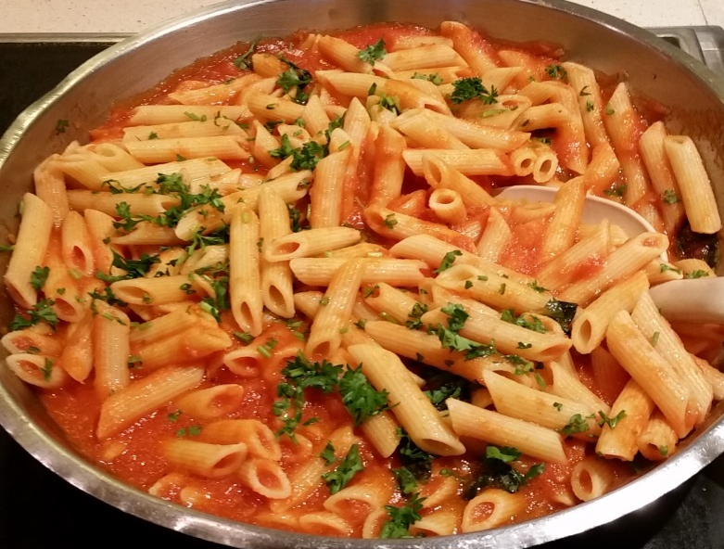
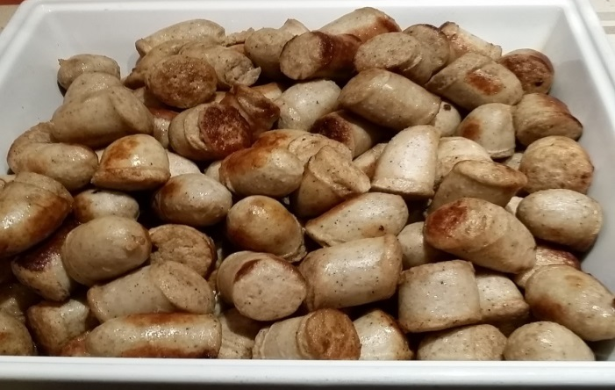
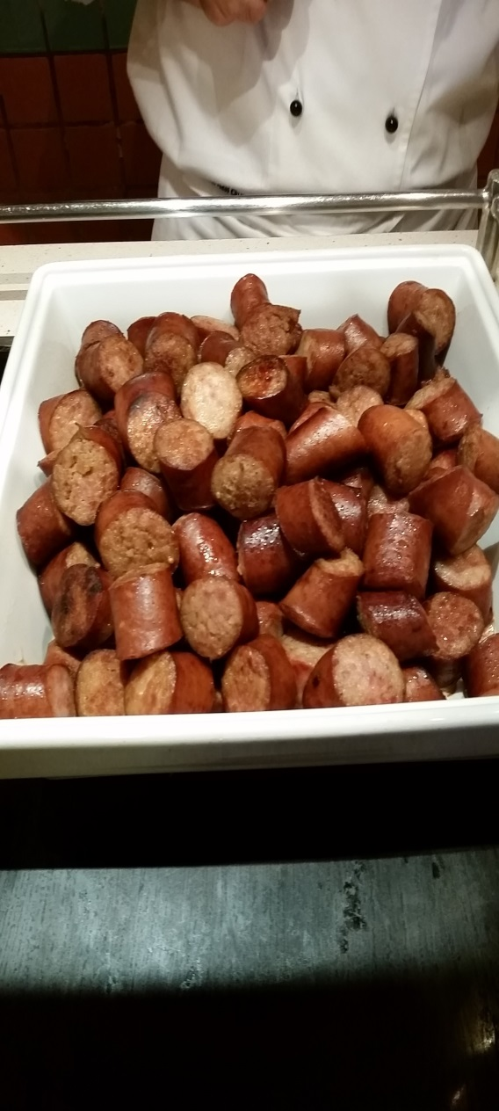
H1 & H 2 PASTA, SAUSAGES

Slide 11
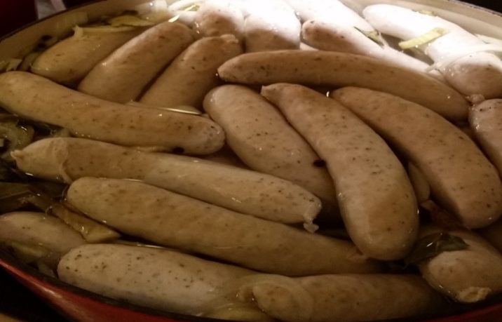
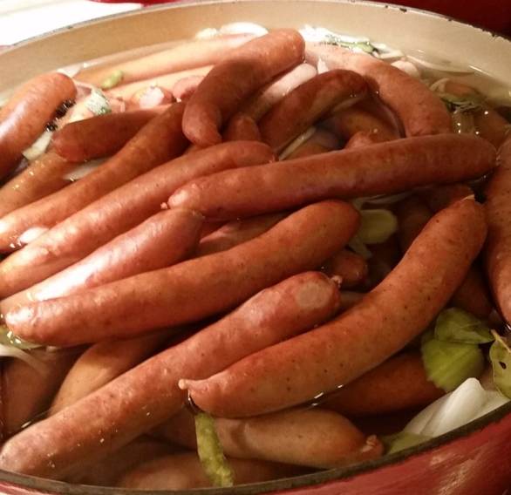
H 3 SAUSAGES

Slide 12
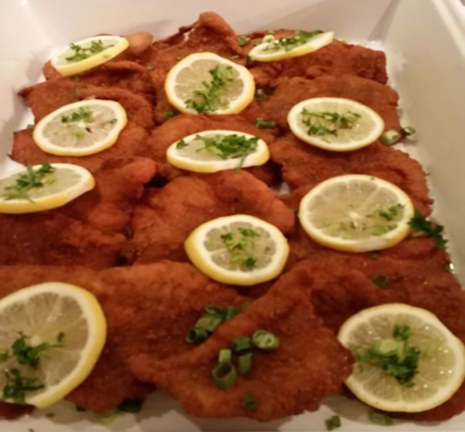
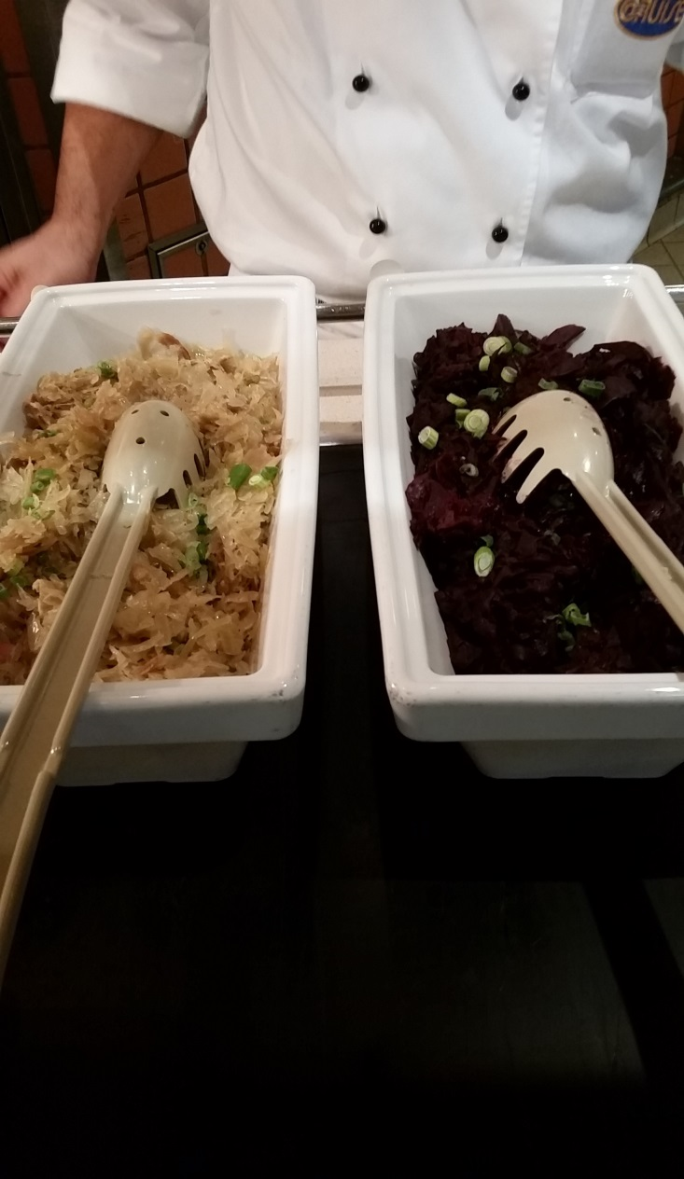
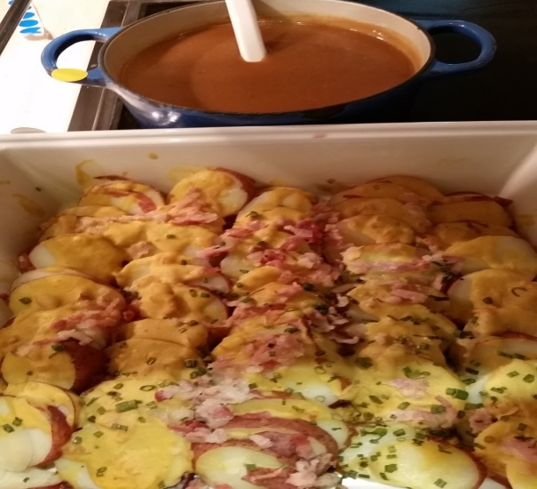
H4 & H5 VEAL SCHNITZEL, POTATO SALAD & BRAISED CABBAGE

Slide 13
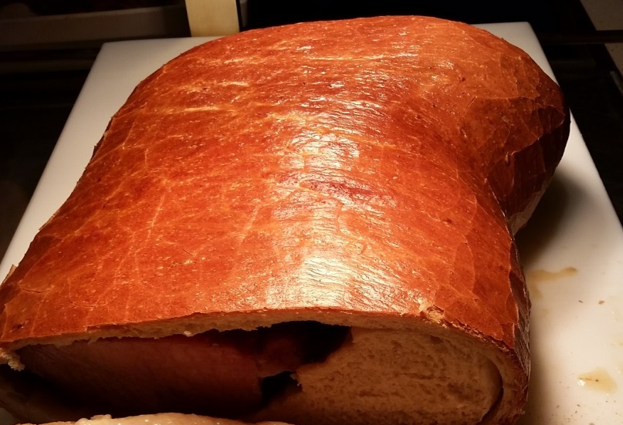
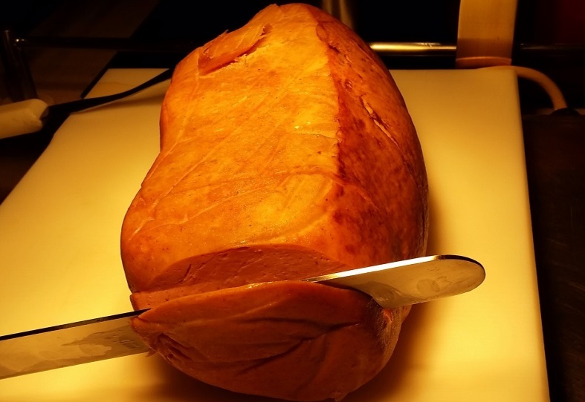
CARVING

Slide 14
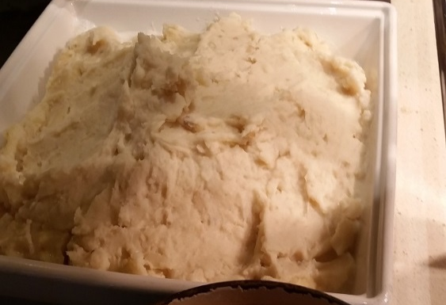
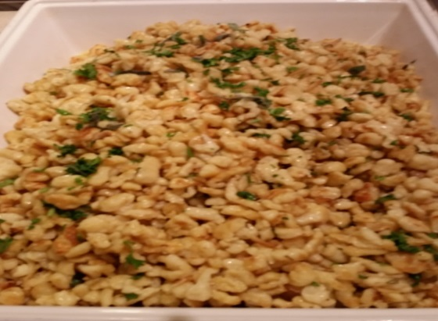
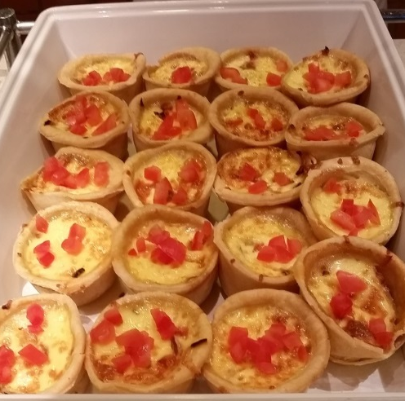
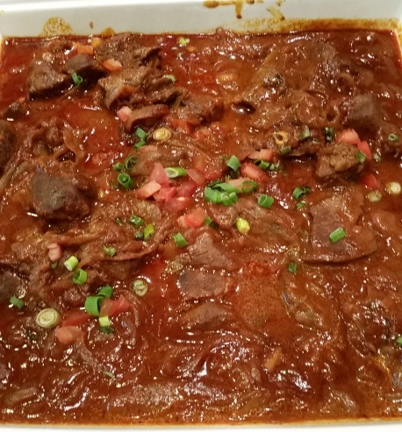
H6 & H7 Quiche, Mashed Potato, Beef Goulash & Spätzle

Slide 15
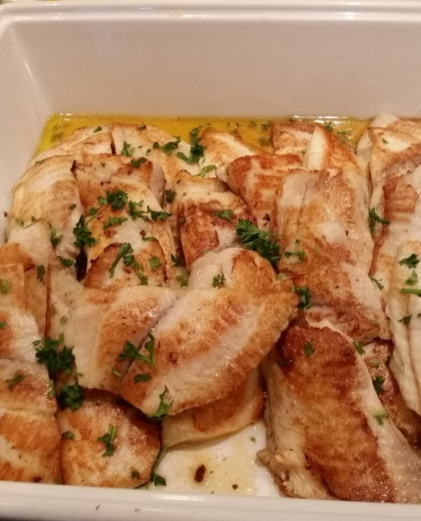
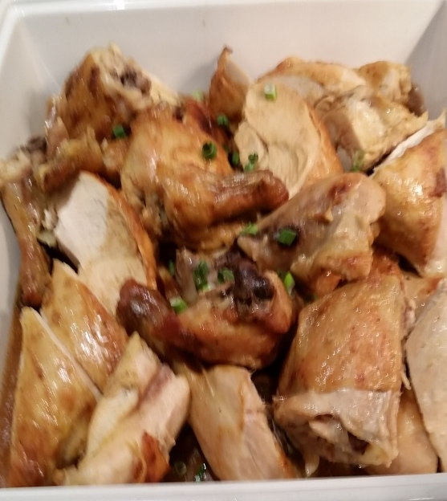
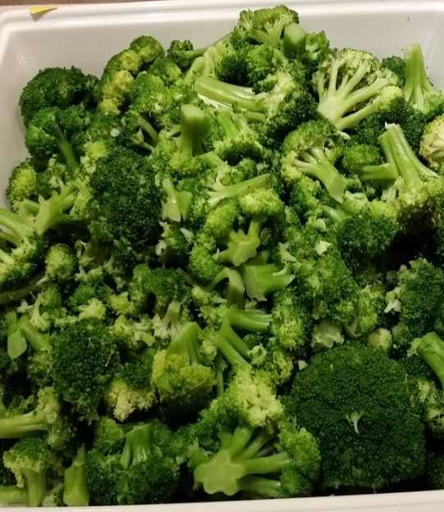
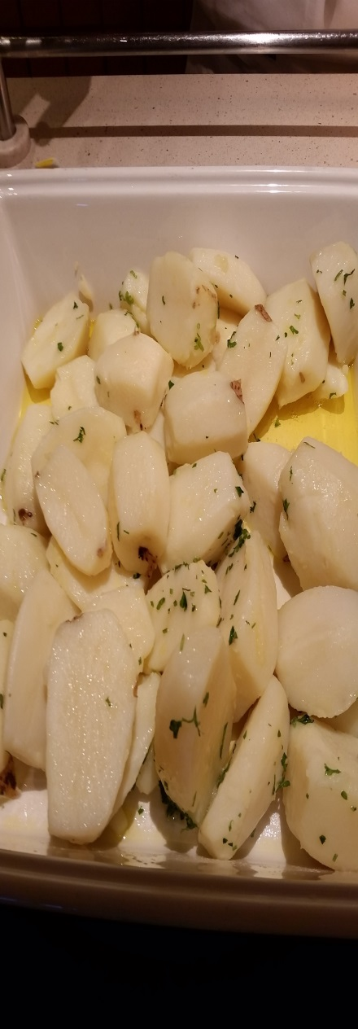
H8 & H9 Fish, Broccoli, Mustard Chicken & Parsley Potatoes

Slide 16
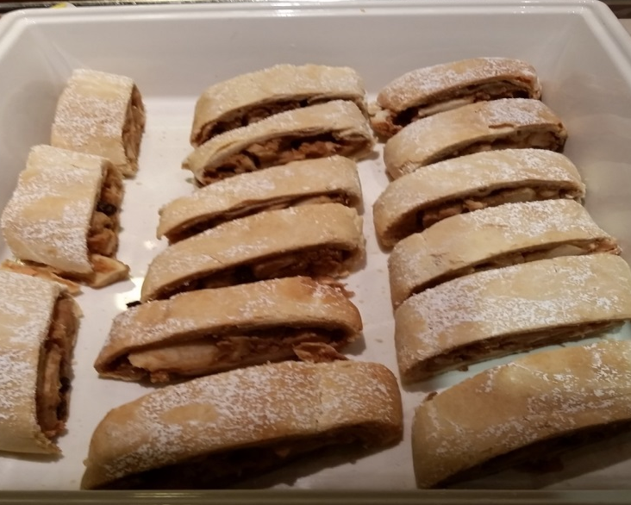
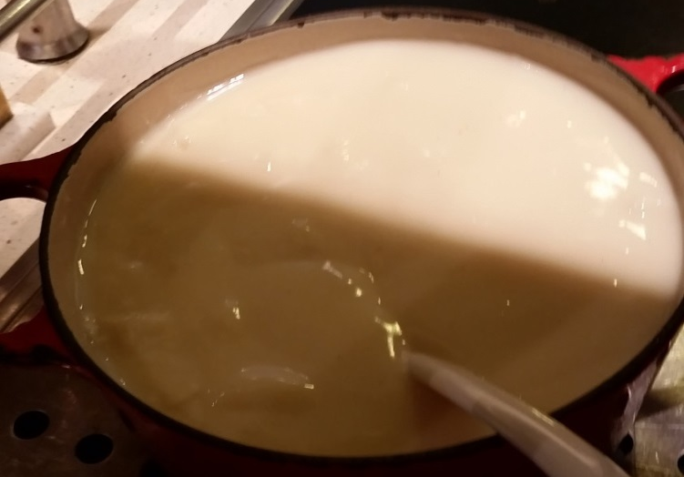
H10 Hot Dessert

Slide 17
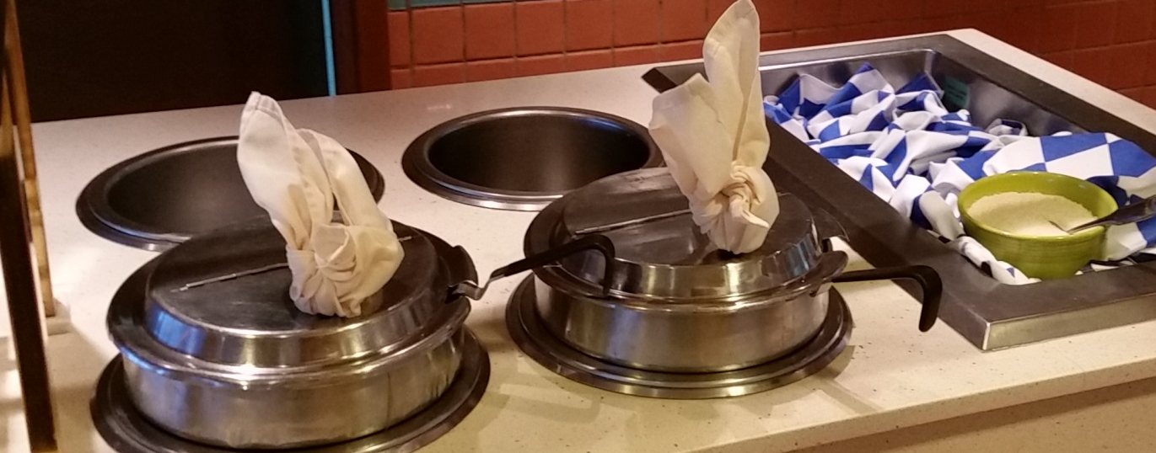
H11 Soup

