Slide 1
H10 Hot Dessert
H9 √ Braised White Beans with Chopped Herbs and Tomato , √ Steamed Root Vegetables
H8 Abacchio Alla Romana , Fennel Gratin with Parmesan Cheese Melted Butter
H7 Sautéed Shrimp with Garlic Tomato Chilli Chopped Parleys, (v) Sautéed Broccoli
H6 Pork Scaloppini Pizzaiola Garlic Mashed Potatoes + Gravy
H5 Pot Roast of Beef in Barolo Wine Sauce Mushrooms, Lima Beans Tuscany Style
H4 Rice Pilaf with Peas , Chicken Breast, Ham, and Fontina Cheese
H3 Black Mussels Marinara Sauce, (v) Eggplant Parmiggiana with Basil-Tomato Sauce
H2 Broiled Mahi - Mahi Filet Maître D'hôtel Butter, (v) Sautéed Zucchini
H1 √ (v) Penne Pasta Arrabbiata with Spicy Tomato Sauce, Pasta with Meatballs in Fresh Tomato Sauce
Veal Leg's Tuscany style Rosemary Gravy
C6
Assorted Cheese Platter
C3
DRESSINGS
C5
DESSERT 5 ASSORTED PASTRY
C4
SALAD BAR
H11 Red Bean Soup with Pasta Ham Hocks Parsley √ Vegetable Minestrone Soup
C0
Assorted Cheese Plates
C1
Mozzarella -Ripened Tomatoes, Basil, Capers Anchovies, Balsamic Reduction, Grilled Vegetables Marinated in Segesta Olive Oil and Basil, Trattoria Style Cheese and Parmesan Pecorino Olives , Sea Food Salad, Celery, Tomato Julienne
C8
ASSORTED BREAD ,
C7
SLICE FRUIT and Fresh Fruits
C2
Cold Cuts Mortadella-Prosciutto-Salami-Pancetta, Coppa
exit
C0:_ 2nd Commis
C1 – C4:___2nd Commis
C5 – C8:__ 1st Commis
entrance
H1 – H5:___2nd Commis
H11:____2nd Commis
CARVING:_ 2nd Commis
H6 – H10:__2nd Commis
HOT FILLER:__DCDP
COLD FILLER:___1st Commis
GAZEBO:__DCDP
INSIDE RUNNER:_2nd Commis
STARBOARD SIDE DINNER Trattoria Dinner

Slide 2
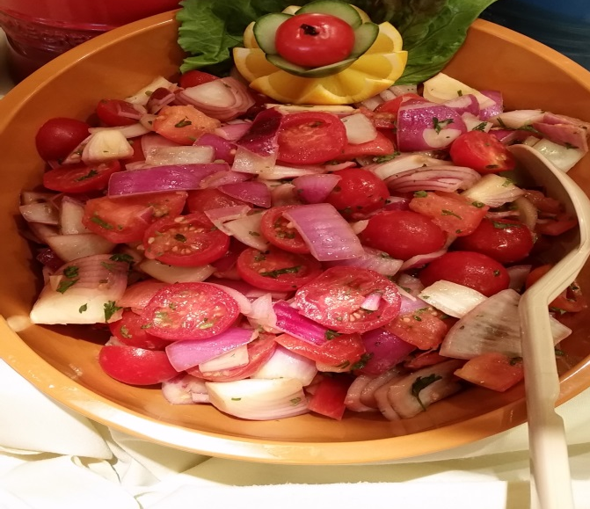
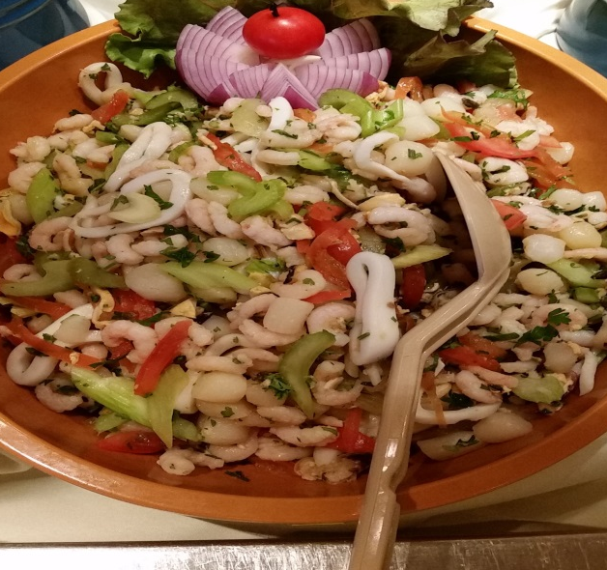
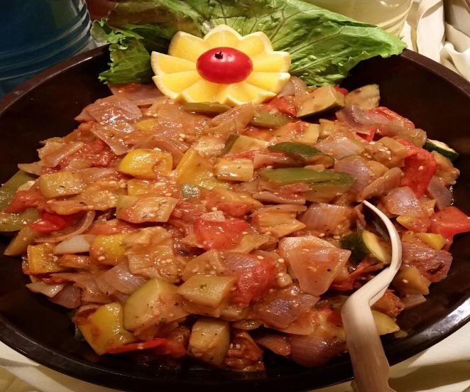
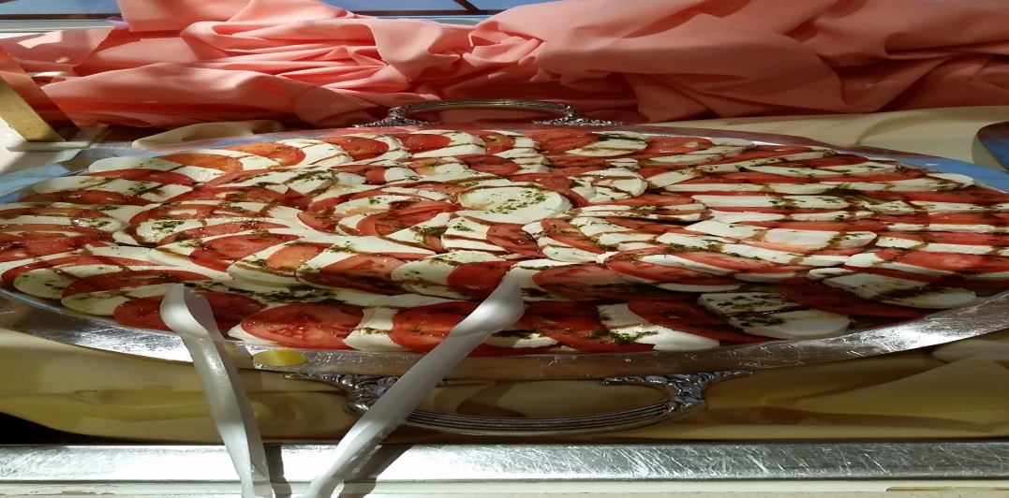
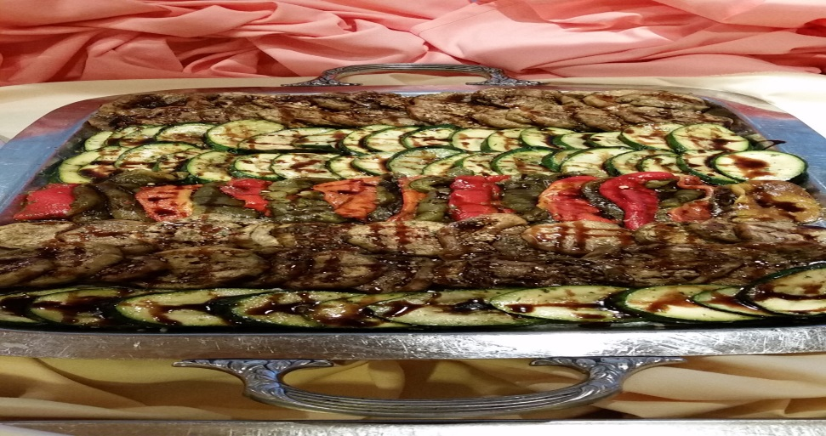
C 1 Compote Salad

Slide 3
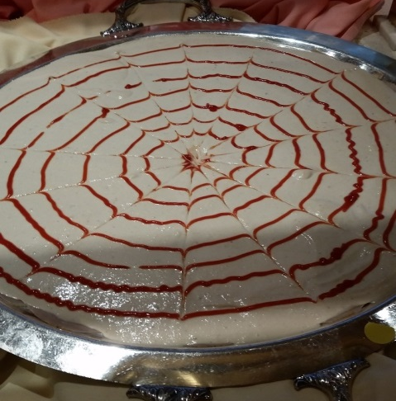
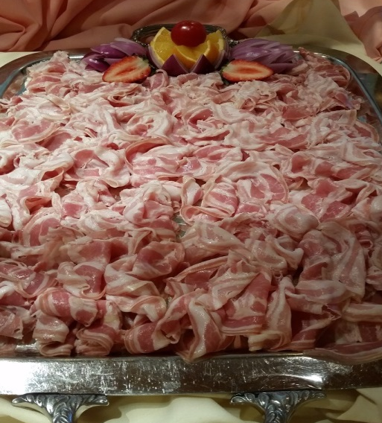
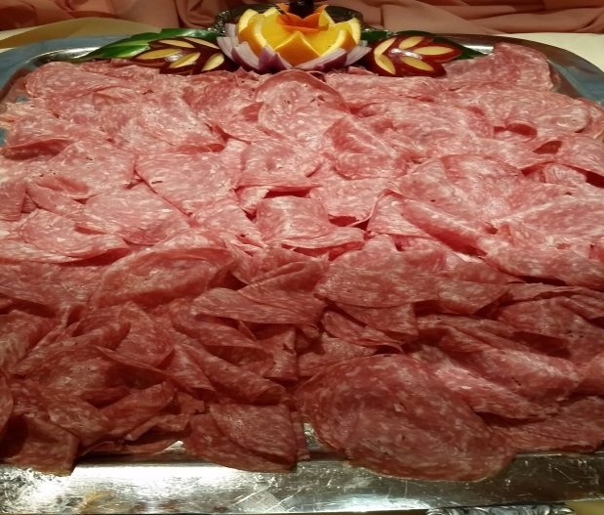
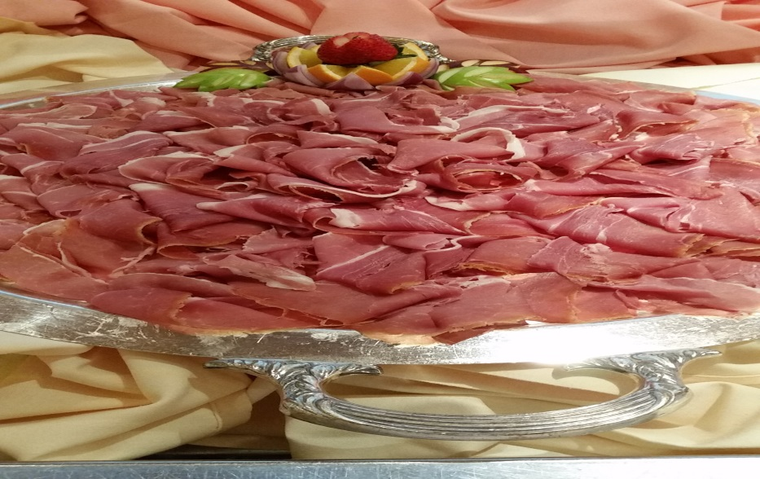
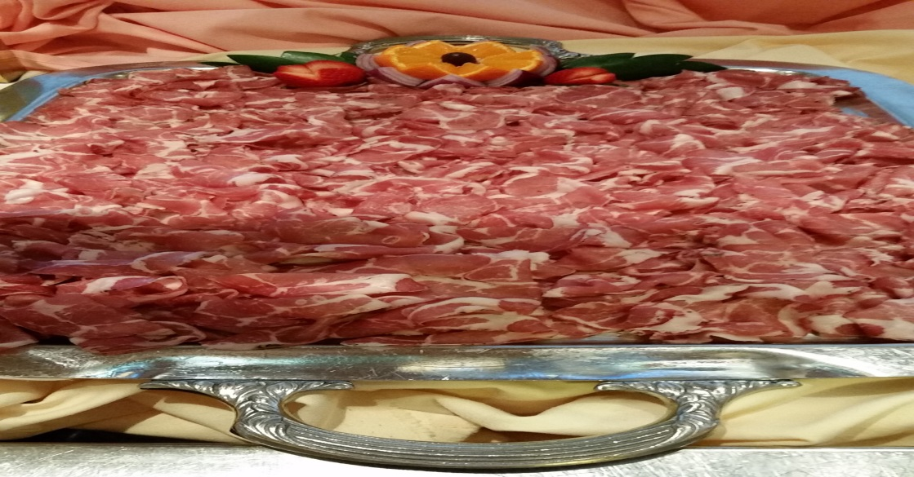
C 2 Assorted Cold Cuts

Slide 4
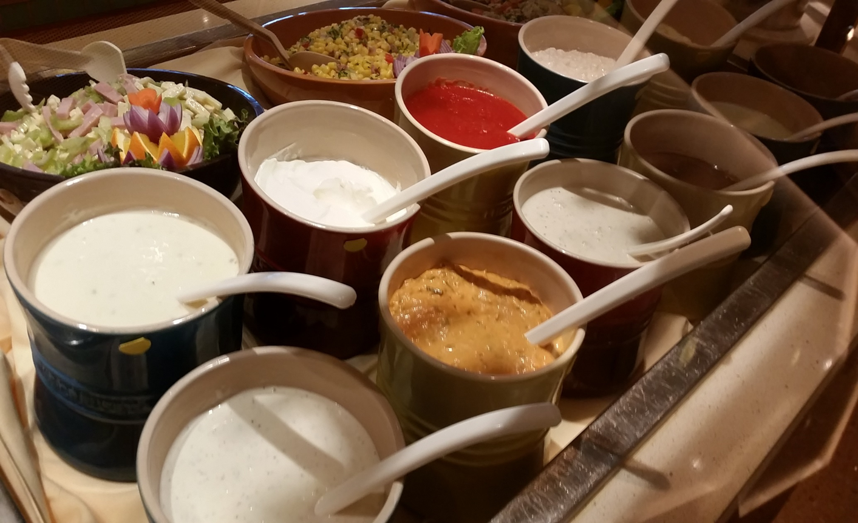
C3 DRESSING

Slide 5
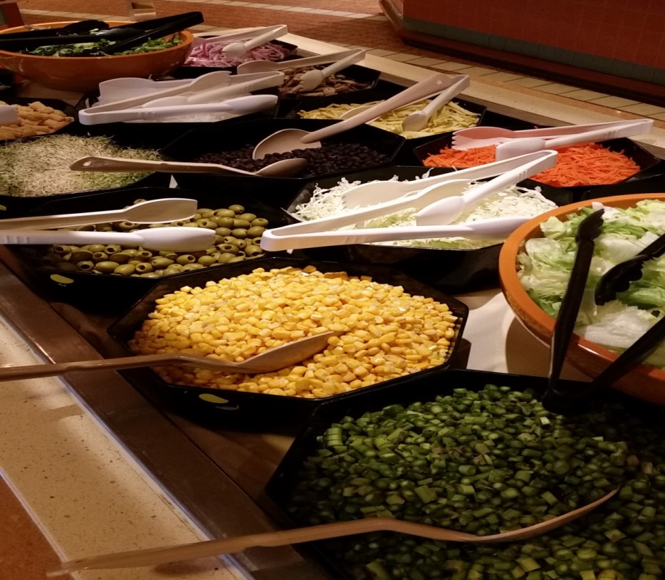
C4 SALAD BAR

Slide 6
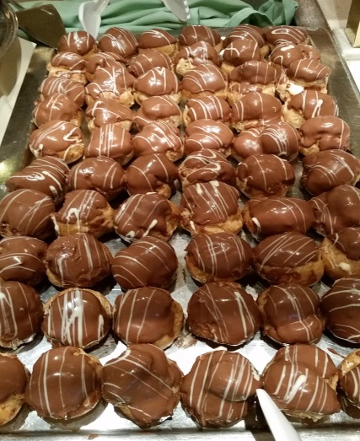
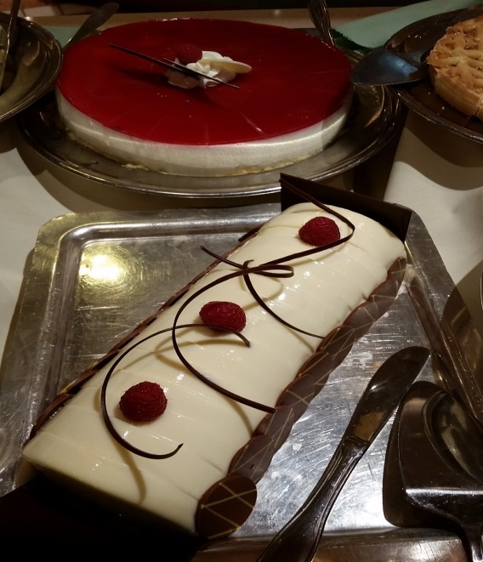
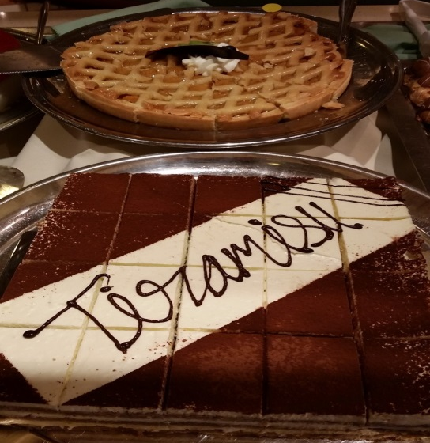
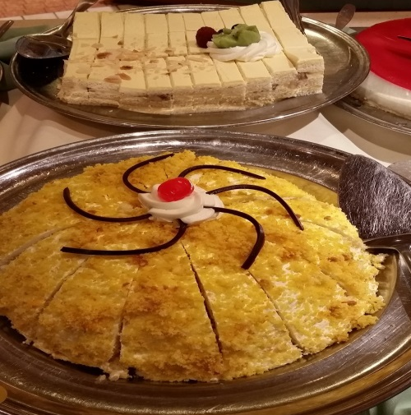
C5 DESSERT ASSORTED PASTRY

Slide 7
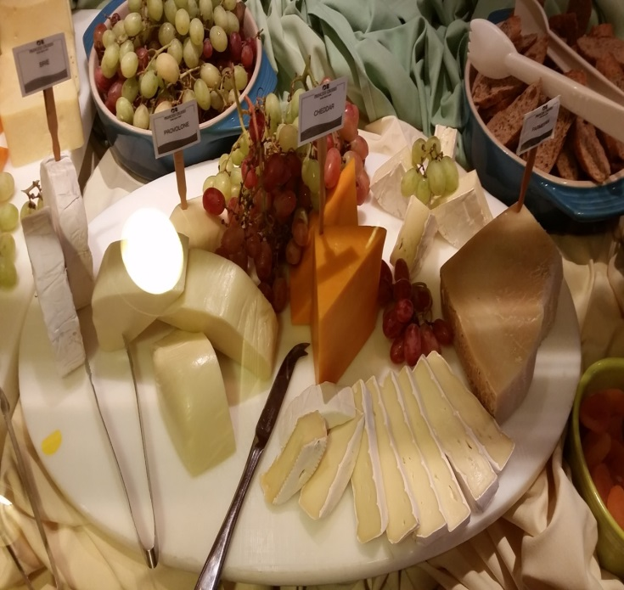
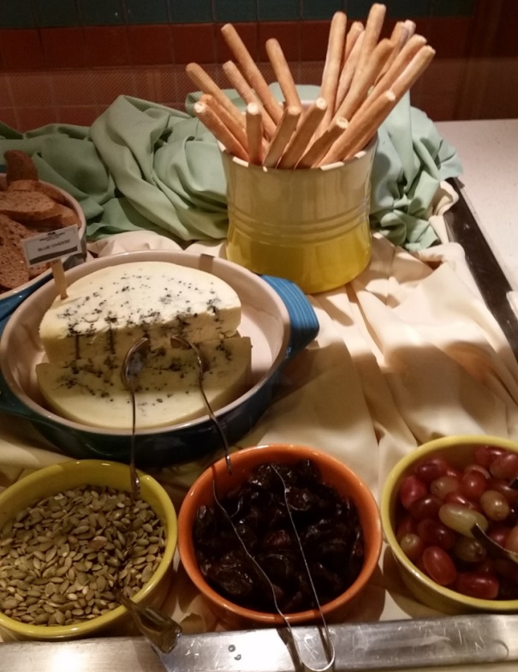
C6 ASSORTED CHEESE COUNTER

Slide 8
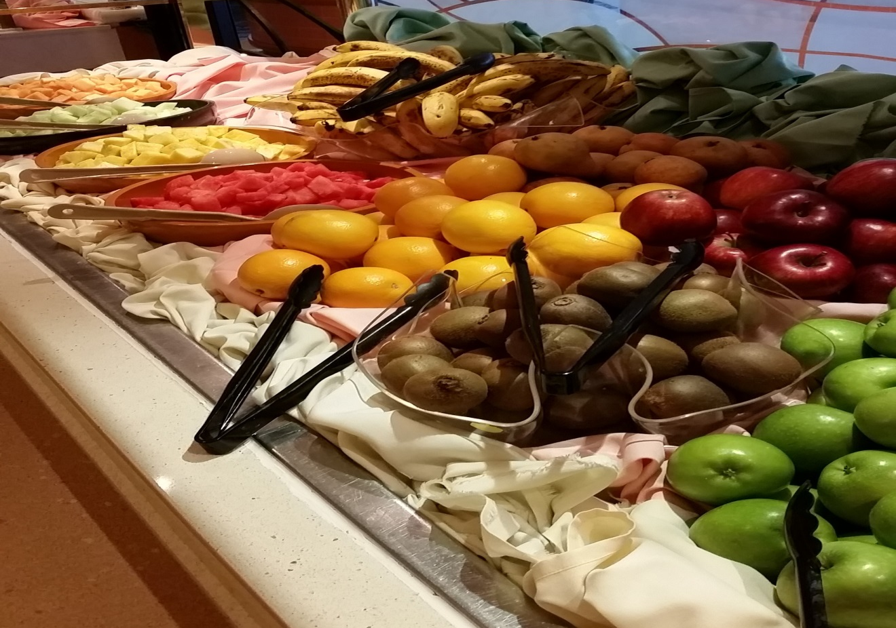
C7 Sliced Assorted Fruit and Fresh Fruit

Slide 9
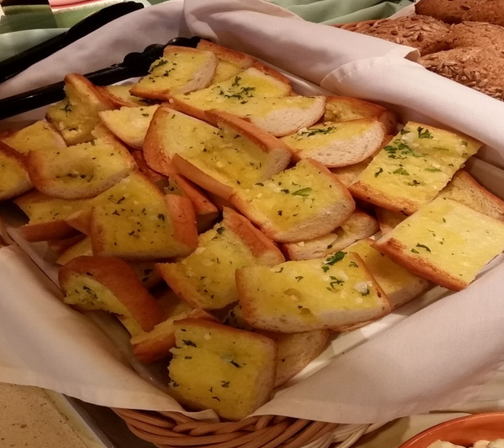
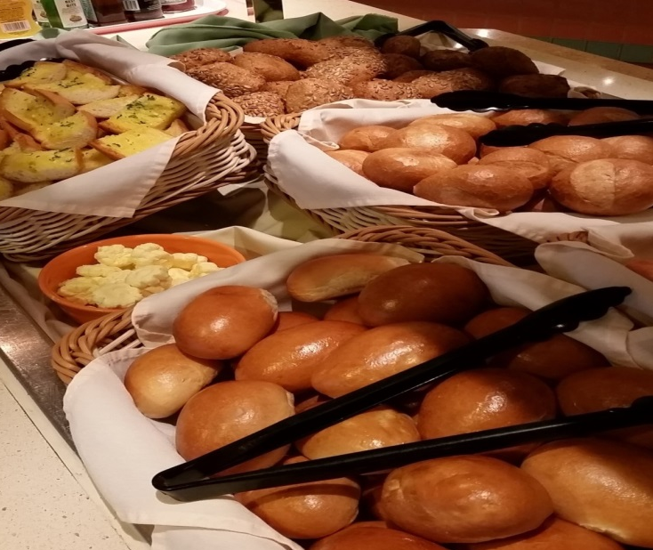
C8 ASSORTED BREAD

Slide 10
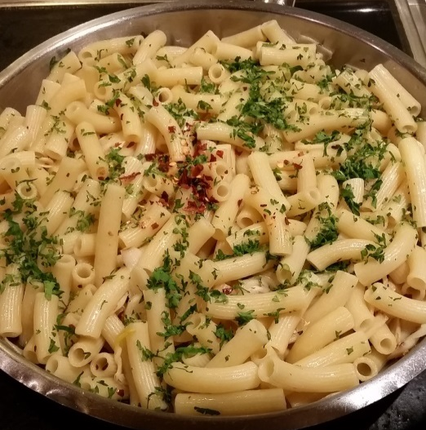
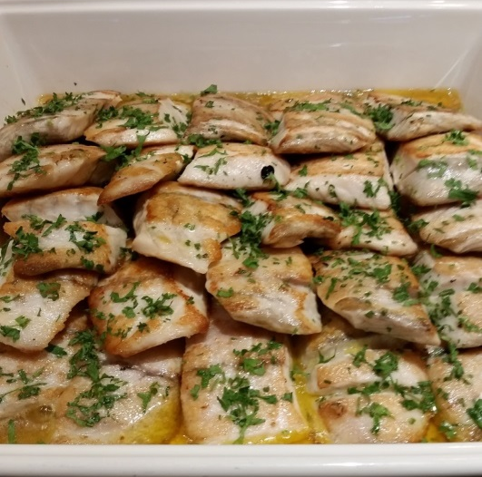
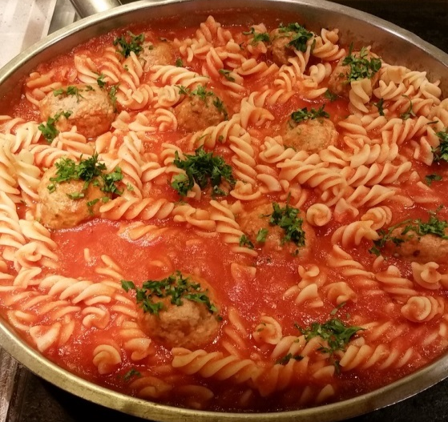
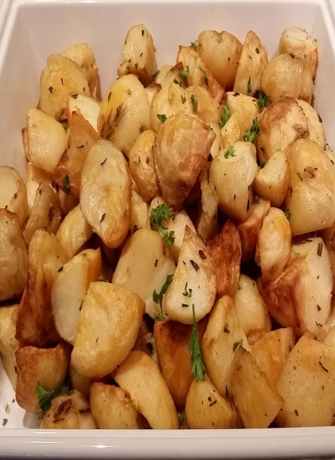
H1 & H 2 Pasta, Fish and Sautéed Vegetables and Roast Potatoes

Slide 11
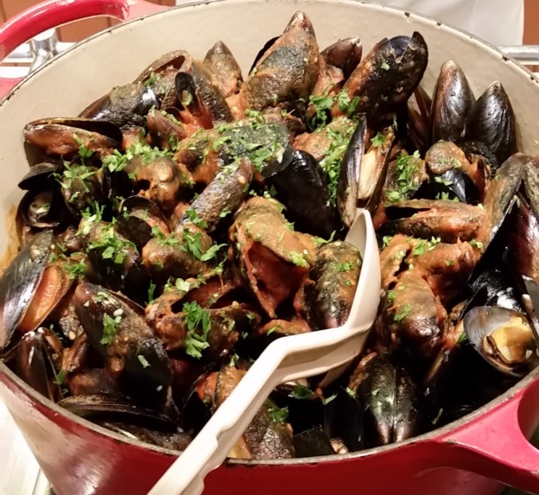
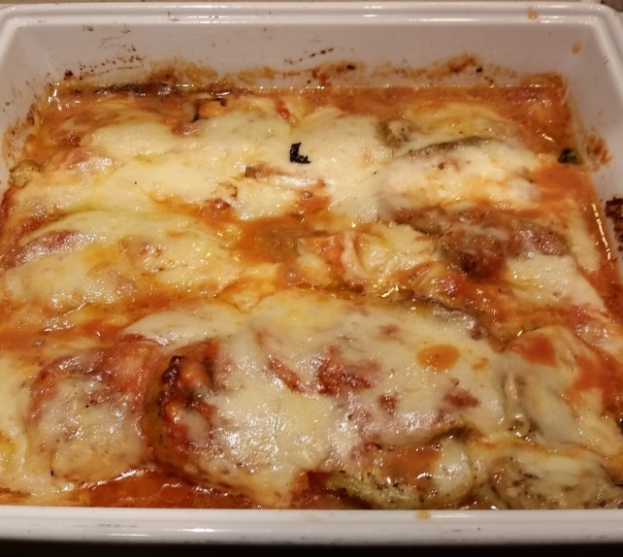
H 3 Black Mussels in Marinara Sauce and Eggplant Parmiggiana

Slide 12
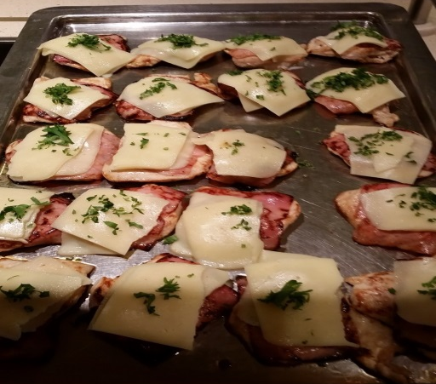
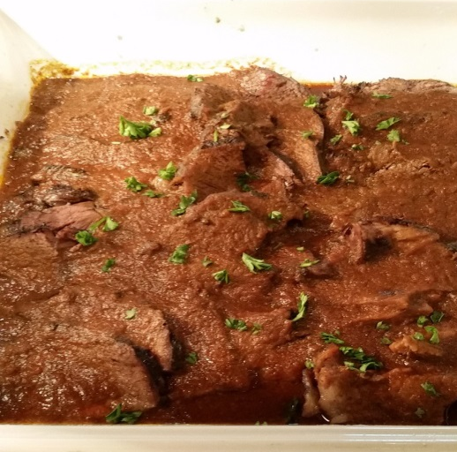
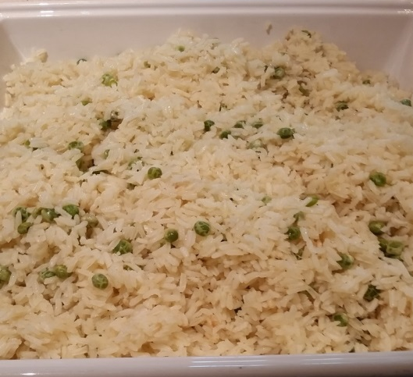
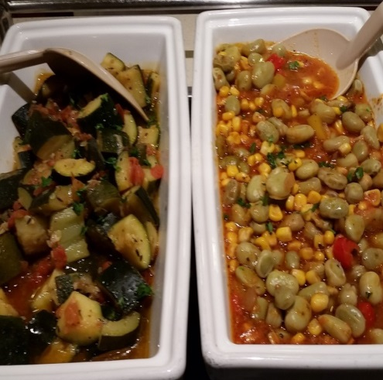
H4 Chicken, Rice Pilaf, Roast Beef and Lima Beans Tuscan Style

Slide 13
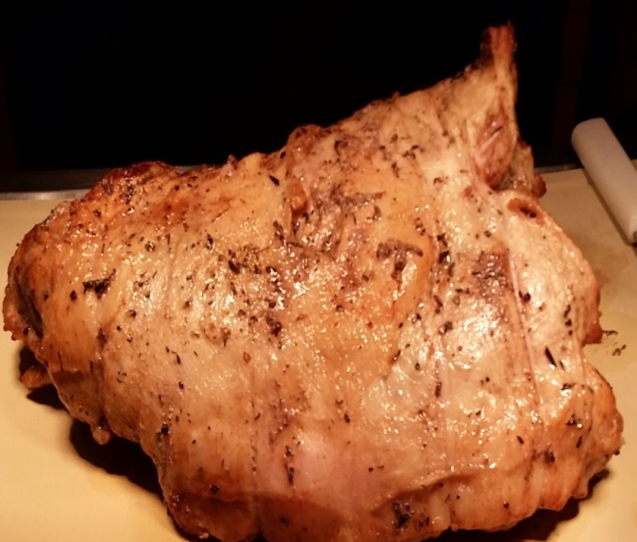
CARVING

Slide 14
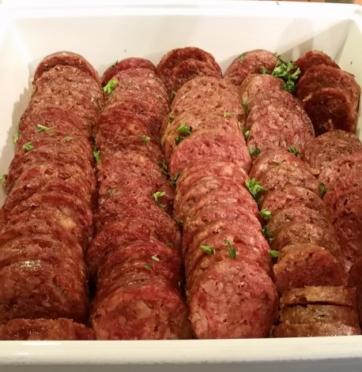
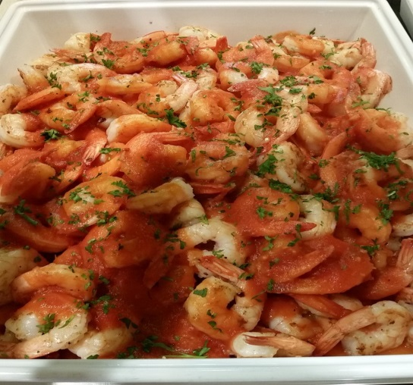
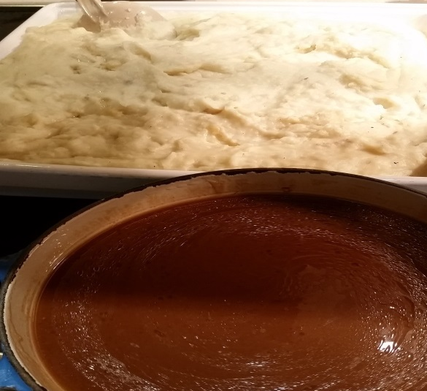
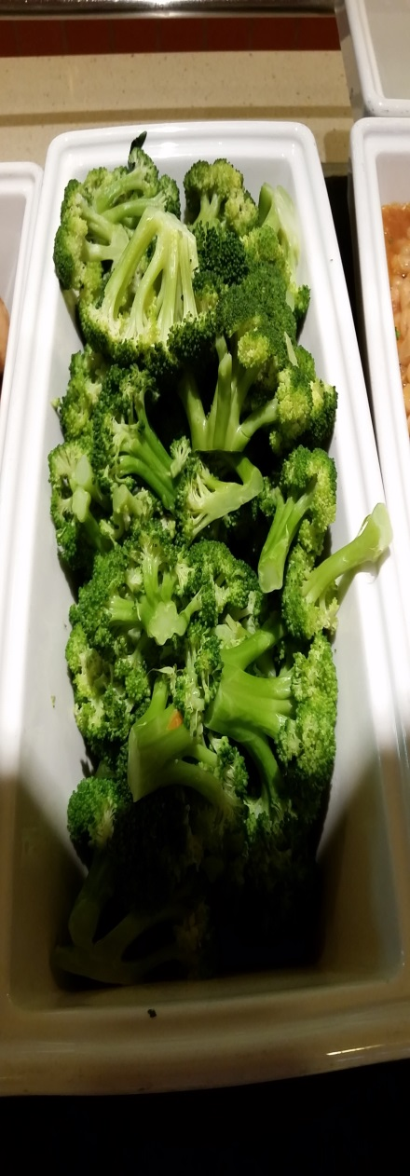
H6 & H7 Scaloppini, Mashed Potato, Sautéed Shrimp and Sautéed Broccoli

Slide 15
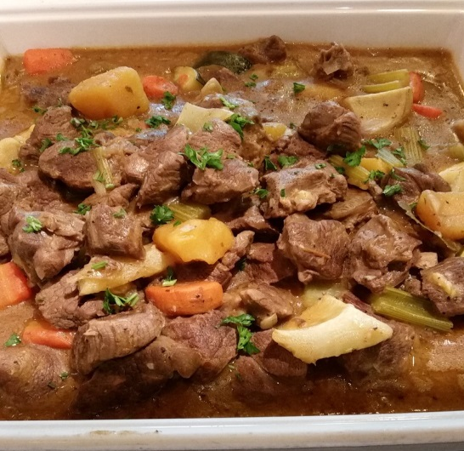
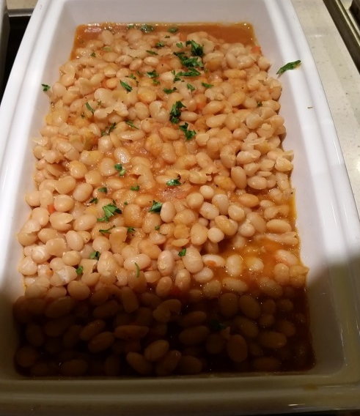
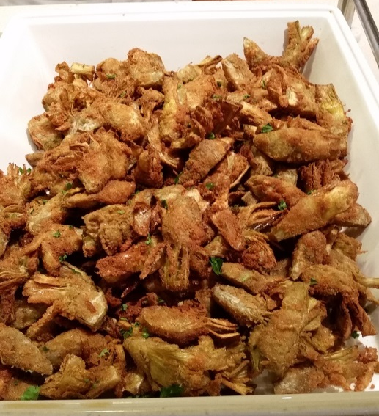
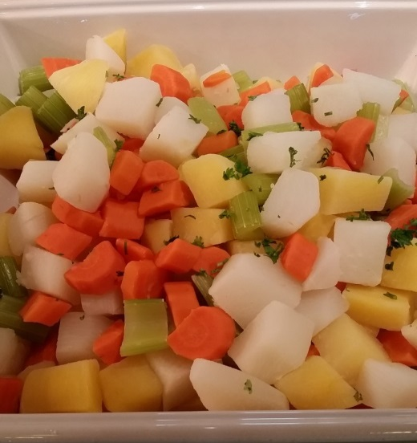
H8 & H9 Lamb Stew, Fennel Gratin, Braised White Beans and Steamed Root Vegetables

Slide 16
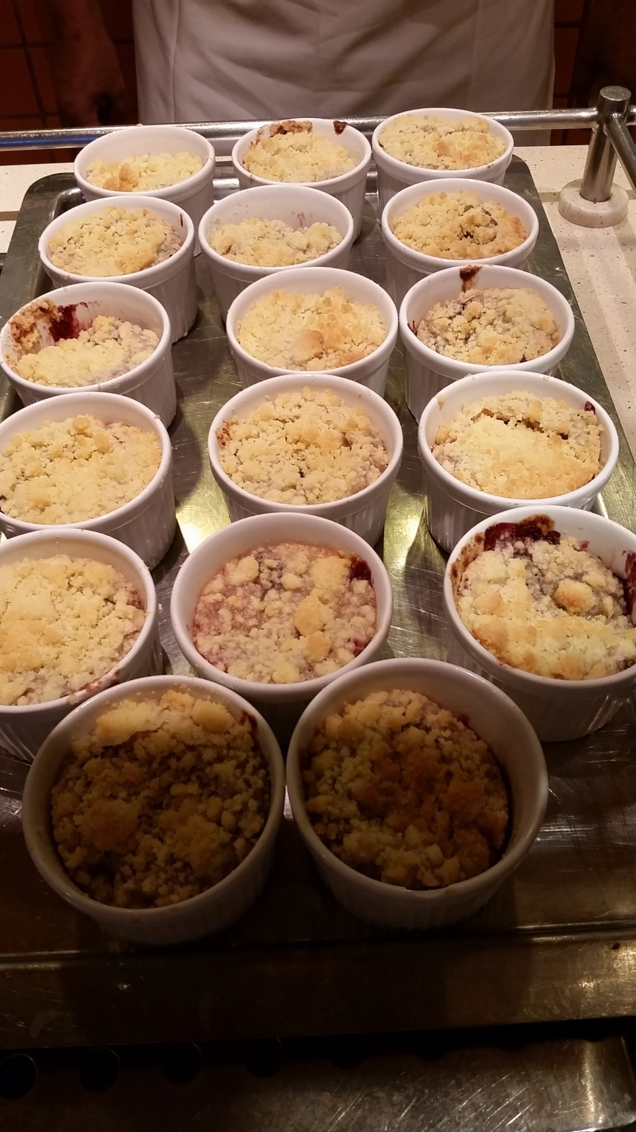
H 10 Hot Dessert

Slide 17
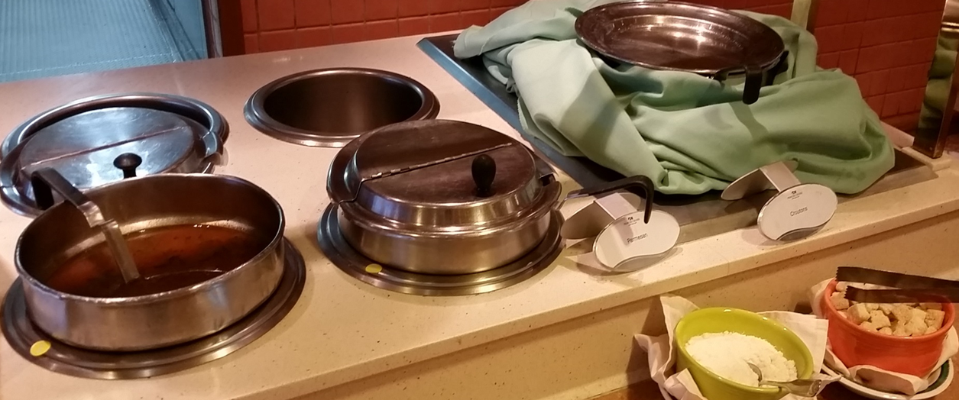
H11 Soup

