Slide 1
Main Dining Room Top 10 2.0 plus Italian Menu Item Descriptions

Slide 2
Princess Favorites:

Slide 3
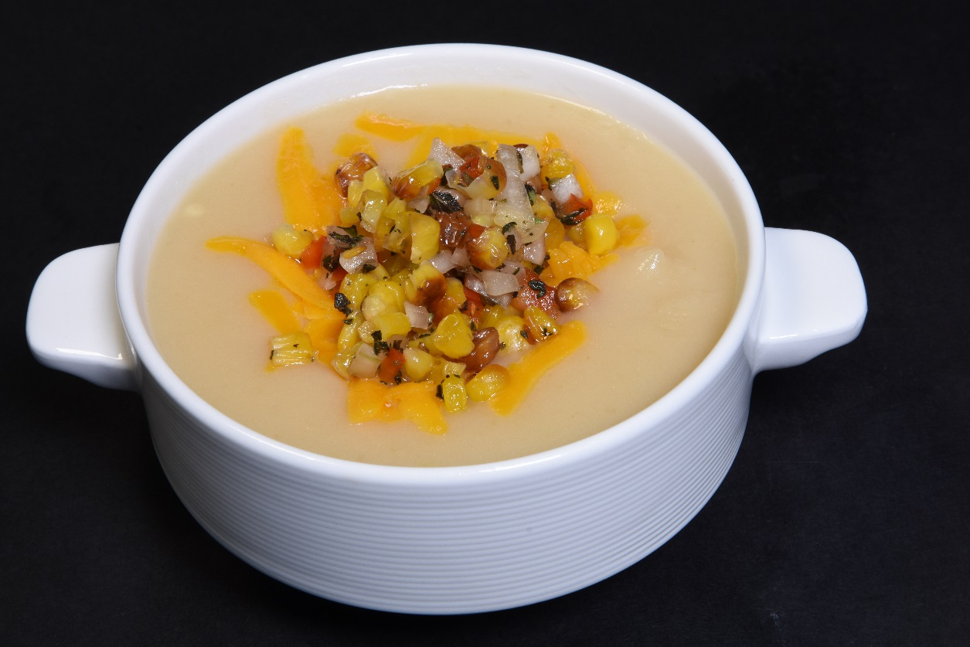


Baked Potato Soup (v) w/ Roasted Corn Relish & Aged Cheddar
Flavor Profile & Texture
Freshly Baked Potatoes
Aged Cheddar Cheese
Sweet Corn Relish
Menu Explanation
A hearty & rich soup with savory corn relish and aged cheddar cheese.
Available in small or large portion.
Allergens

Slide 4
Dinner 1

Slide 5


Seared Basa Filet, Pineapple-Mango Pilaf* w/ Vegetable Casserole, Basil-Infused Quinoa
Flavor Profile & Texture
Mild white fish topped with a tropical pineapple-mango
Fresh basil pesto quinoa
Sweet chili sauce
Island vegetables
Menu Explanation
Thai sweet chili sauce is made from fresh red chilies blended with garlic for a taste that adds sweet flavor not just spice.
Terminology
Casserole - a kind of stew or side dish that is cooked slowly in an oven
Allergens
Dinner 1
Notes:
Seared Basa Filet, Pineapple-Mango Salsa
island vegetable casserole, basil-infused quinoa pilaf
Recipe Number - 20-RCP27268

Slide 6
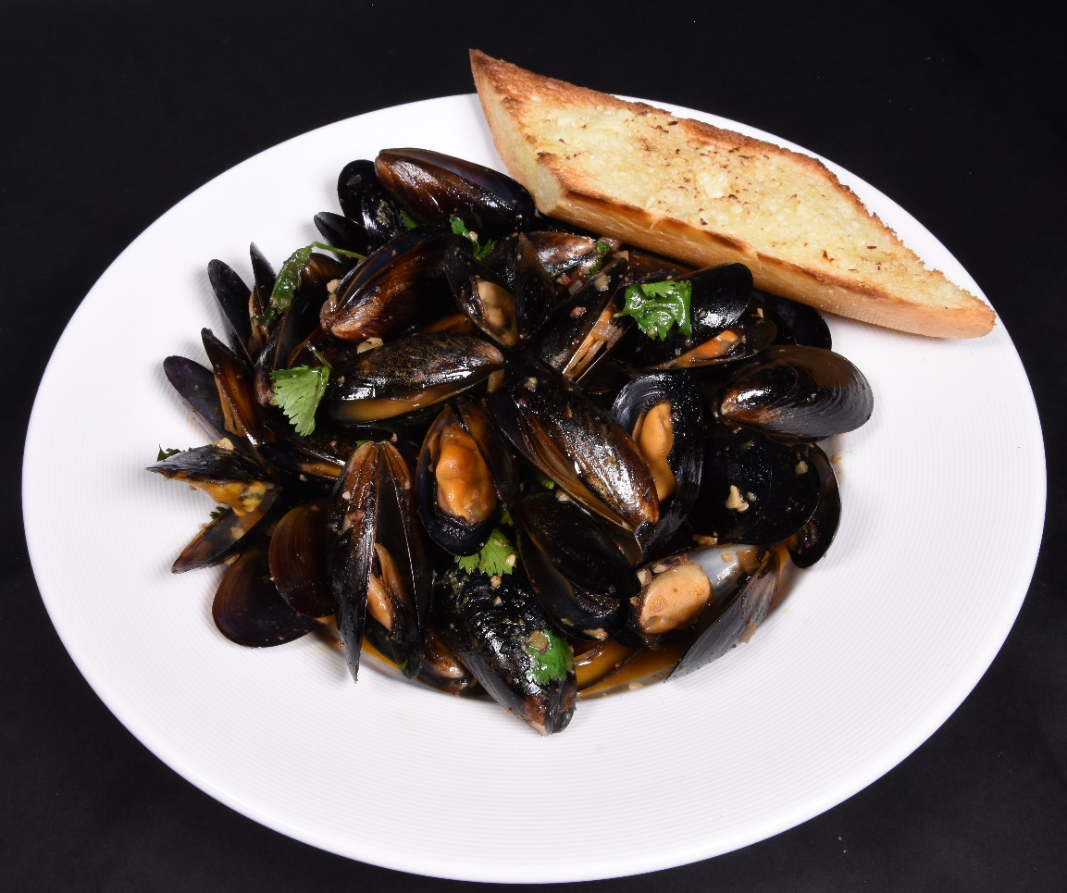



Steamed Mussels with Chorizo and White Wine Toasted Baguette, Cilantro, Steak Fries
By Curtis Stone
Flavor Profile & Texture
Black mussels
Spicy Mexican sausage seasoned broth with smoked paprika, shallots, butter and white wine
Toasted baguette slices
Cilantro garnish
Menu Explanation
A flavorful mussel appetizer by Curtis Stone crafted full of flavor.
Allergens
Dinner 1
Notes:
CS Appetizer - Steamed Mussels with Chorizo and White Wine
Recipe Number - 20-RCP27905

Slide 7
Captain’s Welcome

Slide 8
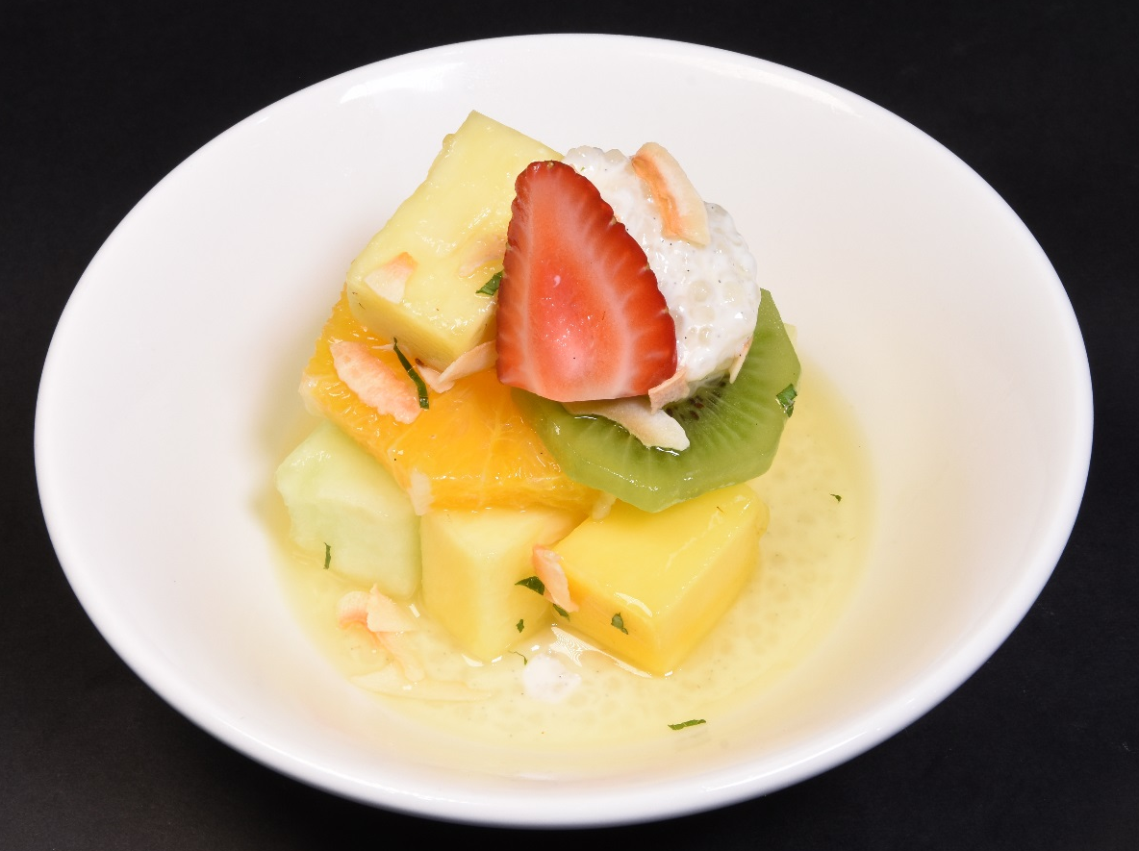
White Rum Tapioca Fruit Salad Orange, pineapple, mango, melon, strawberry, toasted coconut
Flavor Profile & Texture
Fresh Mango, Pineapple, Orange, Kiwi, Passion Fruit, Orange, melon, Pineapple and Lime juices.
Topped with a creamy vanilla-cinnamon tapioca
Garnished with white rum, fresh mint toasted coconut and sliced strawberries.
Menu Explanation
A fresh tropical twist of a classic ambrosia salad
Terminology
Tapioca - a starch extracted from cassava root
Allergens
Captain’s Welcome
Notes:
Rum Tapioca Fruit Salad
orange, pineapple, mango, strawberry, toasted coconut
Recipe Number - 20-RCP27622

Slide 9
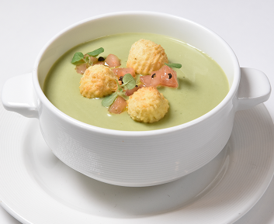

Chilled Sweet Pea Soup Fresh Tomato, Mini Cheese Bacon Biscuit
Flavor Profile & Texture
A creamy chilled soup of sweet peas, potatoes, leeks, onions, basil and mint.
Garnished with mini cheese bacon biscuits.
Menu Explanation
With a surprise layer of sweet pea hummus, every bite gets that fresh taste of sweet peas and
Allergens
Captain’s Welcome
Notes:
Chilled Sweet Pea, Potato Soup (v)
fresh tomato, mini cheese bacon biscuit
Recipe Number - 20-RCP27752

Slide 10
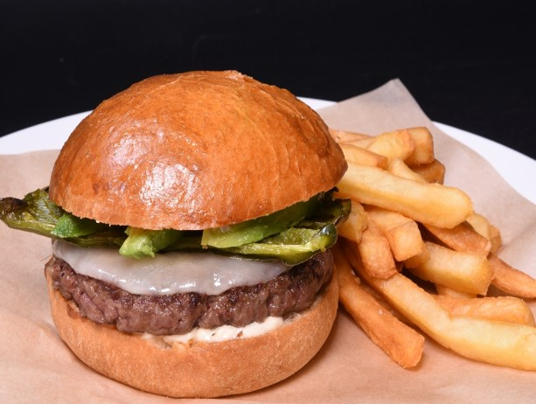
Cal-Mex Burger by Ernesto Uchimura avocado, provolone cheese, poblano chilies, jalapeño aioli, French fries
Flavor Profile & Texture
Ernesto’s burgers feature a blend of rib eye steak & beef short ribs
Freshly baked brioche buns
Topped with avocado slices, roasted green chilies, provolone cheese and a unique jalapeno aioli.
Served with French fries
Menu Explanation
Part of a unique collection of burgers made exclusively for Princess, this burger captures the flavors of California with its avocado, chilies & unique aioli
.
Terminology
Aioli – A base sauce made of garlic and olive oil
Allergens
Captain’s Welcome
Notes:
Ernesto Burger – Avocado, Roasted Green Chiles, Provolone
house Cajun spice rub, beef gravy, grilled tomato, roasted potato medley
Recipe Number - 20-RCP27676

Slide 11
Dinner 3

Slide 12
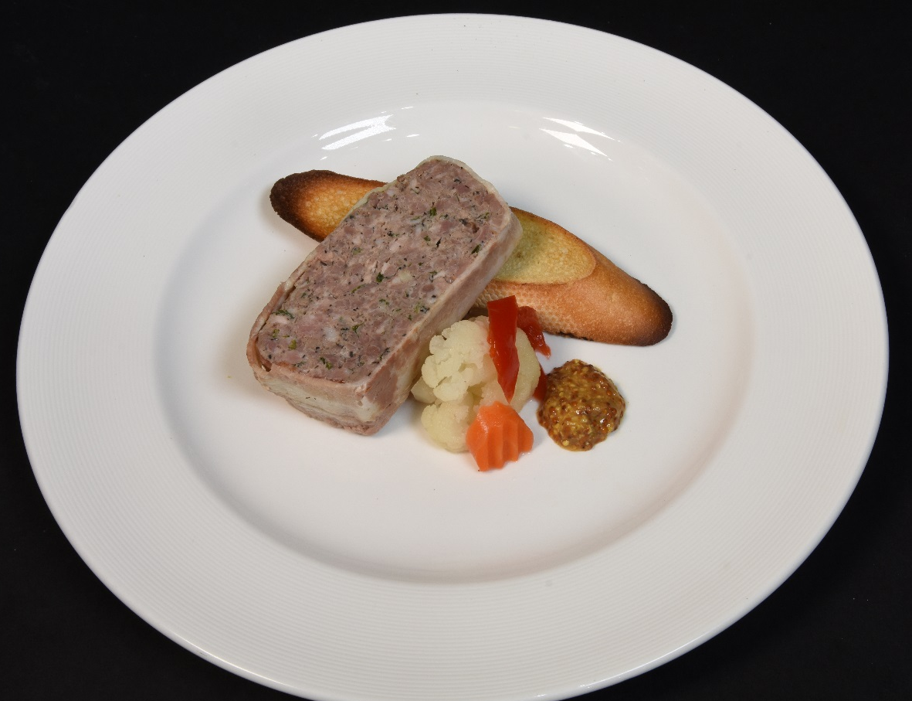
Bacon-Wrapped Pork Terrine pickled vegetables, whole grain mustard, baguette
Flavor Profile & Texture
Country style pate wrapped in bacon and seasoned with garlic, pepper, onion, parsley & brandy.
Toasted baguette slices
Whole grain mustard
Tart pickled crispy vegetables
Menu Explanation
This country style pork terrine is slow cooked and served chilled with lightly toasted baguette slices and whole grain mustard.
Terminology
Giardiniera - a mix of carrots, celery, cauliflower and colorful vegetables pickled at their height of flavor to preserve their garden freshness
Allergens
Dinner 3
Notes:
Bacon-Wrapped Pork Terrine
pickled vegetables, whole-grain mustard, toasted baguette
Recipe Number - 20-RCP27392

Slide 13
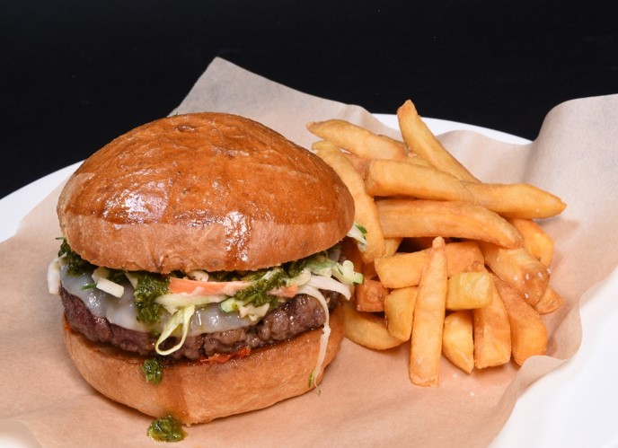
Chimichurri Burger by Ernesto Uchimura sun-dried tomato, provolone cheese, shredded zucchini slaw, French fries
Flavor Profile & Texture
Ernesto burgers feature a combination of rib eye steak and beef short ribs
Freshly baked brioche buns
Zucchini coleslaw
Smoky provolone cheese
Chimichurri sauce
Menu Explanation
Part of a unique collection of burgers made exclusively for Princess, this burger combines a juicy patty with sweet, spicy and tangy toppings giving every bite a new flavor sensation.
Terminology
Chimichurri – a sauce typically containing parsley, garlic, vinegar, olive oil, and flakes of chili pepper
Allergens
Dinner 3
Notes:
Ernesto Chimichurri Burger
sundried tomato, provolone cheese, shredded zucchini slaw, French fries
Recipe Number - 20-RCP27681

Slide 14
Chef’s Dinner

Slide 15
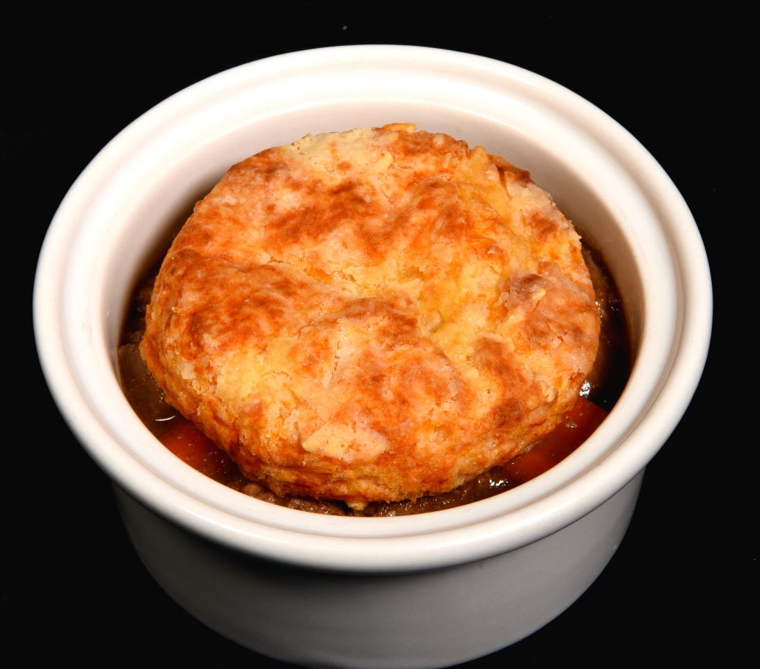
Beef Tenderloin Tips and Mushroom Cobbler carrots, Gruyere biscuits
By Curtis Stone
Flavor Profile & Texture
Tender beef chunks in a stew of carrots, onions and mushrooms seasoned with garlic, dijon mustard, red wine & fresh thyme.
Flakey-cheesy biscuit topping.
Menu Explanation
A Curtis Stone crafted comfort entrée full of rich flavors, tender beef, carrots and mushrooms with a cheesy biscuit topping.
Terminology
Cobbler – a fruit or savory filling poured into a baking dish and covered with a batter, biscuit, or dumpling & baked
Gruyere - a firm, tangy cheese
Allergens
Chef’s Dinner
Notes:
CS Tender Sirloin Steak & Mushroom Cobbler
carrots, Gruyere biscuits
Recipe Number - 20-RCP28030

Slide 16
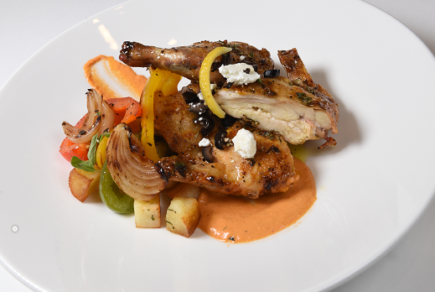
Lemon-Rosemary Cornish Game Hen Olive-Feta Relish Crispy Roasted Potato and Peppers
Flavor Profile & Texture
Citrusy Mediterranean spiced game hens seasoned with lemon and rosemary
Black olive-feta relish
Roasted peppers and potatoes
Creamy Romesco pepper sauce
Menu Explanation
Cornish game with salty olive-feta relish and creamy pepper sauce.
Allergens
Chef’s Dinner
Notes:
Lemon-Rosemary Grilled Cornish Game Hen, Olive-Feta Relish
roasted potato and peppers
Recipe Number - 20-RCP25580

Slide 17
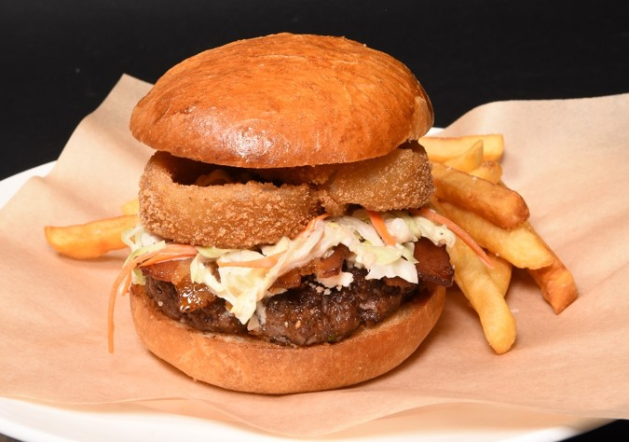
Backyard Burger by Ernesto Uchimura BBQ glaze, smoked bacon, cotija cheese, onion rings, French fries
Flavor Profile & Texture
Ernesto’s burgers feature a combination of rib eye steak & beef short ribs
Freshly baked brioche buns
Smoky BBQ glaze and smoked bacon
Cotija Mexican cheese
Topped with crisp onion rings
Served with French fries
Menu Explanation
Part of a unique collection of burgers made exclusively for Princess, this backyard burger combines the juiciest patties, sweet BBQ sauce, crisp bacon, creamy coleslaw and is topped with crisp onion rings.
Terminology
Cotija Cheese - a hard cow's milk cheese that originated in Mexico. It is named after the town of Cotija.
Allergens
Chef’s
Notes:
Ernesto Backyard Burger
BBQ glaze, smoked bacon, cotija cheese, onion rings & fries
Recipe Number - 20-RCP27677

Slide 18
Captain’s Gala

Slide 19
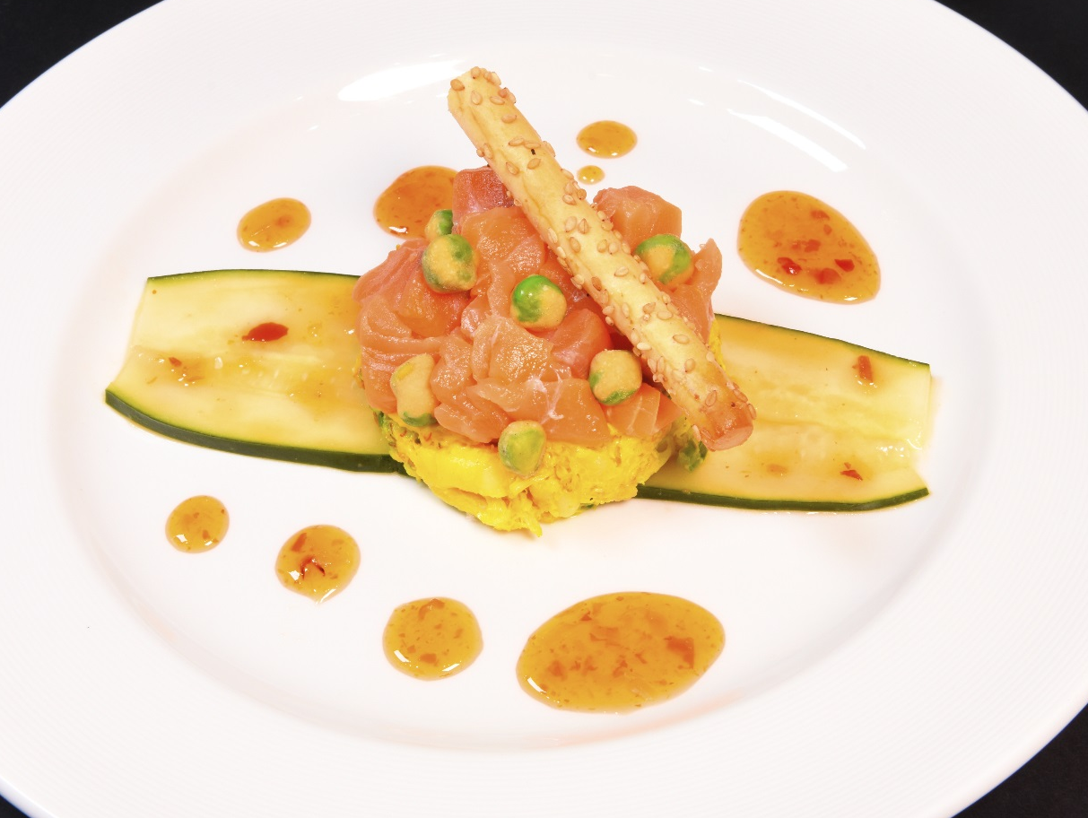
Lime and Salt-Cured Salmon, Citrus Chili Sauce crab, shrimp, dill-cucumber salad, crunchy peas
Flavor Profile & Texture
Lime and salt cured salmon, crab and shrimp.
Lemon juice marinade seasoned with turmeric
Sweet Thai chili sauce
Spicy-crunchy wasabi peas
Crispy crostini
Menu Explanation
A mix of flavorful seafood with spicy wasabi peas and sweet chili sauce
Allergens
Captain’s Gala
Notes:
Lime & Salt-Cured Salmon, Citrus Chili Sauce
crab and shrimp dill-cucumber salad, crunchy peas
Recipe Number - 20-RCP25602

Slide 20
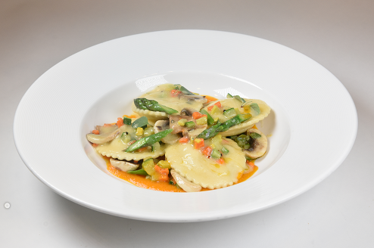
Lemon Scented Ravioli, Truffle Oil mascarpone, sage-vegetable ragout, carrot emulsion
Flavor Profile & Texture
Delicate raviolis filled with lemon and mascarpone cheese
Sautéed squash, carrots, asparagus, mushrooms & sage.
Creamy carrot emulsion
Truffle oil
Menu Explanation
Small pasta envelopes are filled with a buttery lemon and mascarpone cheese.
Terminology
Ragout - a highly seasoned dish of meat or vegetables cut into small pieces and stewed
Emulsion - oil and water are shaken together, tiny droplets of one liquid spread through the other liquid forming a mixture
Terminology
Captain’s Gala
Notes:
Lemon Scented Ravioli, Truffle Oil mascarpone, sage vegetable ragout, carrot emulsion
Recipe Number - 20-RCP27666

Slide 21
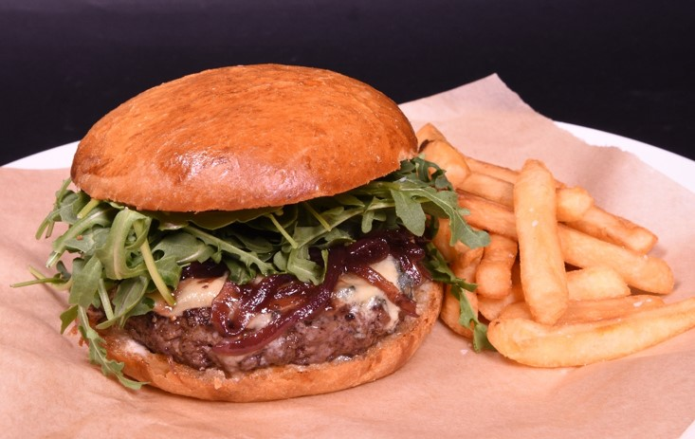
Blue Burger by Ernesto Uchimura blue cheese, port wine onions, arugula, aioli, French fries
Flavor Profile & Texture
Ernesto’s burgers feature a unique combination of rib eye steak and beef short ribs
Freshly baked brioche buns
Blue cheese
Fresh arugula and mayonnaise
Menu Explanation
Part of a unique collection of burgers made exclusively for Princess. Our blue cheese burger combines the juiciest of beef patties with blue cheese, peppery fresh arugula and wine infused onions.
Terminology
Aioli - a Mediterranean sauce made of garlic and olive oil
Allergens
Captain’s Gala
Notes:
Ernesto Burger – Blue Cheese, Port Wine Onions, Arugula Aioli
blue cheese, port wine onions, arugula, aioli
Recipe Number - 20-RCP27678

Slide 22
Dinner 2

Slide 23
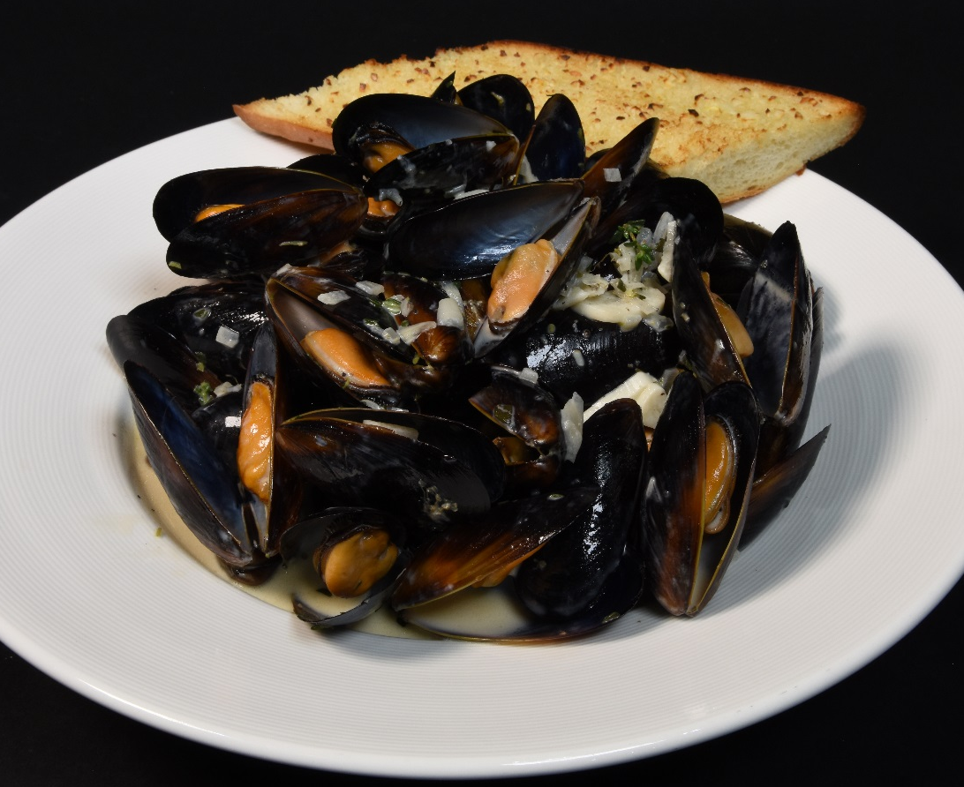
Mariner-Style Black Mussels, in White Wine Cream Sauce home-style garlic bread, French fries
Flavor Profile & Texture
Chilean black mussels cooked in garlic, shallots and white wine with a delicate hint of fresh herbs and licorice (Pernod).
Served with French fries and a rich wine cream sauce.
Menu Explanation
Considered the national dish of Belgium, its French name is Moules et Frites.
Allergens
Dinner 2
Notes:
Mariner-Style Black Mussels, White Wine Cream Sauce
home-style garlic bread, French fries
Recipe Number - 20-RCP20596

Slide 24
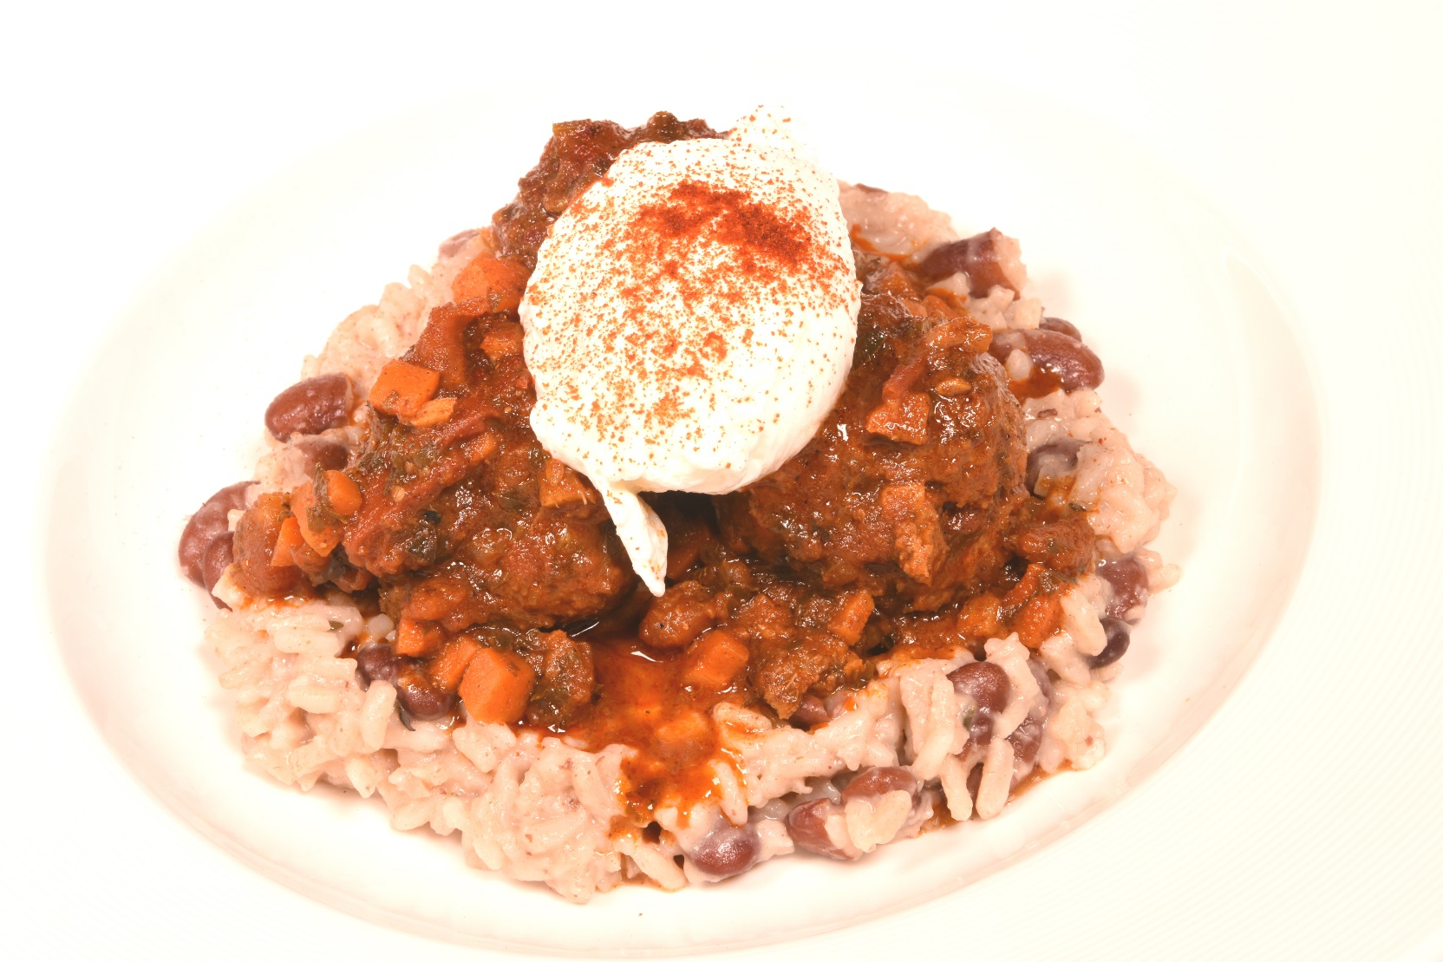
Moroccan-style Meatballs soft-poached egg, tomato ragout, rice & beans
Flavor Profile & Texture
Rich Moroccan-spiced beef meatballs accompanied by a sweet paprika rice and beans.
The dish can be topped by a freshly poached egg.
Menu Explanation
Flavors of Moroccan cuisine include mint, peppermint, parsley, coriander, marjoram, caraway and sage.
Terminology
Ragout - a highly seasoned dish of meat cut into small pieces and stewed with vegetables
Allergens
Dinner 2
Notes:
Moroccan-style Meatballs
soft poached egg, tomato pepper ragout, rice & peas
Recipe Number - 20-RCP27578

Slide 25
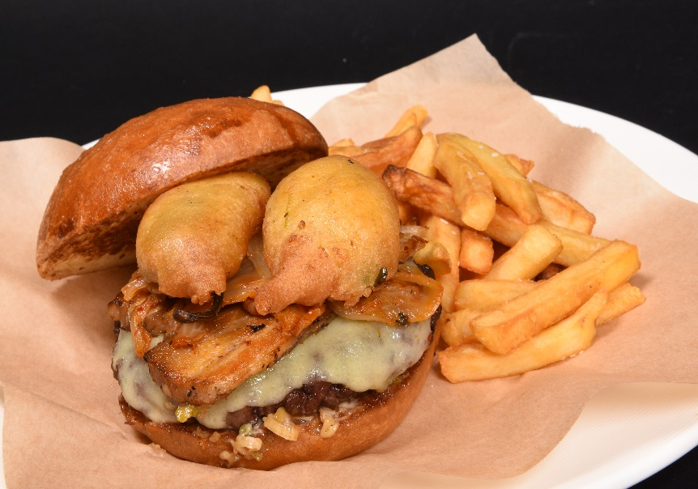
Ernesto Burger by Ernesto Uchimura gruyere cheese, pork belly, Kimchi, beer battered jalapenos, charred oinion aioli, French fries
Flavor Profile & Texture
Ernesto’s burgers feature a unique combination of rib eye steak and beef short ribs
Freshly baked brioche buns
Menu Explanation
Part of a unique collection of burgers made exclusively for Princess.
Terminology
Aioli - a Mediterranean sauce made of garlic and olive oil
Allergens
Dinner 2
Notes:
Ernesto Burger – Blue Cheese, Port Wine Onions, Arugula Aioli
blue cheese, port wine onions, arugula, aioli
Recipe Number - 20-RCP27678

Slide 26
Italian Dinner

Slide 27
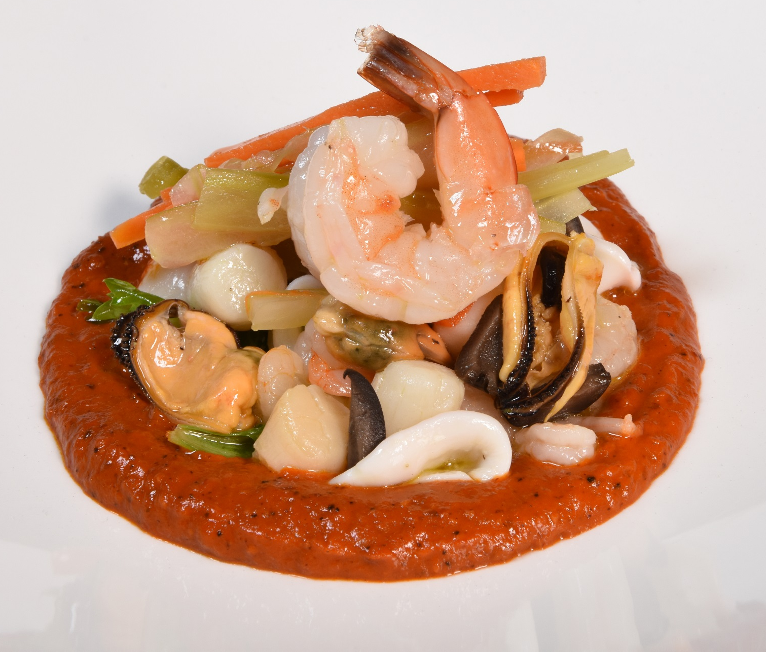
Seafood Antipasto* shrimp, squid, black mussels, white balsamic pickled vegetables, olive-red pepper spread, Kalamata olives
Flavor Profile & Texture
Shrimp, mussels, squid,
Balsamic picked vegetables.
Olive-red pepper sauce
Garnished with black olives and parsley
Menu Explanation
Chilled seafood marinated in fresh lemon juice, olive oil and herbs, with a rich sauce perfect for dipping.
Terminology
Antipasto - an appetizer typically consisting of olives, anchovies, cheeses, and meats
Allergens
Italian Dinner
Notes:
Seafood Antipasto*
shrimp, squid, black mussels, white balsamic pickled vegetables, olive-red pepper spread
Recipe Number - 20-RCP25323

Slide 28
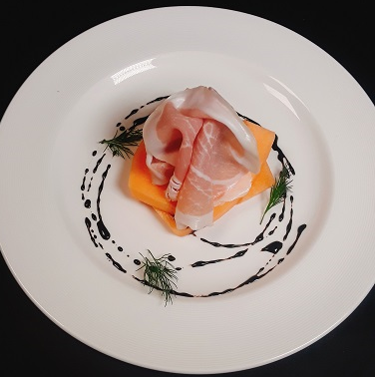
Prosciutto Crudo con Melone dry-cured ham, sweet cantaloupe melon
Flavor Profile & Texture
Thinly sliced cured Italian ham
Sweet cantaloupe melon
Toasted baguette slices
Garnished with fresh chervil
Menu Explanation
A contrast between the saltiness of the prosciutto and the sweetness of the fruit.
Allergens
N/A
Italian Dinner
Notes:
Prosciutto and Melon
dry-cured ham, chunked cantaloupe
Recipe Number - 20-RCP22424

Slide 29
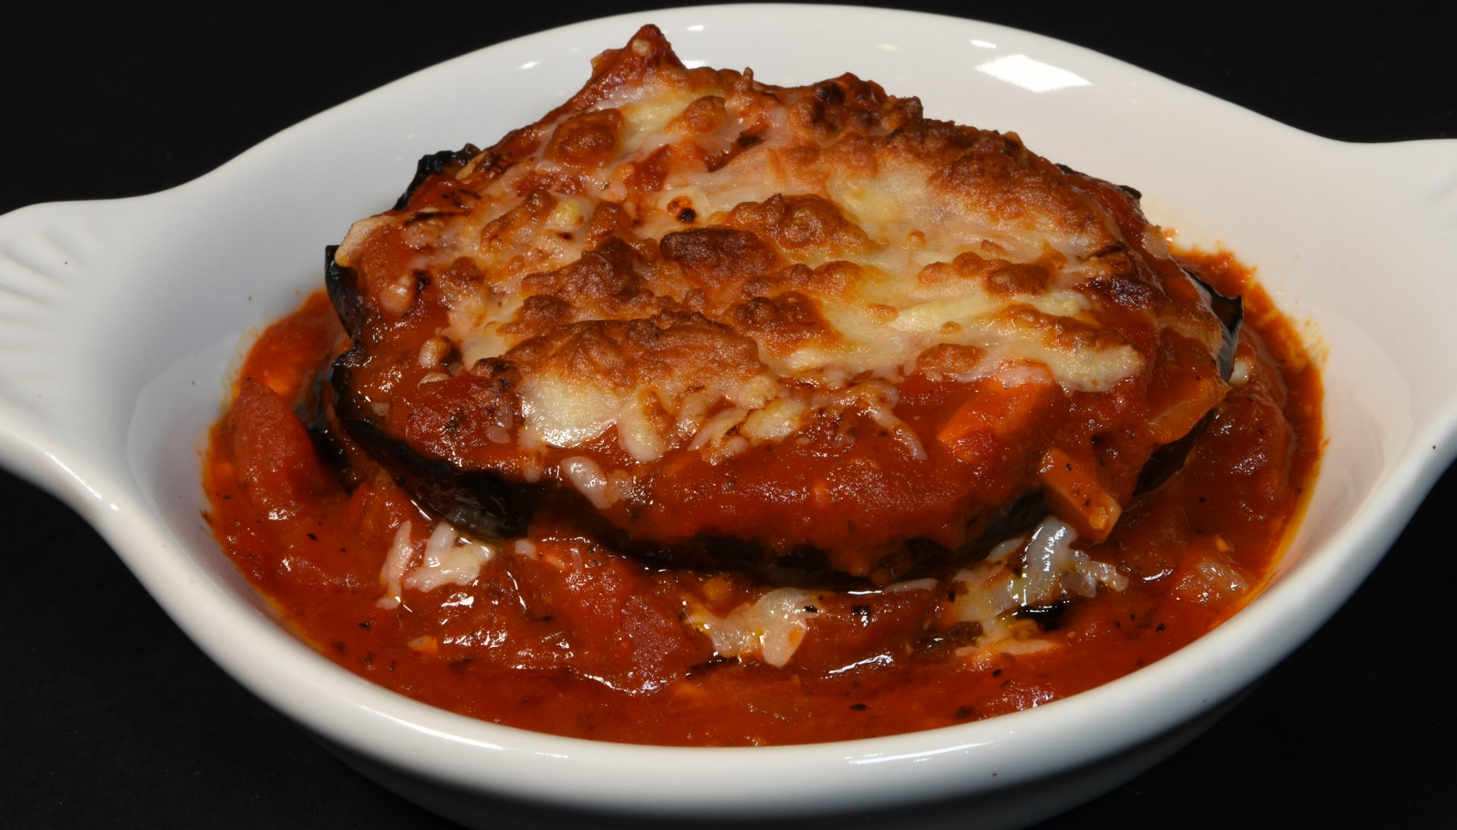
(V) Melanzane alla Parmigiana eggplant, tomato sauce, mozzarella cheese gratin, basil leaves
Flavor Profile & Texture
Thinly sliced and fried eggplant
Layered with creamy mozzarella cheese and rich tomato sauce
Topped with fresh basil and parmesan cheese.
Menu Explanation
Fresh tomato, eggplant layered with cheese and topped with fried basil.
Allergens
Italian Dinner
Notes:
Eggplant Parmesan
tomato sauce, mozzarella cheese
Recipe Number - 20-RCP20287

Slide 30
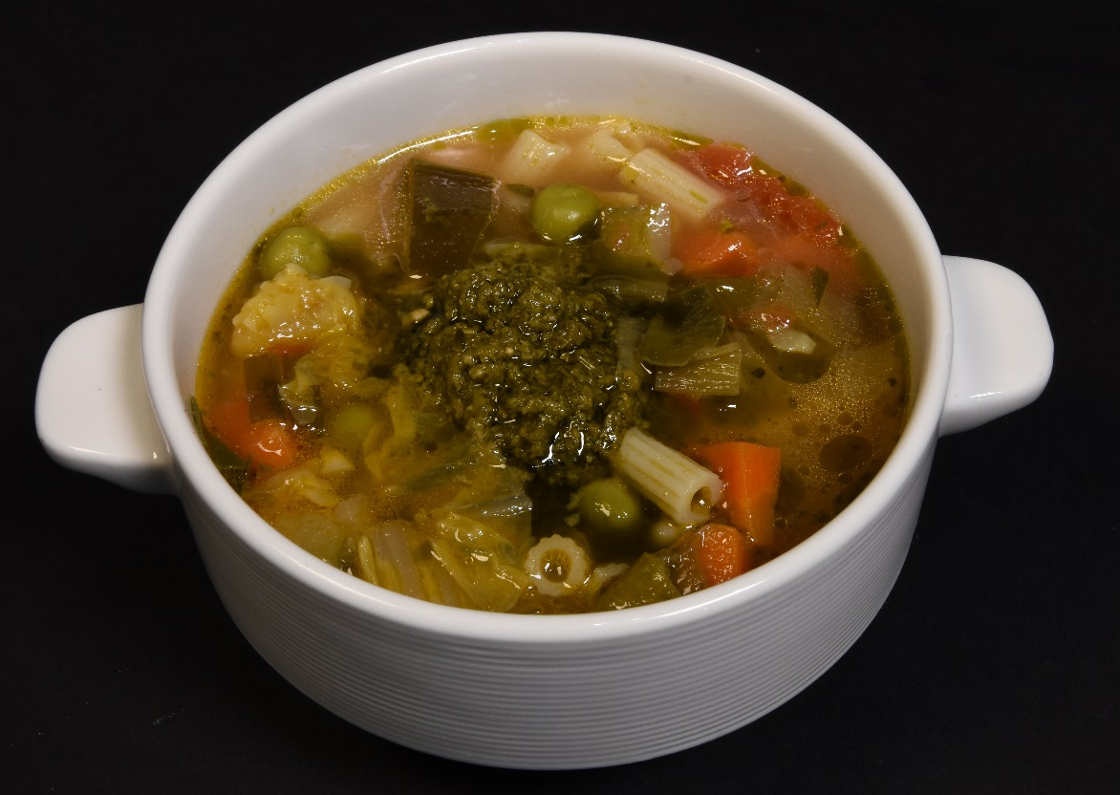
(V) Minestrone Soup vegetables, ditalini pasta, basil pesto
Flavor Profile & Texture
Rich tomato based soup with fresh vegetables, pasta and topped with a basil pesto topping.
Menu Explanation
A famous Italian soup made with fresh root vegetables, Swiss chard and leeks slow cooked in a fresh tomato base.
Terminology
Ditalini - a type of pasta that is shaped like small tubes
Allergens
Italian Dinner
Notes:
Minestrone Soup
vegetables, pasta, basil pesto
Recipe Number - 20-RCP19879

Slide 31
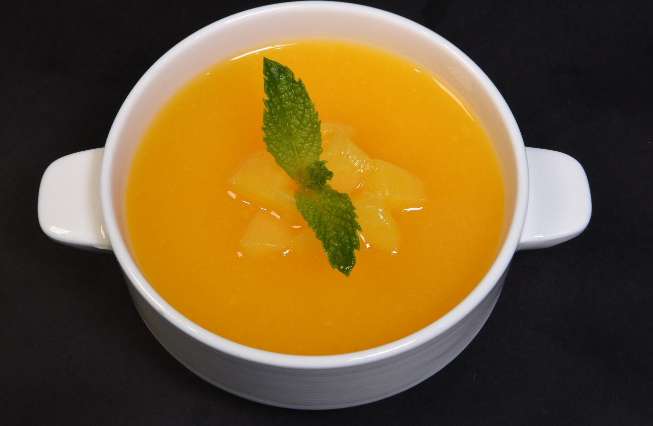
(V) Iced Peach Bellini Soup peach purée and sparkling prosecco
Flavor Profile & Texture
Sweet peaches, and a splash of sparking wine, peach schnapps with a hint of fresh lemon.
Garnished with fresh mint and diced peaches.
Menu Explanation
A sweet and refreshing soup between courses.
Terminology
Prosecco – A sparkling Italian wine made from the Glera Grape
Allergens
N/A
Italian Dinner
Notes:
Iced Peach Bellini Soup
peach purée, sparkling Prosecco
Recipe Number - 20-RCP19887

Slide 32
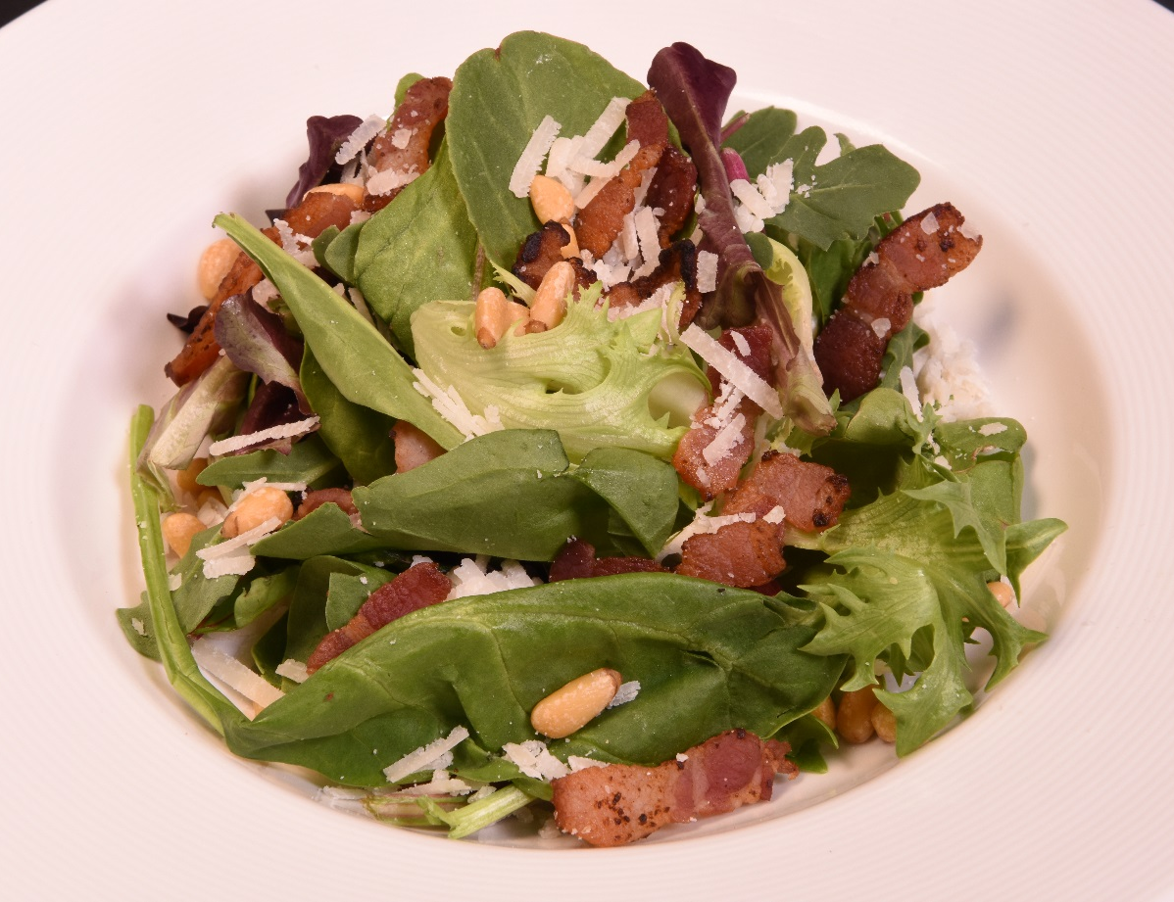
Mixed Greens, Baby Spinach, Crisp Bacon, Pecorino Cheese and Pine Nuts selection of homemade and low-fat dressings
Flavor Profile & Texture
Leafy mixed greens, fresh spinach, crisp bacon, pecorino cheese and toasted pine nuts.
Choice of dressing
Menu Explanation
This garden-fresh salad gets a kick from, crisp bacon bits and pecorino cheese combines the taste and flavor sensations of sweet, salty and nutty at the same time..
Allergens
Italian Dinner
Notes:
Mixed Greens, Baby Spinach, Crisp Bacon, Pecorino Cheese, Pine Nuts
choice of dressings
Recipe Number - 20-RCP20383

Slide 33
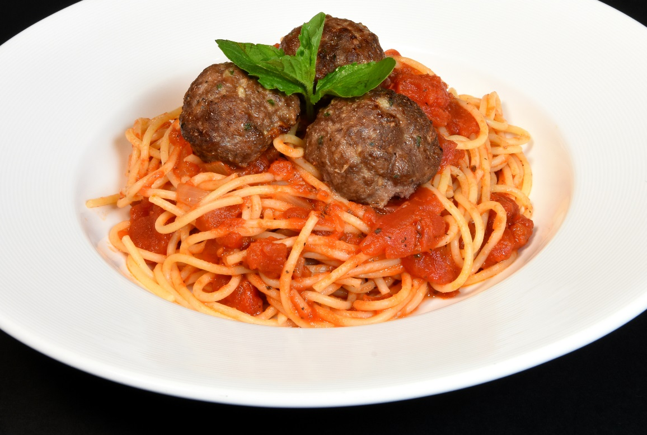
Spaghetti con Polpette in Salsa di Pomodoro Fresco spaghetti with meatballs, fresh tomato sauce
Flavor Profile & Texture
Beef meatballs made with fresh breadcrumbs and with a hint of onion and garlic.
Freshly made basil tomato sauce
Salty parmigiana cheese
Spaghetti noodles of durum wheat.
Menu Explanation
A generous portion of pasta tossed with rich tomato sauce served with house made beef meatballs.
Allergens
Italian Dinner
Notes:
Spaghetti and Meatballs
house made fresh tomato sauce
Recipe Number - 20-RCP19964

Slide 34
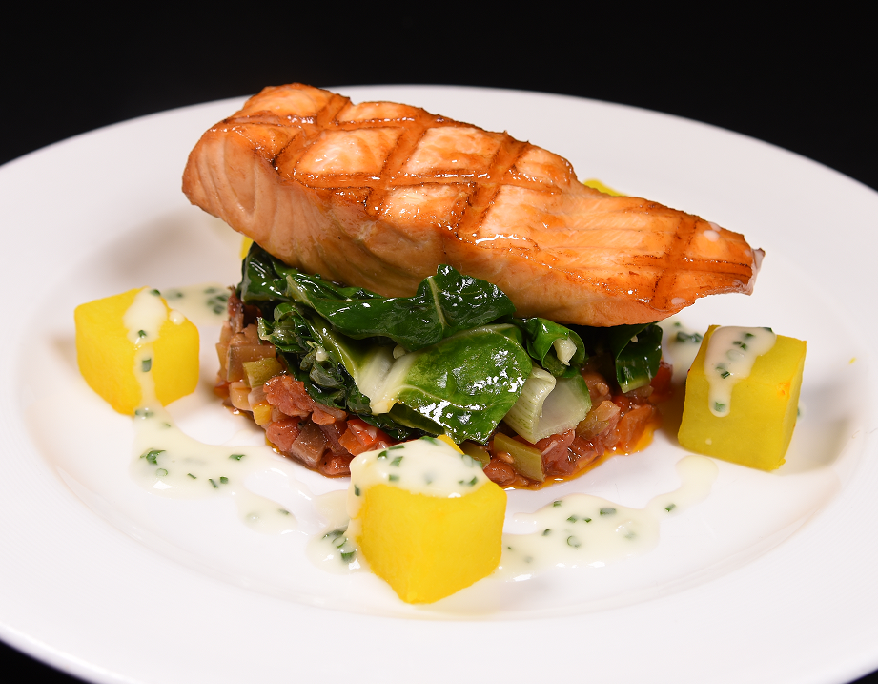
Grilled Salmon Fillet, Eggplant Caponata Swiss chard, saffron-infused potatoes
Flavor Profile & Texture
Tender grilled salmon filet
Swiss chard in butter & garlic
Saffron infused potatoes
Eggplant caponata
Lemon and herb butter
Rich buttery wine sauce
Menu Explanation
Grilled salmon topped with buttery lemon wine sauce.. Rustic eggplant and sweet Swiss chard vegetables
.
Terminology
Caponata - a dish of eggplant, olives, and onions seasoned with herbs, typically served as an appetizer
Allergens
Italian Dinner
Notes:
Filet of Grilled Salmon Caponata
Swiss chard, saffron-infused potatoes
Recipe Number - 20-RCP27709

Slide 35
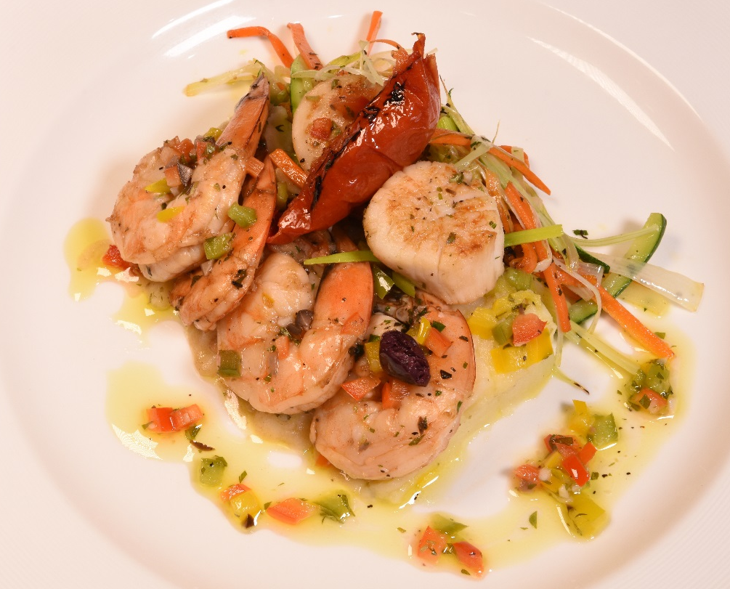
Capesante e Gamberi Grigliati, Marinata all'Aglio con Verdure Miste sautéed sea scallops and shrimp, garlic marinade, mixed vegetables, crushed potato
Flavor Profile & Texture
Scallops and shrimp with parsley, olive oil and marjoram.
Crisp carrots, zucchini and leeks
Mashed potatoes
Menu Explanation
Sautéed seafood flavored with fresh lemon, olive oil and herbs.
Terminology
Salmoriglio Sauce – made of lemon juice, olive oil, minced garlic, chopped oregano, bell peppers and parsley
Allergens
Italian Dinner
Notes:
Seared Sea Scallops and Shrimp, Garlic and Herbs
mixed vegetables, crushed potato
Recipe Number - 20-RCP27386

Slide 36
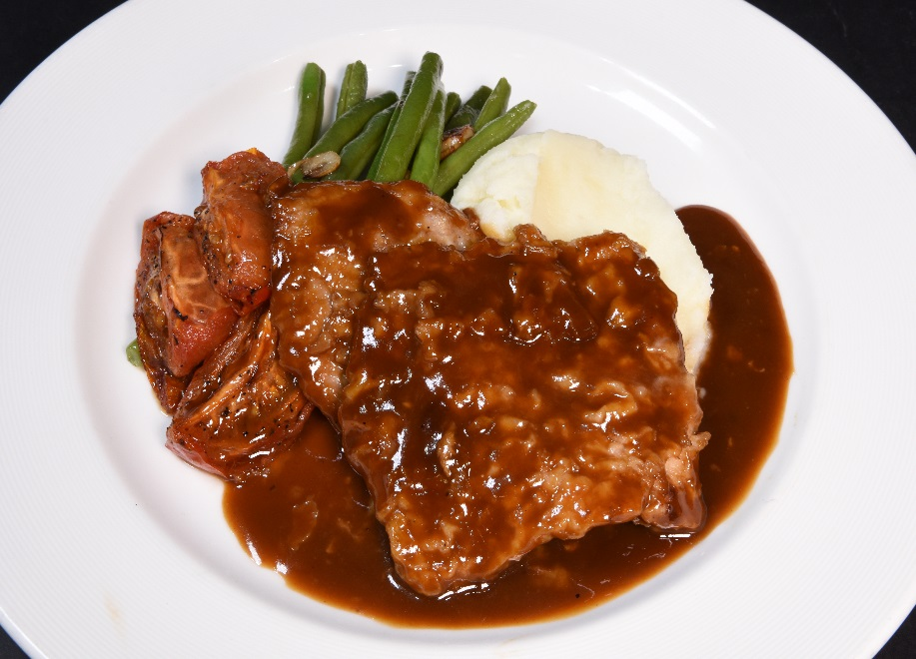
Scaloppine di Vitello al Marsala veal scallopini, marsala wine sauce, green beans, tomatoes, creamy mashed potatoes
Flavor Profile & Texture
Thinly sliced veal dredged in flour and cooked in butter.
Creamy mashed potatoes
Sautéed green beans and roasted tomatoes
Rich buttery and lightly smoky flavored Marsala wine sauce.
Menu Explanation
Tender pan-fried veal served with a buttery smoky Marsala wine sauce.
Terminology
Scaloppini - thin, boneless slices of meat, typically veal, sautéed or fried
Marsala – a sweet Italian red wine
Allergens
Italian Dinner
Notes:
Veal Scaloppini, Marsala Wine Sauce
green beans, cherry tomatoes, creamy mashed potatoes
Recipe Number - 20-RCP27350

Slide 37
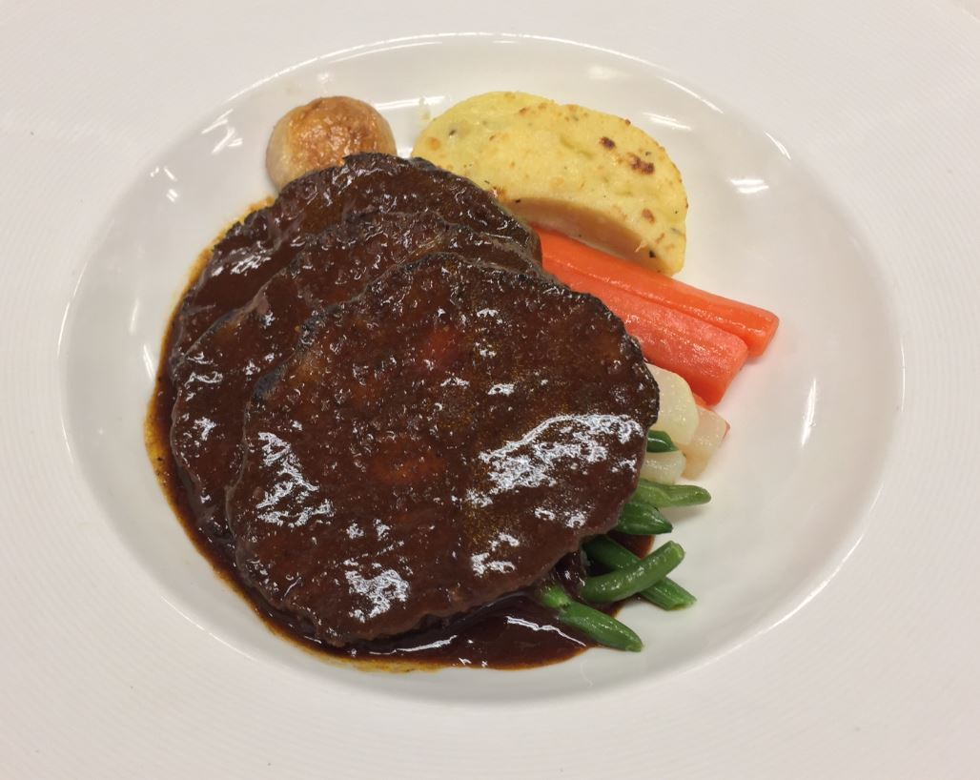
Brasato di Manzo al Barolo beef pot roast, barolo wine, Tuscan vegetables, grilled polenta cakes
Flavor Profile & Texture
Braised chuck roast
Porcini mushrooms
Red wine
Crisp vegetables of green beans, carrots, turnips, mushrooms
Grilled roasted garlic polenta cake
Menu Explanation
Traditional Italian pot roast cooked in a rich red wine sauce served with vegetables and roasted garlic polenta cakes
Terminology
Barolo is a red wine produced in the Piedmont region of Italy
Allergens
Italian Dinner
Notes:
Breaded Chicken Breast, Prosecco Radicchio Cream
stuffed with Fontina cheese, spinach, mushrooms, grilled asparagus, roasted potato cubes
Recipe Number - 20-RCP27490

Slide 38
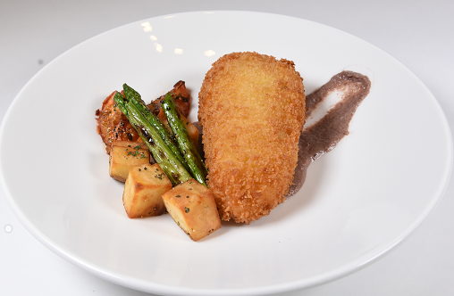
Petto di Pollo Ripieno con Crema di Radicchio breaded chicken breast stuffed with fontina cheese, spinach and mushrooms grilled asparagus, roasted potatoes, radicchio cream
Flavor Profile & Texture
Crispy breaded chicken breast stuffed with mushrooms, spinach, fontina and parmesan cheese and Marsala wine
Roasted potato cubes roasted with garlic, olive oil and parsley
Lightly grilled asparagus
Prosecco radicchio cream
Menu Explanation
Fried in a mixture of butter and olive oil with a moist cheese and spinach filling with a touch of Marsala wine.
The prosecco radicchio cream brings a chicory (coffee) flavor.
Terminology
Prosecco – A sparkling Italian wine made from the Glera Grape
Allergens
Italian Dinner
Notes:
Breaded Chicken Breast, Prosecco Radicchio Cream
stuffed with Fontina cheese, spinach, mushrooms, grilled asparagus, roasted potato cubes
Recipe Number - 20-RCP27490

Slide 39
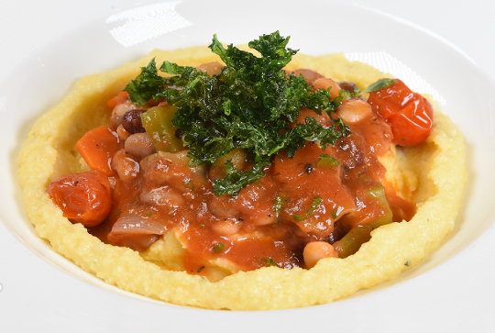
(V) Cannellini Bean & Vegetable Stew herb-scented polenta
Flavor Profile & Texture
Creamy herb polenta seasoned with fresh rosemary, thyme and tarragon is prepared with rich butter, parmesan cheese, vegetable stock and milk.
Cannellini bean stew and fresh vegetables
Garnished with crispy fried kale
Menu Explanation
Creamy corn-meal porridge from Northern Italy served with savory beans and vegetable stew.
Terminology
Polenta – a paste or dough made from cornmeal, which is boiled
Allergens
Italian Dinner
Notes:
Cannellini Bean & Vegetable Stew
herb scented polenta
Recipe Number - 20-RCP27642

