Slide 1
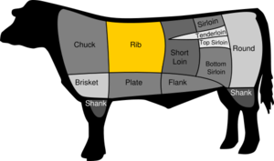
RIB EYE STEAK
Beef Cut: Rib
Also known as: Delmonico steak, scotch fillet, beauty steak, market steak, Spencer steak, Entrecôte (French)
The rib eye, or rib eye, also known as the Delmonico or scotch fillet (Australia) is a beef steak from the small end of the rib roast. When cut into steaks, the rib eye is one of the most popular, juiciest, (and expensive) steaks on the market. Meat from the rib section is tender and fattier (the meat is said to be "marbled") than other parts of the cow. This extra fat makes rib eye steaks and roasts especially tender and flavorful.

Slide 2
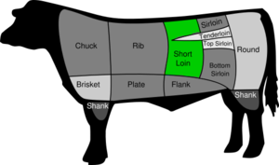
NEW YORK STRIP
Beef Cut: Short Loin
Also known as: New York strip steak, Kansas City strip steak, strip loin, shell steak, Delmonico, boneless loin, boneless club steak
The strip steak, Kansas City or New York strip steak, is one of the highest quality beef steaks on the market. In British Commonwealth countries, this is called "porterhouse steak". Cut off of the back of the cow from the strip loin, the strip steak consists of a muscle that does little work, and so it is particularly tender. Unlike the nearby filet mignon, the strip loin is a sizable muscle, allowing it to be cut into the larger portions favored by many steak eaters.
When still attached to the bone, and with a piece of the beef tenderloin also included, the strip steak becomes a T-bone steak.
Due to its proximity to the spinal column, the strip steak has been one of the steaks that attracts the most concern with regards to Bovine spongiform encephalopathy, more popularly known as mad cow disease [citation needed].

Slide 3

PORTERHOUSE STEAK
Beef Cut: Short Loin + Tenderloin
The T-bone is a steak cut of beef. It consists of a T-shaped bone with meat on each side. The larger side contains meat from the strip loin, whereas the smaller side contains the tenderloin. T-bone steaks from the rear end of the tenderloin contain a much larger section of the tenderloin, and are called porterhouse steaks. (NB, in British Commonwealth countries, only the strip loin side is called the porterhouse, and the tenderloin side is called the filet. Thus a "porterhouse steak" order results in a boneless steak that is the equivalent of strip steak.)
There is little agreement among experts on how large the tenderloin must be to call a T-bone a porterhouse; some steaks with a large tenderloin may be called a mere T-bone in some restaurants and steakhouses. However, there is general agreement the tenderloin can be no thinner than the diameter of a US quarter dollar coin (24.26 mm) to be classified as a porterhouse.
Due to their large size and the fact that they contain meat from two of the most prized cuts of steak, T-bone steaks are generally considered one of the highest quality steaks, and prices at steakhouses are accordingly high. Porterhouse steaks are even more highly valued due to their large tenderloin.
In the United States, the T-bone has the meat-cutting classification NAMP 1174; the porterhouse is NAMP 1173.
Because bone conducts heat, and because of the differences in the two cuts of meat, different parts of the steak will reach the desired cooked temperature at different times. The meat near the bone will cook more slowly than the rest of the steak, and the tenderloin will tend to reach the desired level of doneness before the strip.

Slide 4
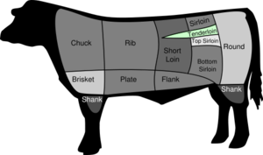
FILET MIGNON
Beef Cut: Tenderloin
The same cut of beef can also be called:
French: chateaubriand, tournedos, filet de bœuf
English: Medallions, Tenderloin Steak
The tenderloin runs along either side of the spine, and is usually harvested as two long snake-like shaped cuts of beef. The tenderloin is sometimes sold whole. If the short end of the tenderloin is cut into portions before cooking, that portion is known as Filet Mignon, or the filet, from the French boneless meat (mignon meaning "small" as true mignons are cut from the smaller tail end of the tenderloin).
The filet is considered to be the tenderest cut of beef, and one of the most expensive. The average cow provides no more than 4-6 pounds of filet per animal. Because the muscle is non-weight bearing, it receives very little exercise, which makes it tender.
The filet can be cut into 1-2 inch thick portions, then grilled and served as-is, with minimum seasoning. Most chefs expect this cut to be cooked no more than medium rare.

